Slide 1
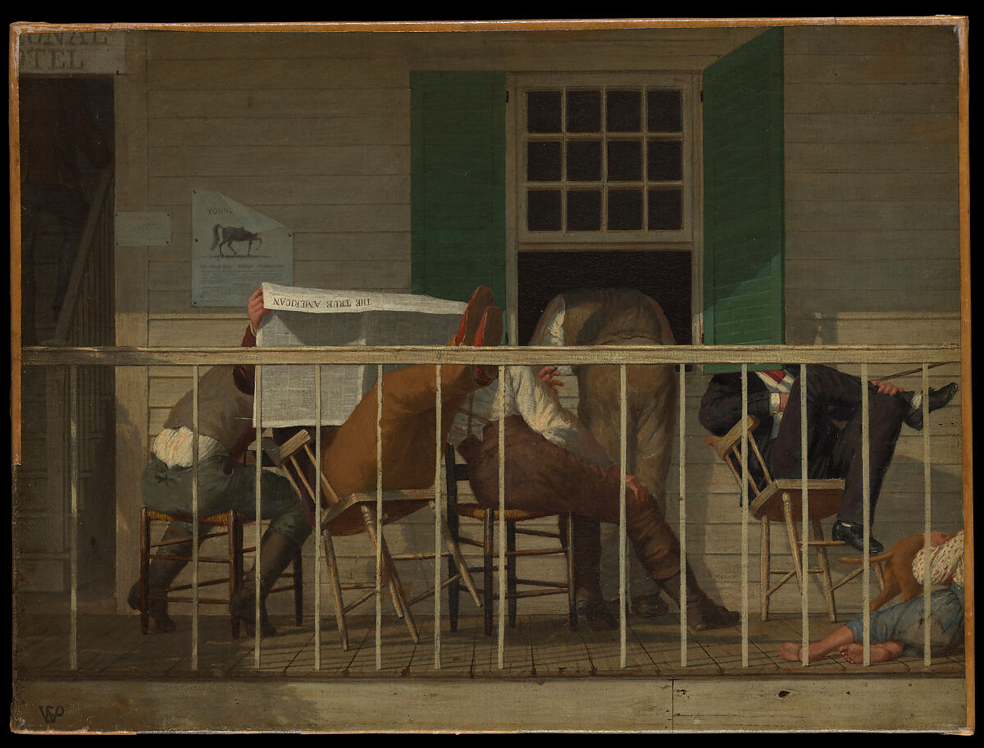
Unity in Christ
Philippians 1.1-30:
To Live Is Christ

Slide 2
Philippians 1.1-2 – The Greeting
What is a saint? All those who are called by God and are sanctified by His Spirit. Modern culture associates saints with perfection: striving after God qualifies you as a saint.
True grace and peace can only be found in Christ. “Pax Romana” lasted 200 years. The peace of Christ lasts for eternity.

Slide 3
Philippians 1.3-11 – Giving Thanks
Paul’s thankfulness, humility, and love exude from this first section. Are we this way towards our church?
We should have confidence that since God began the good work in us, He will be the one to finish it.
We need to strive for growth in love, knowledge, and discernment for the glory of God.

Slide 4
Philippians 1.12-18a – Paul’s Imprisonment
Paul could’ve viewed his imprisonment as a burden. Instead, he stood in the strength of the good news. This had two effects: 1. The Roman Guard knew about the gospel and 2. Other Christians were strengthened.
Our intentions should be to honor Christ in truth in love. Even if others are selfish teach from evil motives, if Christ is glorified, we can rejoice with Paul.

Slide 5
Philippians 1.18b-26 – “To Live is Christ, To Die is Gain”
Paul talks through his mindset should help us understand where our desire should be as well.
To fall asleep and be with the Lord is “far better”. Confidence in going home to be with Christ gives us courage.
But if Christ gives us more time on this earth, it should be in the service of others to help them grow.

Slide 6
Philippians 1.27-30 – Suffering for the Sake of Christ
Our aim should be unity: one spirit, one mind, striving side by side for the faith, and going about it courageously.
We are going to be different in many ways – but our goals need to be aligned in Christ.
Suffering for Christ is our reality. But just as He suffered, and Christians for thousands of years have suffered, our suffering will show how glorious and worthy He truly is.

Slide 7
For Meditation
Service: We should desire growth in our group. Who is one person we could serve to encourage their growth?
Joy: Christ has brought us unity. How can we do more to display the joy that unity brings us? (Examples: Singing and Gratitude)
Peace: We are called to a high standard in Christ. But we should take confidence knowing, “…that he who began a good work in you will bring it to completion at the day of Jesus Christ.”

