Slide 1
The Bible: Divine Revelation
April 21, 2024
Northwood
Speaker: Allen Dvorak

Slide 3
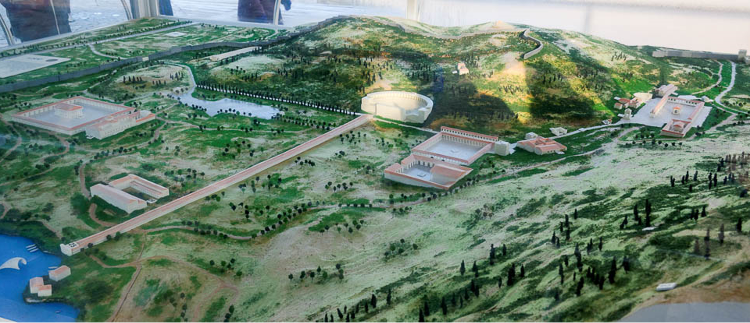
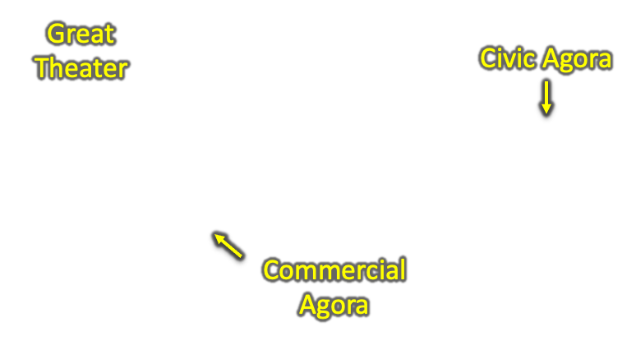
3
2
1

Slide 4
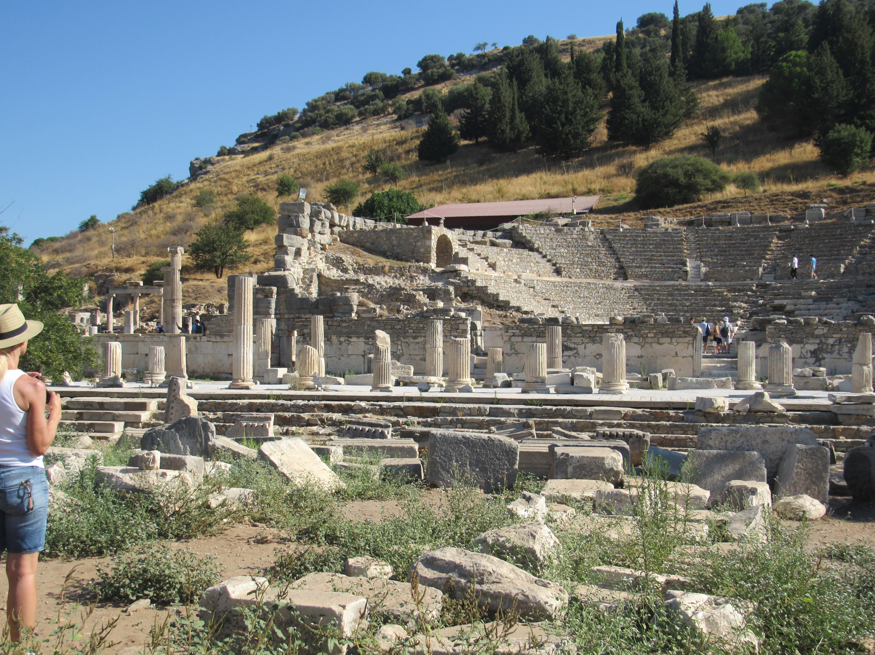
Odeon - the small theater

Slide 5
3
2
1

Slide 7
3
2
1

Slide 8
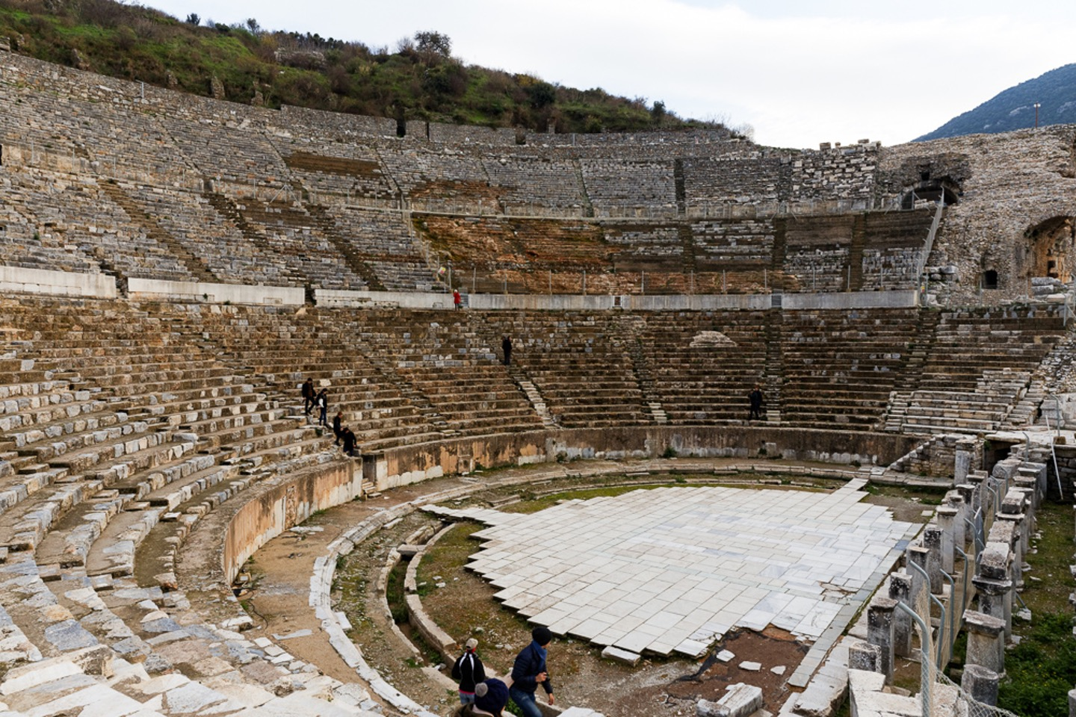
The Great Theater

Slide 9
Acts 19:28–31 (ESV)
²⁸ When they heard this they were enraged and were crying out, “Great is Artemis of the Ephesians!” ²⁹ So the city was filled with the confusion, and they rushed together into the theater, dragging with them Gaius and Aristarchus, Macedonians who were Paul’s companions in travel. ³⁰ But when Paul wished to go in among the crowd, the disciples would not let him. ³¹ And even some of the Asiarchs, who were friends of his, sent to him and were urging him not to venture into the theater.
The Great Theater

Slide 10
Chain of Belief

Slide 11
Evidence?
Evidence?
Evidence?
The Bible: Divine Revelation
Existence of God
Transmission Process
Authoritative
Scripture
Need for Special Revelation
Inspired:
All or Just Part?
Interpretation:
Literal or figurative?
Cultural?
Covenant?
Evidence?
Evidence?
Evidence?

Slide 12
The Bible: Divine Revelation
Foundation for Faith in the Scriptures

Slide 13
Is the Bible Divine Revelation?
“More Americans are moving toward an interpretation of the Bible as a book of fables, history, and moral precepts…Attempts at demythologizing the Bible that have been ongoing in the academy for years seem to be moving more and more from the classroom to the pews…As recently as 1963, two persons in three viewed the Bible as the actual word of God, to be taken literally, word for word. Today, only one person in three still holds to that interpretation.”
(George Gallup, Jr. & D. Michael Lindsay, Surveying the Religious Landscape: Trends in U.S. Beliefs, 1999, p. 36)
1999
1963
0%
33%
66%
100%

Slide 14
Is the Bible Divine Revelation?
“More Americans are moving toward an interpretation of the Bible as a book of fables, history, and moral precepts…Attempts at demythologizing the Bible that have been ongoing in the academy for years seem to be moving more and more from the classroom to the pews…As recently as 1963, two persons in three viewed the Bible as the actual word of God, to be taken literally, word for word. Today, only one person in three still holds to that interpretation.”
(George Gallup, Jr. & D. Michael Lindsay, Surveying the Religious Landscape: Trends in U.S. Beliefs, 1999, p. 36)
1999
1963
0%
33%
66%
100%

Slide 15
Is the Bible Divine Revelation?
“Fewer than one in four Americans (24%) now believe the Bible is ‘the actual word of God, and is to be taken literally, word for word,’ similar to the 26% who view it as ‘a book of fables, legends, history and moral precepts recorded by man.’ This is the first time in Gallup's four-decade trend that biblical literalism has not surpassed biblical skepticism. Meanwhile, about half of Americans -- a proportion largely unchanged over the years -- fall in the middle, saying the Bible is the inspired word of God but that not all of it should be taken literally.”
(https://news.gallup.com/poll/210704/record-few-americans-believe-bible-literal-word-god.aspx; May 15, 2017)
0%
24%
26%

Slide 16
“You believe in a book that has talking animals, wizards, witches, demons, sticks turning into snakes, burning bushes, food falling from the sky, people walking on water, and all sorts of magical absurd and primitive stories, and you say that we are the ones that need help.”
— Mark Twain
(Samuel Clemens)

Slide 17
The Bible Claims to be the Word of God
The Claim
The OT prophets claimed to speak for God.
(e.g., Jer. 1:7, 9, 2:1; Ezek. 2:7-3:4)

Slide 18
The Bible Claims to be the Word of God
The Claim
2 Timothy 3:16
2 Peter 1:21
John 14:25-26; 15:26; 16:13
The OT prophets claimed to speak for God.
(e.g., Jer. 1:7, 9, 2:1; Ezek. 2:7-3:4)

Slide 19
The Bible Claims to be the Word of God
The Claim
2 Timothy 3:16
2 Peter 1:21
John 14:25-26; 15:26; 16:13
The OT prophets claimed to speak for God.
(e.g., Jer. 1:7, 9, 2:1; Ezek. 2:7-3:4)
Paul claimed that he had received from the Holy Spirit the very words he used to preach the gospel
(1 Corinthians 2:13).

Slide 20
The Scriptures Should Be Inerrant
The Implication

Slide 21
The Scriptures Should Be Inerrant
The Implication
Some Caveats:
Human knowledge regarding the past is limited.

Slide 22
The Scriptures Should Be Inerrant
The Implication
Some Caveats:
Human knowledge regarding the past is limited.
The Bible employs figurative language.

Slide 23
The Scriptures Should Be Inerrant
The Implication
Some Caveats:
Human knowledge regarding the past is limited.
The Bible employs figurative language.
Some of what we “know” about ancient history is NOT accurate.

Slide 24
The Scriptures Should Be Inerrant
The Implication
Some Caveats:
Human knowledge regarding the past is limited.
The Bible employs figurative language.
Some of what we “know” about ancient history is NOT accurate.
Inspiration does not guarantee perfect replication of ancient documents.

Slide 25
The Scriptures Should Be Inerrant
The Implication
Some Caveats:
Human knowledge regarding the past is limited.
The Bible employs figurative language.
Some of what we “know” about ancient history is NOT accurate.
Inspiration does not guarantee perfect replication of ancient documents.
The Bible isn’t true because it is confirmed by exterior evidence; exterior evidence confirms the accuracy of the Bible because it is true!

Slide 26
Categories of Evidence
The Evidence
Fulfilled prophecies
Confirmed accuracy in various disciplines
Unity of theme, doctrine

Slide 27
Categories of Evidence
The Evidence
Fulfilled prophecies
who says of Cyrus, ‘He is my shepherd, and he shall fulfill all my purpose’; saying of Jerusalem, ‘She shall be built,’ and of the temple, ‘Your foundation shall be laid.’ ”
— Isaiah 44:28; ESV
Thus says the Lord to his anointed, to Cyrus, whose right hand I have grasped, to subdue nations before him and to loose the belts of kings, to open doors before him that gates may not be closed:
— Isaiah 45:1; ESV

Slide 28
Categories of Evidence
The Evidence
Fulfilled prophecies
But you, O Bethlehem Ephrathah, who are too little to be among the clans of Judah, from you shall come forth for me one who is to be ruler in Israel, whose coming forth is from of old, from ancient days.
— Micah 5:2; ESV

Slide 29
Categories of Evidence
The Evidence
Fulfilled prophecies
Betrayal for 30 pieces of silver
Zechariah 11:12-13; Matthew 26:14-16
Taunts of those at the cross
Psalm 22:8; Matthew 27:43
No broken bones
Psalm 34:20; 22:16-17; John 19:36-37

Slide 30
Categories of Evidence
The Evidence
Fulfilled prophecies
Confirmed accuracy in various disciplines
Sergius Paulus, the proconsul of Cyprus (Acts 13:4-7)
Springs of the sea (Job 38:16; Genesis 7:11; 8:2)
Paths of the sea (Psalm 8:8)

Slide 31
Categories of Evidence
The Evidence
Fulfilled prophecies
Confirmed accuracy in various disciplines
Unity of theme, doctrine

Slide 32
Responding to Truth
We must believe the truth.
We must obey the truth.
I told you that you would die in your sins, for unless you believe that I am he you will die in your sins.”
— John 8:24; ESV
Whoever believes and is baptized will be saved, but whoever does not believe will be condemned.
— Mark 16:16; ESV
And Peter said to them, “Repent and be baptized every one of you in the name of Jesus Christ for the forgiveness of your sins, and you will receive the gift of the Holy Spirit.
— Acts 2:38; ESV
And the ones on the rock are those who, when they hear the word, receive it with joy. But these have no root; they believe for a while, and in time of testing fall away.
— Luke 8:13; ESV

