Slide 2
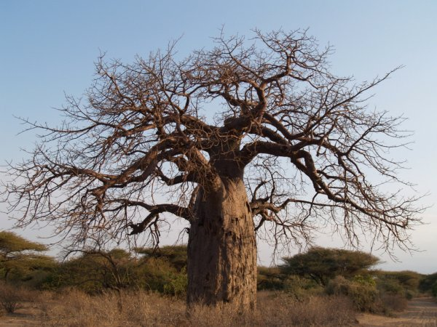
⁶ He also spoke this parable: “A certain man had a fig tree planted in his vineyard, and he came seeking fruit on it and found none. ⁷ Then he said to the keeper of his vineyard, ‘Look, for three years I have come seeking fruit on this fig tree and find none. Cut it down; why does it use up the ground?’⁸ But he answered and said to him, ‘Sir, let it alone this year also, until I dig around it and fertilize it.⁹ And if it bears fruit, well. But if not, after that you can cut it down.’” Luke 13

Slide 3
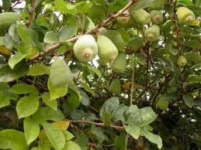
²² But the fruit of the Spirit is love, joy, peace, longsuffering, kindness, goodness, faithfulness,²³ gentleness, self-control. Against such there is no law. Gal 5

Slide 4
A. God's Kindness (Titus 3:4-5)
B. Kindness to Others (Ruth 2:13, Col. 3:12-13)
A. Too Busy?
B. Is my first response to others clothed in kindness? (Jn. 8:11).
C. Is my treatment of others based on circumstances
D. Are others “at ease” in my presence or “on edge?”
C. Kindness to Our Enemies? (Luke 6:35-36)
I. Sharing Kindness

Slide 5
A. The Selfish- Robbers
B. The Indifferent- The Priest and Levite
C. The Kind and Compassionate- Samaritan
D. The Willing Recipient- The Traveler
II. Making Kindness Real:
Lk. 10:30-35

