Slide 2
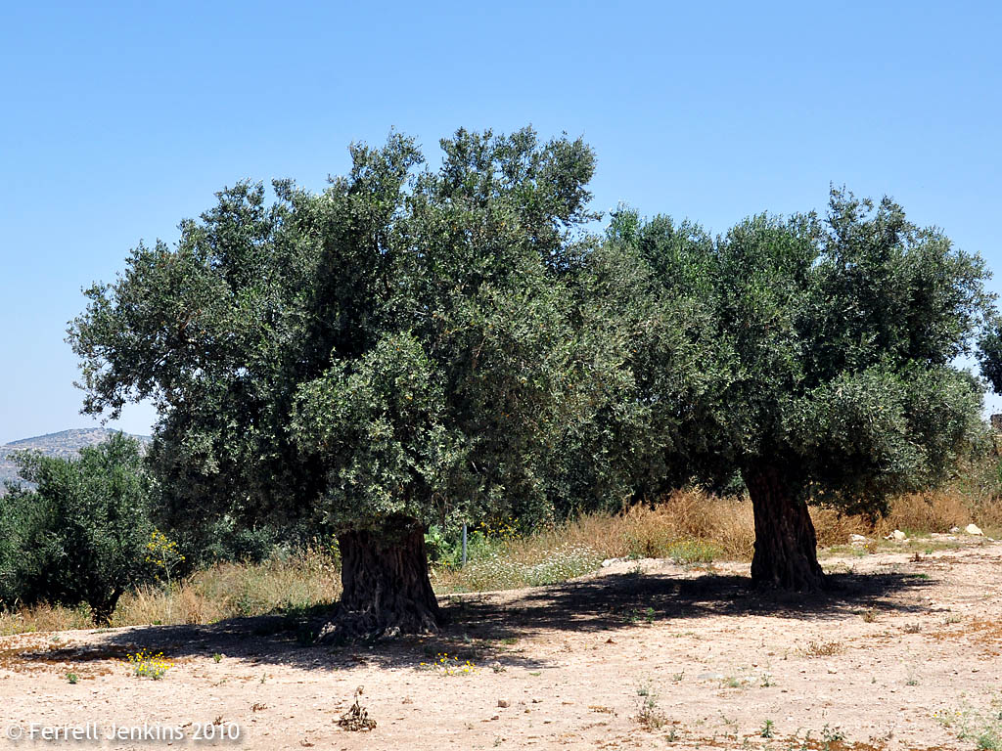

Slide 3
I. Urgency
I beseech you therefore, brethren, by the mercies of God, that you present your bodies a living sacrifice, holy, acceptable to God, which is your reasonable service.
Romans 12:1

Slide 4
II. Sacrifice Necessary
I beseech you therefore, brethren, by the mercies of God, that you present your bodies a living sacrifice, holy, acceptable to God, which is your reasonable service.
Romans 12:1

Slide 5
III. Reasonable
I beseech you therefore, brethren, by the mercies of God, that you present your bodies a living sacrifice, holy, acceptable to God, which is your reasonable service.
Romans 12:1

Slide 8
I. Conform Or Transform
And do not be conformed to this world, but be transformed by the renewing of your mind, that you may prove what is that good and acceptable and perfect will of God. Romans 12:2

Slide 9
II. Living Out God’s Will
And do not be conformed to this world, but be transformed by the renewing of your mind, that you may prove what is that good and acceptable and perfect will of God. Romans 12:2

