Slide 1
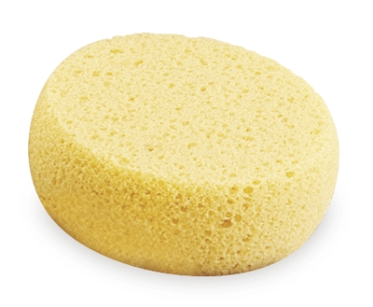
Sponges

Slide 2
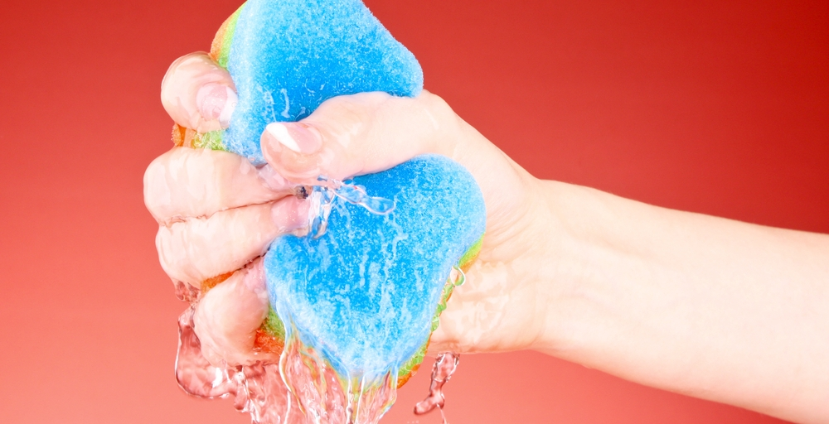
Wet sponges can only give.

Slide 3
Dry sponges can only take.

Slide 4
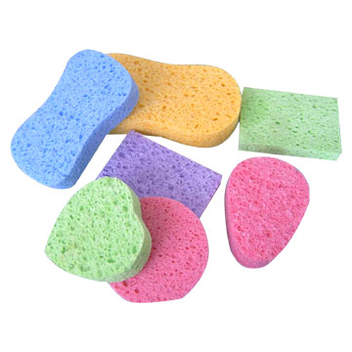
We are sponges.

Slide 5
Vanity of vanities, says the Preacher,
Vanity of vanities! All is vanity.
What does man gain by all the toil
At which he told under the sun?
Ecclesiastes 1:2-3

Slide 6
…to know the love of Christ that surpasses knowledge, that you may be filled with all the fullness of God. Ephesians 3:19

Slide 7
And do not get drunk with wine, for that is debauchery,
but be filled with the Spirit
Ephesians 5:18

Slide 8
And do not get drunk with wine, for that is debauchery, but be filled with the Spirit, addressing one another in psalms and hymns and spiritual songs, singing and making melody to the Lord with your heart, giving thanks always and for everything to God the Father in the name of our Lord Jesus Christ, submitting to one another out of reverence for Christ. Ephesians 5:18-21

Slide 9
And do not get drunk with wine, for that is debauchery, but be filled with the Spirit, addressing one another in psalms and hymns and spiritual songs, singing and making melody to the Lord with your heart, giving thanks always and for everything to God the Father in the name of our Lord Jesus Christ, submitting to one another out of reverence for Christ. Ephesians 5:18-21

Slide 10
Romans 1

Slide 11
Romans 12

Slide 12
Focus on one specific blessing each day.

Slide 13
Express gratitude in the moment.

Slide 14
Give thanks in public ways.

Slide 15
Be thankful for people more than things.

Slide 16
Do it the old fashioned way:
write a letter!

Slide 17
Write a letter to God.

Slide 18
Give thanks for your enemies.

Slide 19
When you need something extra, come to the cross and you’ll find it.

