Slide 1
“I WILL BE WITH YOU”
Joshua 3

Slide 2
Constant Reminders
Lists
Tasks On Phones
Planners
Calendars
Updates
Important
Don’t Forget

Slide 3
1 After the death of Moses the servant of the Lord, the Lord said to Joshua the son of Nun, Moses‘ assistant, ² “Moses my servant is dead. Now therefore arise, go over this Jordan, you and all this people, into the land that I am giving to them, to the people of Israel. ³ Every place that the sole of your foot will tread upon I have given to you, just as I promised to Moses. ⁴ From the wilderness and this Lebanon as far as the great river, the river Euphrates, all the land of the Hittites to the Great Sea toward the going down of the sun shall be your territory. ⁵ No man shall be able to stand before you all the days of your life. Just as I was with Moses, so I will be with you. I will not leave you or forsake you.

Slide 4
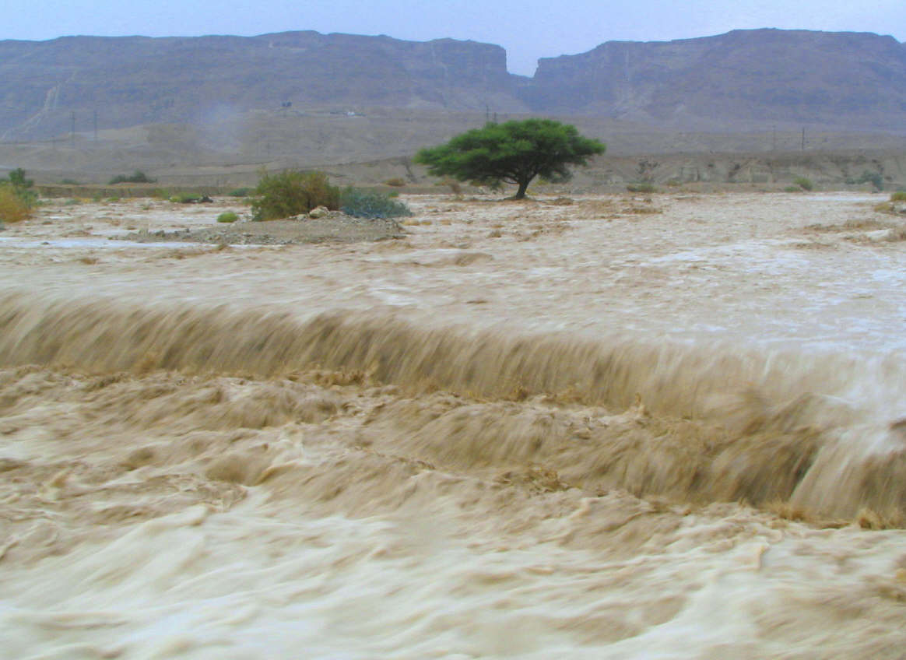
¹⁵ (now the Jordan overflows all its banks throughout the time of harvest),

Slide 5
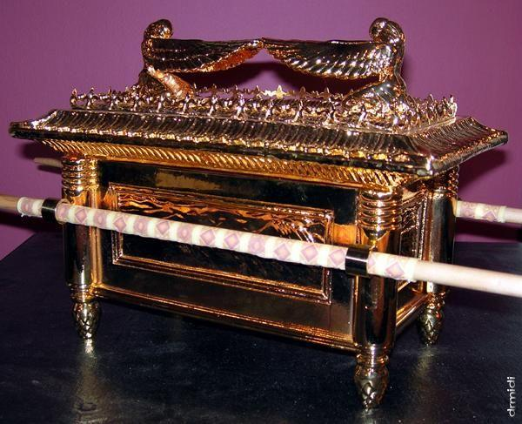

Slide 6
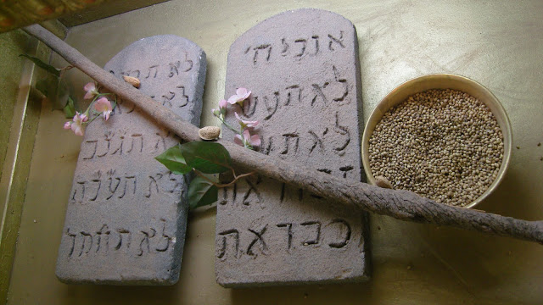

Slide 7
1. The 10 Commandments (Exodus 20:1-17; 25:16)
*Remember God’s Word Is With Us
2. The Manna (Exodus 16:9-12, 31-34)
*Remember God Cares And Sustains Us
3. Aaron’s Rod (Numbers 16:8-11, 31-32; 17:1-11)
*Remember God Chooses The Right Leader

Slide 8
Wouldn’t it be great if we had a gold plated, acacia box: And where it went, God went. And because you believed in what was inside it, you followed, and God led you through???
Would This Remind You That God Is With You?

Slide 9
Hebrews 9:1-5
9 Now even the first covenant had regulations for worship and an earthly place of holiness. ² For a tent was prepared, the first section, in which were the lampstand and the table and the bread of the Presence. It is called the Holy Place. ³ Behind the second curtain was a second section called the Most Holy Place, ⁴ having the golden altar of incense and the ark of the covenant covered on all sides with gold, in which was a golden urn holding the manna, and Aaron's staff that budded, and the tablets of the covenant. ⁵ Above it were the cherubim of glory overshadowing the mercy seat. Of these things we cannot now speak in detail.

Slide 10
Matthew 1:20-23
²⁰ But as he considered these things, behold, an angel of the Lord appeared to him in a dream, saying, “Joseph, son of David, do not fear to take Mary as your wife, for that which is conceived in her is from the Holy Spirit. ²¹ She will bear a son, and you shall call his name Jesus, for he will save his people from their sins.” ²² All this took place to fulfill what the Lord had spoken by the prophet: ²³ “Behold, the virgin shall conceive and bear a son, and they shall call his name ”Immanuel” (which means, God with us).

Slide 11
Hebrews 9:11-14
¹¹ But when Christ appeared as a high priest of the good things that have come, then through the greater and more perfect tent (not made with hands, that is, not of this creation) ¹² he entered once for all into the holy places, not by means of the blood of goats and calves but by means of his own blood, thus securing an eternal redemption. ¹³ For if the blood of goats and bulls, and the sprinkling of defiled persons with the ashes of a heifer, sanctify for the purification of the flesh, ¹⁴ how much more will the blood of Christ, who through the eternal Spirit offered himself without blemish to God, purify our conscience from dead works to serve the living God.

Slide 12
1. Jesus is our Word (Jn 1:14-17, 12:48, 14:15)
*Remember God’s Word Is With Us
2. Jesus is our Bread of Life (Jn 6:47-51,Phil.4:5-7,13)
*Remember God Cares And Sustains Us
3. Jesus is our King (Heb. 2:14-18, 4:14-16)
*Remember God Chose The Right Leader

Slide 13
“I WILL BE WITH YOU”
Joshua 3
3 The sea looked and fled; Jordan turned back. 4 The mountains skipped like rams, the hills like lambs.5 What ails you, O sea, that you flee? O Jordan, that you turn back? 6 O mountains, that you skip like rams? O hills, like lambs 7 Tremble, O earth, at the presence of the Lord, at the presence of the God of Jacob, Psalm 114

