Slide 1
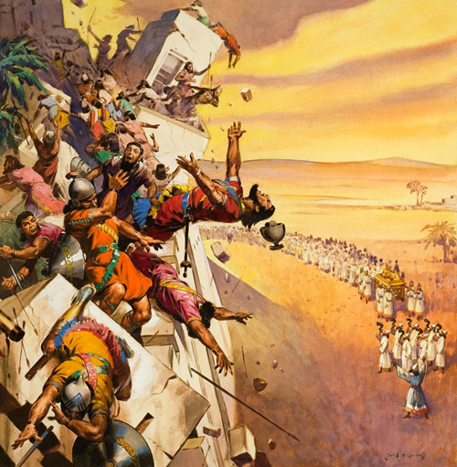
Be Strong and Very Courageous Everyday Lessons from the Battle of Jericho

Slide 2
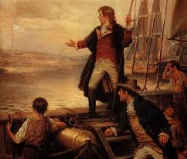
O'er the land of the free and the home of the brave!

Slide 3
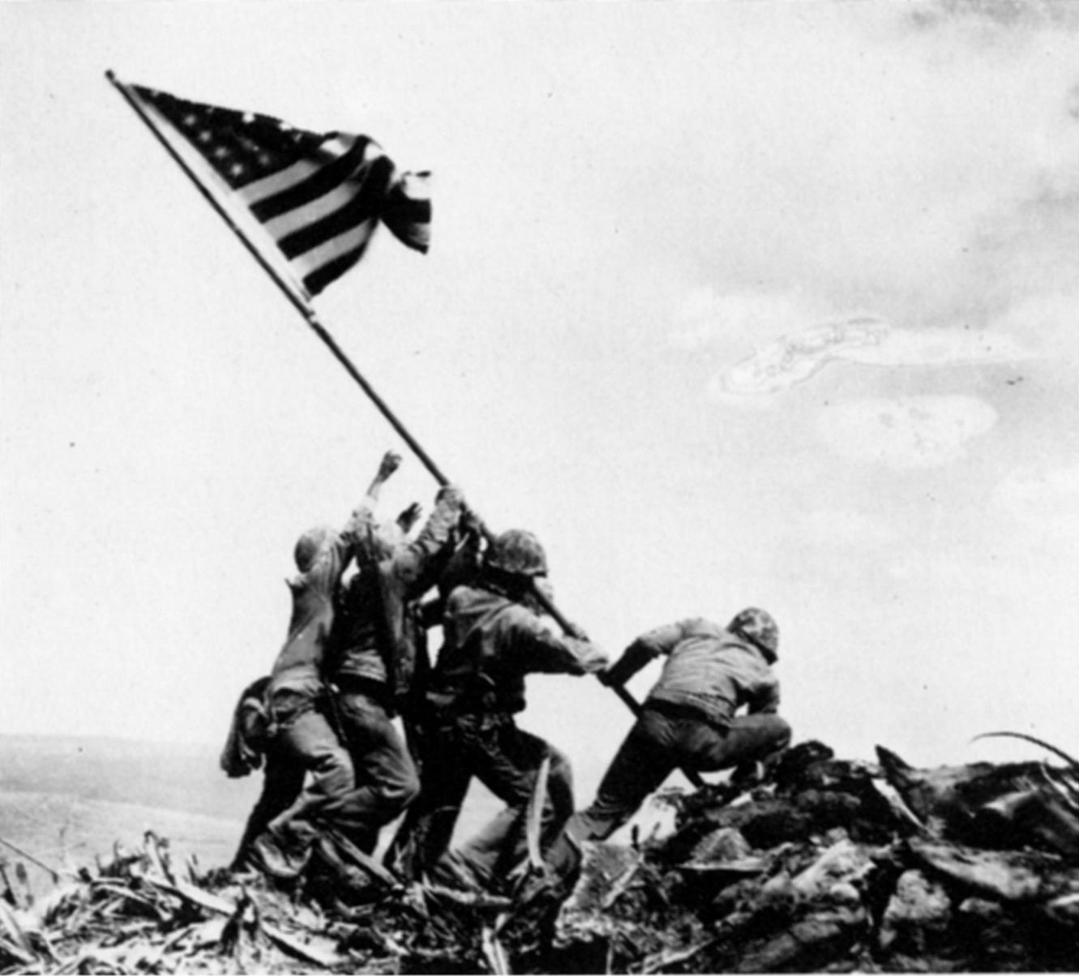

Slide 4
The Lessons from Jericho
Although God was giving them the Promise Land; it would not be without EFFORT on their part.
It would take courageous people to complete God’s often usual plans.
This kind of courage is still needed today!

Slide 5
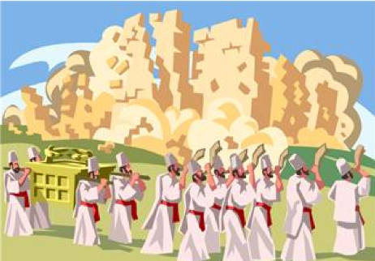
Their Courage Was NOT Founded in their OWN Ability

Slide 6
Courage Based on God’s Ability
God had been preparing Israel for this idea long before they entered the promise land!
Deut 6
Israel’s success at Jericho was because of God’s ability and not their own!
Numbers 13:33 …we were like grasshoppers in our own sight, and so we were in their sight."

Slide 7
Courage Based on God’s Ability
A lesson needed today.
I want to rely on my ability!!!
During times of Discouragement.
Heb 10:24 And let us consider one another in order to stir up love and good works, 25 not forsaking the assembling of ourselves together, as is the manner of some, but exhorting one another, and so much the more as you see the Day approaching.

Slide 8
Courage Based on God’s Ability
During times of temptation and sin…
1John 1:9 If we confess our sins, He is faithful and just to forgive us our sins and to cleanse us from all unrighteousness.
James 5:16 Confess your trespasses to one another, and pray for one another, that you may be healed. The effective, fervent prayer of a righteous man avails much.

Slide 9
Courage Based on God’s Ability
I forget what God is capable of…
Eph 3:20-21 Now to Him who is able to do exceedingly abundantly above all that we ask or think, according to the power that works in us, to Him be glory in the church by Christ Jesus to all generations, forever and ever. Amen.

Slide 10
Courage Is Found In Acting Even When The Way Is Improbable/Lacks Human Wisdom

Slide 11
Acting When the Way is Improbable
God’s ways are NOT man’s ways.
Isa 55:8 "For My thoughts are not your thoughts, Nor are your ways My ways," says the LORD. 9 "For as the heavens are higher than the earth, So are My ways higher than your ways, And My thoughts than your thoughts.

Slide 12
Acting When the Way is Improbable
How badly this kind of courage is NEEDED TODAY!!!
Many doubt God’s ways today

Slide 13
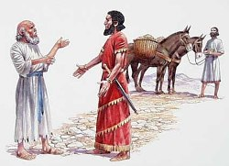
Acting When the Way is Improbable
Not a new problem.
2 Kings 5. The Story of Naaman

Slide 14
Acting When the Way is Improbable
Not a new problem.
John 6:60 Therefore many of His disciples, when they heard this, said, "This is a hard saying; who can understand it?"… 66 From that time many of His disciples went back and walked with Him no more.

Slide 15
Acting When the Way is Improbable
The Necessity of Baptism
Stressed by Jesus Himself stressed
Mark 16:15 And He said to them, "Go into all the world and preach the gospel to every creature. 16 "He who believes and is baptized will be saved; but he who does not believe will be condemned.

Slide 16
Acting When the Way is Improbable
Paul spoke of Baptism as it relates to our Relationship IN CHRIST!!!
Romans 6:3-4 Or do you not know that as many of us as were baptized into Christ Jesus were baptized into His death? Therefore we were buried with Him through baptism into death, that just as Christ was raised from the dead by the glory of the Father, even so we also should walk in newness of life.

Slide 17
Acting When the Way is Improbable
1Pe 3:21 There is also an antitype which now saves us--baptism (not the removal of the filth of the flesh, but the answer of a good conscience toward God), through the resurrection of Jesus Christ,

Slide 18
Acting When the Way is Improbable
God’s plan for the church.
Romans 1:16 For I am not ashamed of the gospel of Christ, for it is the power of God to salvation for everyone who believes, for the Jew first and also for the Greek. 17 For in it the righteousness of God is revealed from faith to faith; as it is written, "The just shall live by faith.

Slide 19
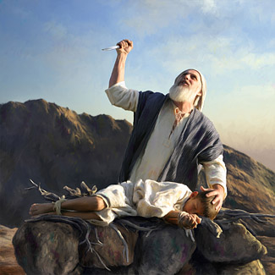
God’s often improbable plans
Abraham to offer Isaac!

Slide 20
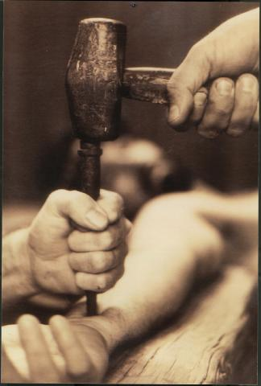
God’s often improbable plans
Jesus dying on the Cross!

Slide 21
Courage Is Based on Faithful Promises

Slide 22
Courage Based on Promises
God’s great promises were not just for Israel.
God has given to use promises that are just as sure and steadfast as those He gave to Israel.
2Peter 1:2-4…given to us exceedingly great and precious promises…

Slide 23
Courage Based on Promises
Heb 6:11-20
Heb 13:5 Let your conduct be without covetousness; be content with such things as you have. For He Himself has said, "I will never leave you nor forsake you." 6 So we may boldly say: "The LORD is my helper; I will not fear. What can man do to me?"

Slide 24
Courage Based on Promises
Paul was willing to suffer because of His assurance in God!
2Tim 1:12, “For this reason I also suffer these things; nevertheless I am not ashamed, for I know whom I have believed and am persuaded that He is able to keep what I have committed to Him until that Day.”
Heb 11:13 These all died in faith, not having received the promises, but having seen them afar off were assured of them, embraced them and confessed that they were strangers and pilgrims on the earth.

Slide 25
Courage Based on Promises
Rev 2:10 "Do not fear any of those things which you are about to suffer. Indeed, the devil is about to throw some of you into prison, that you may be tested, and you will have tribulation ten days. Be faithful until death, and I will give you the crown of life.

Slide 26
Do I still believe in God’s promises? Do I know that God will keep His promises? Am I still motivated by the Promises of God?

