Slide 1
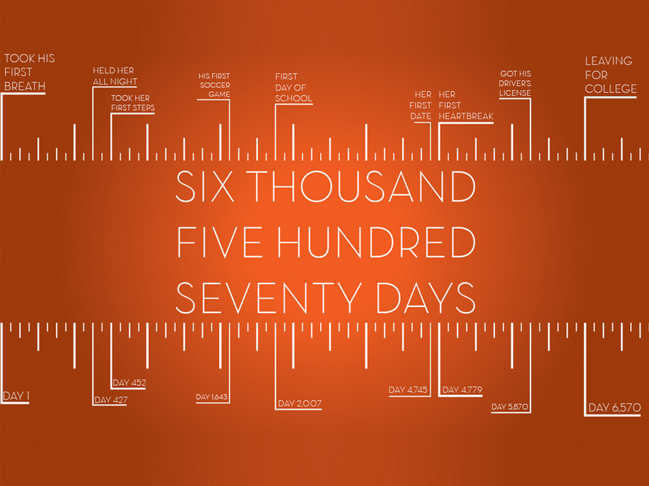
6570 Days
1 Thessalonians 2:13-20
Notes:
The Bible calls on us to number our days…but have you ever sat down and numbered the days you will have your children under your roof?
From birth to 18 is only 6,570 days.
I understand that we will continue to be a big part of their life – but friends. The window of time that they are in our home is…well, my heart says …. Looks awfully small.
It seems even smaller when we admit that most of our kids aren’t newborns! Many of these days are already gone…

Slide 2
How Many Days Do We Have Left?
Ella = 6,558
With Our 3 Yr Olds = 5,475
With Our 6 Yr Olds = 4,380
With Our 10 Yr Olds = 2,920
With Our 14 Yr Olds = 1,460
With Our 16 Yr Olds = 730
Notes:
MY POINT:: This is not a series to make mothers cry – this is a series to help us have one of Jesus favorite TRAITS - Alertness - Over and over he calls us to BE ALERT.
Today – I want to share 5 ideas I want to be absolutely sure are planted in the hearts of our CHILDREN.

Slide 3
Is This Just For Parents?
Single-Parent Families - 39%
Neither Parent- 6%
Grandparents- 7%
Kinship- 4%
Religion that is pure and undefiled before God, the Father, is this: to visit orphans and widows in their affliction, and to keep oneself unstained from the world. James 1:27

Slide 4
Recap
1. I Will Share My Life With You v.7-8
2. I Will Live The Gospel v.9-10
3. I Want You To Be Part Of His Kingdom & Glory v.11-12

Slide 5
4. I Want You To Receive The Word Of God. v13
And we also thank God constantly for this, that when you received the word of God, which you heard from us, you accepted it not as the word of men but as what it really is, the word of God, which is at work in you believers.

Slide 6
Fewer than half of all adults can name the four gospels
Many professing Christians cannot identify more than two or three of the apostles
60% of Americans can’t name even five of the Ten Commandments
82% of Americans believe “God helps those who help themselves” is a Bible verse
Source: Barna Group

Slide 7
4. I Want You To Receive The Word Of God. v13
Hear God's word from us
- Romans 10:14-15
Receive the word and accept it
- Romans 10:10-13
Have the word working in you
- Romans 10:18-21, Psalm 119

Slide 8
And we also thank God constantly for this, that when you received the word of God, which you heard from us, you accepted it not as the word of men but as what it really is, the word of God, which is at work in you believers.
I thank God for sparing their life one more day so they can come back to Him

Slide 9
Challenge: What are you doing right now to help them receive and accept the word of God?

Slide 10
5. I Will Be An Example Of Suffering For You. v14-16
¹⁴ For you, brothers, became imitators of the churches of God in Christ Jesus that are in Judea. For you suffered the same things from your own countrymen as they did from the Jews,¹⁵ who killed both the Lord Jesus and the prophets, and drove us out, and displease God and oppose all mankind ¹⁶ by hindering us from speaking to the Gentiles that they might be saved—so as always to fill up the measure of their sins. But wrath has come upon them at last!

Slide 11
Why don't we suffer? Do we suffer? How do we suffer?

Slide 12
5. I Will Be An Example Of Suffering For You. v14-16
Suffering comes from our countrymen
- Matthew 5:10-12
Hinder you from sharing how to be saved
- 2 Timothy 3:12
Suffering teaches you how to trust God
- 1 Peter 2:23

Slide 13
Challenge: What are you doing right now to be an example of suffering?

Slide 14
6. I Want You To Be My Glory And Joy. v17-20
Our children are on loan from God
- Psalm 78:1-7, Psalm 127:3-5
Satan will hinder you... I'm going to do my best not too
- Col. 3:18-25, 21
My greatest joy would be to hear Jesus say to you “Well Done Good And Faithful Servant” on judgment day

Slide 15
What Will Be Your Joy On Judgment Day?
A good job?
A college degree?
Money in the bank?
Lots of friends?
A large reputation?
A successful career?
The praise of others?
Take A Good Look At Your Children…

Slide 17
Challenge: We Want To Spend Eternity With Children… Are We Giving It 100%?
“Not everyone who says to me, ‘Lord, Lord,’ will enter the kingdom of heaven, but the one who does the will of my Father who is in heaven. Mt. 7:21

Slide 18
When I Examine Myself, I Will… Remember The LAST DAY Is Coming Soon.
The Last Day…
They Are Under My Roof.
I Have To Guide Them On Earth.
Before My Family & I Stand In Judgment.
Notes:
None of us truly know exactly how many days we have left – but one thing we do know – they are limited, and the last DAY will be here before we know it.

Slide 19
6570 Days

