Slide 1
1st and 2nd Peter

Slide 2
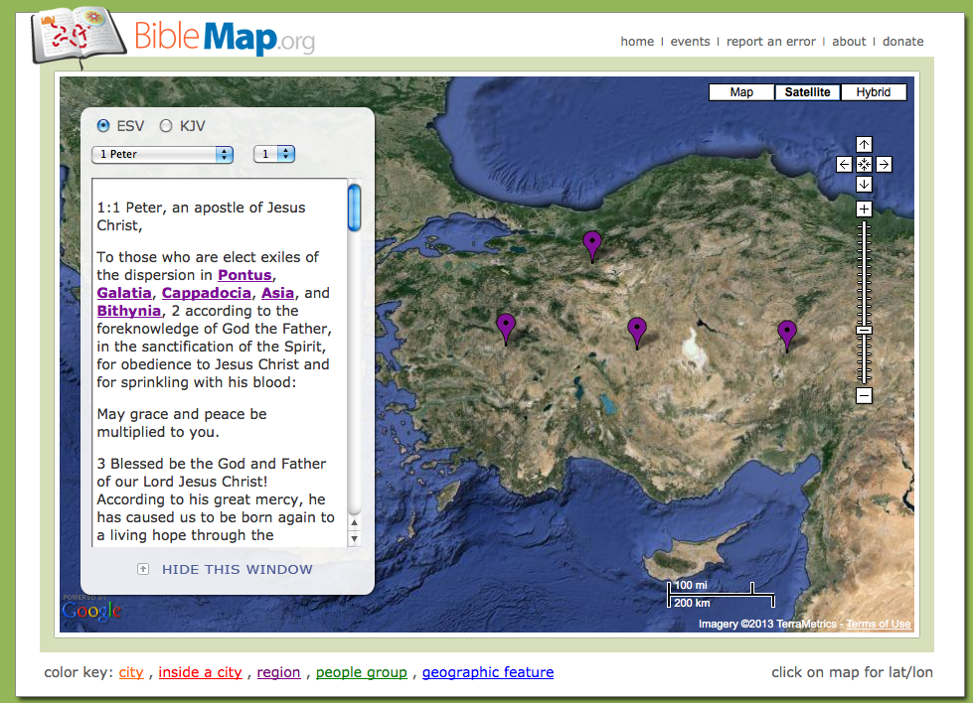
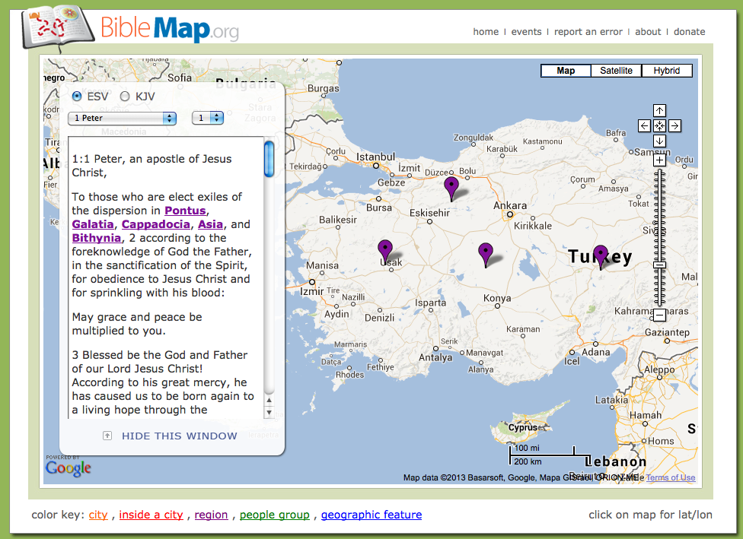
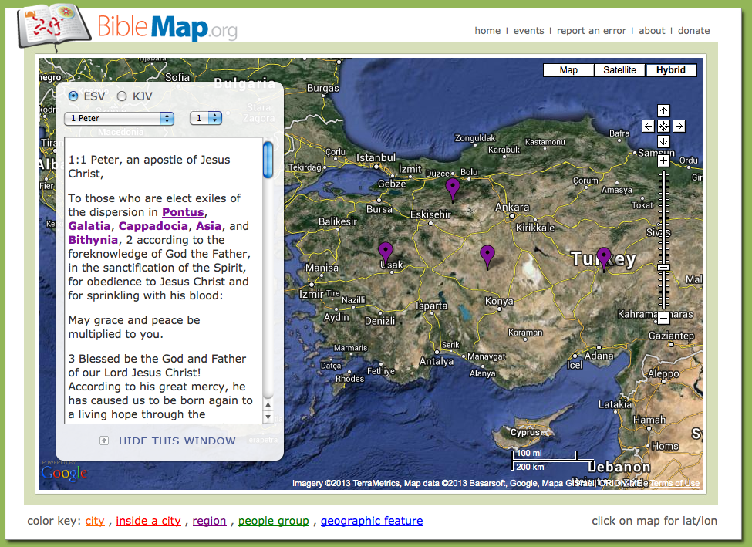
Peter’s Great Influence
Notes:
He is an EYEWITNESS. The guy everyone wants to hear from. He is an APOSTLE – whose words everyone hang on. He is an ELDER – a man who moved beyond his past to serve the church with great love. & He is writing to a very broad audience. Churches in a common region, with common problems, but also full of unique people with their own special set of needs.

Slide 3
Peter, an apostle of Jesus Christ,To those who are elect exiles of the Dispersion in Pontus, Galatia, Cappadocia, Asia, and Bithynia,² according to the foreknowledge of God the Father, in the sanctification of the Spirit, for obedience to Jesus Christ and for sprinkling with his blood: May grace and peace be multiplied to you.
1 Peter 1:1-2

Slide 4
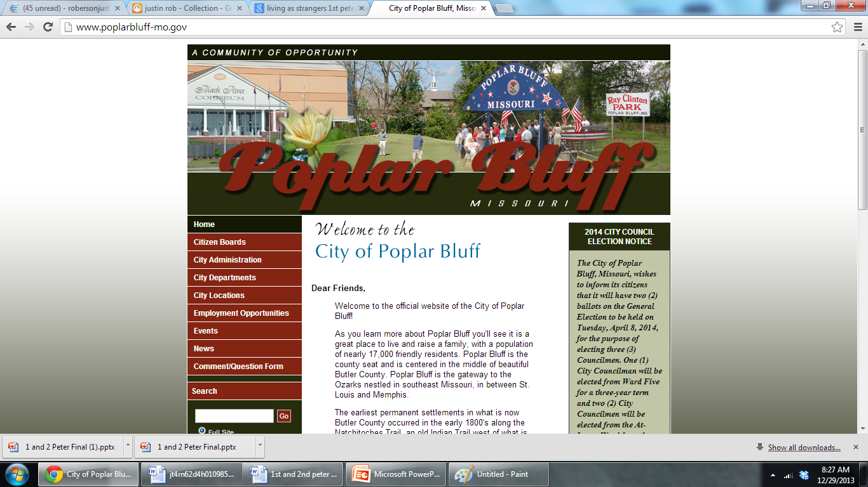

Slide 5
Peter’s Final Epistle
“I consider it right, as long as I am in this earthly dwelling, to stir you up by way of reminder, knowing that the laying aside of my earthly dwelling is imminent, as also our Lord Jesus Christ has made clear to me. And I will be diligent that at any time after my departure you will be able to call these things to mind.”
2 Peter 1:13-15

Slide 6
Peter’s Final Epistle
“This is now, beloved, the second letter I am writing to you in which I am stirring up your sincere mind by way of reminder, that you should remember the words spoken beforehand by the holy prophets and the commandments of the Lord and Savior spoken by your apostles.”
2 Peter 3:1-2
Notes:
And talk about repitition and reminders – he even repeats the purpose of the book again!

Slide 7
His Unforgettable Message
Christian, Be Transformed!
2 Peter 1:5-11
Christian, Be Taught!
You Have Reliable Testimony (1:16)
You Have Reliable Scriptures (1:20-21)
Christian, Be Careful! (2 Peter 2)
False Teachers Are Coming…
Don’t Be Entangled or Overcome
Notes:
So please see that this is not a book to read – this is a book to absorb – to carry these truths with you constantly! It was literally the dying wish of Peter the apostle that Christians take these things to heart.
What a priviledge for us to hear him speak to us tonight…

Slide 8
His Unforgettable Message
Christian, Be Certain The Lord Is Coming!
2 Peter 3:3-10
Christian, Be Ready For His Return!
Holy Conduct (2 Peter 3:11-14)
Just A Paul Teaches (2 Peter 3:15-16)
Christian, Be On Your Guard!
2 Peter 3:17-18
Notes:
So please see that this is not a book to read – this is a book to absorb – to carry these truths with you constantly! It was literally the dying wish of Peter the apostle that Christians take these things to heart.
What a priviledge for us to hear him speak to us tonight…

Slide 9
1st and 2nd Peter

Slide 10
Peter’s Great Influence
Notes:
He is an EYEWITNESS. The guy everyone wants to hear from. He is an APOSTLE – whose words everyone hang on. He is an ELDER – a man who moved beyond his past to serve the church with great love. & He is writing to a very broad audience. Churches in a common region, with common problems, but also full of unique people with their own special set of needs.

Slide 11
Peter, an apostle of Jesus Christ,To those who are elect exiles of the Dispersion in Pontus, Galatia, Cappadocia, Asia, and Bithynia,² according to the foreknowledge of God the Father, in the sanctification of the Spirit, for obedience to Jesus Christ and for sprinkling with his blood: May grace and peace be multiplied to you.
1 Peter 1:1-2

Slide 12
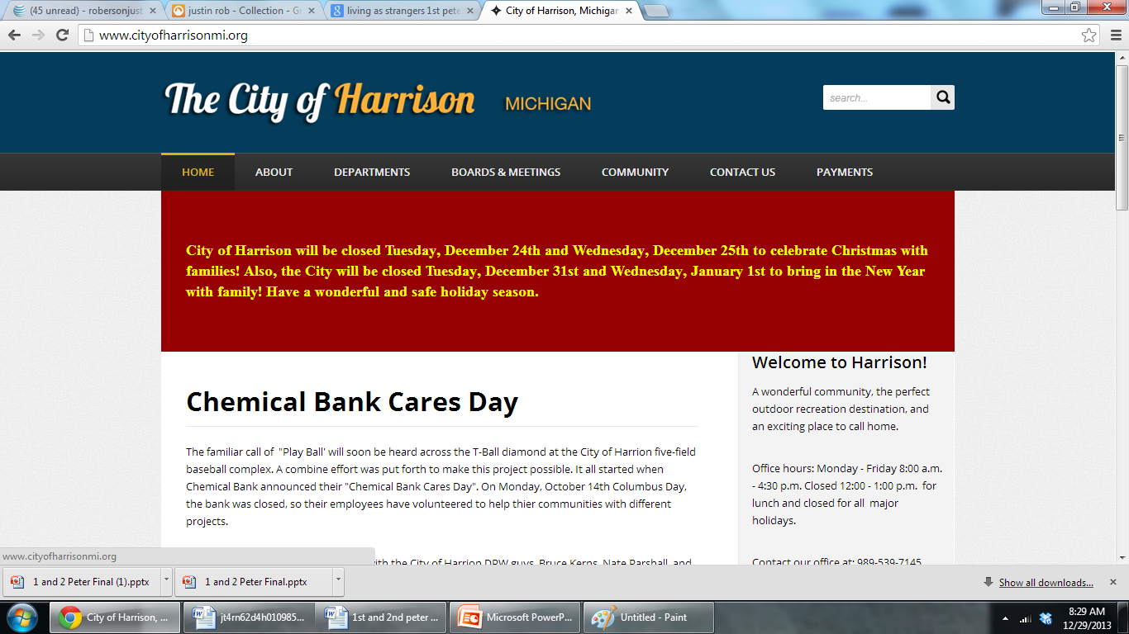

Slide 13
“I consider it right, as long as I am in this earthly dwelling, to stir you up by way of reminder, knowing that the laying aside of my earthly dwelling is imminent, as also our Lord Jesus Christ has made clear to me. And I will be diligent that at any time after my departure you will be able to call these things to mind.”
2 Peter 1:13-15

Slide 14
We Share So Much…
Our Common Salvation
1 Peter 1:3-9
Our Common Transformation
Holiness (1 Peter 1:13-16)
Love (1 Peter 1:22)
Diet (1 Peter 2:1-3)
Our Common Challenges
Evil Government (1 Peter 2:13-17)
Difficult Masters (1 Peter 2:18-25)
Unbelieving Spouse (1 Peter 3:1-2)

Slide 15
Our Lives Can Be…
Full of Good Works
1 Peter 3:13-15
Full of the Approval of Jesus
Good Conscience (1 Peter 3:16-17)
Salvation (1 Peter 3:18-22)
Full of Purpose
1 Peter 4:1,7-10
Full of Perseverance
1 Peter 4:12-16

Slide 16
Trying Times Call For…
Empathy & Exhortation for The Elders
Shepherding The Local Flock
Exercising Voluntary Oversight
Fulfilling the Will of God
Serving With Eagerness
Resisting The Temptation To “Lord Over” But Rather Proving To Be Examples.
Humility Among God’s People
Resisting The Devil’s Attacks
Notes:
If these first 4 chapters have given you a sense that Peter really cares about these people and about what they are facing – then chapter 5 will make complete sense – because if he cares this much from hundreds of miles away – how much more do the local shepherds care! They are right in the middle of it all – so you get Peter’s empathetic words to strengthen and encourage the elders in each of these churches…

Slide 17
1st and 2nd Peter

