Slide 1
Plans for 2015
Northwood church of Christ

Slide 2
Disciples Making Disciples
2015 Theme at Northwood:

Slide 3
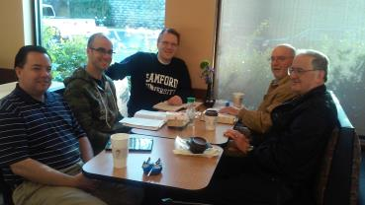
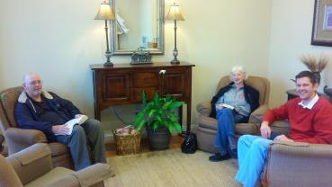
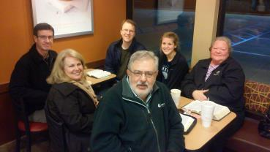
Mondays – 7:00 am Chick-fil-a in Northport Tuesdays – 12:15 pm UA Campus (Shelby) Tuesdays – 1:15 pm Davis Dental in Northport Tuesdays – 8:00 pm Chick-fil-a on Skyland Wednesdays – 8:00 am Chick-fil-a in Northport Fridays – 5:30 am IHOP Saturdays – 10:00 am Heritage House

Slide 4
Evangelism Workshops
Monthly at the Maxsons
First class:
Monday, Jan 26th

Slide 5
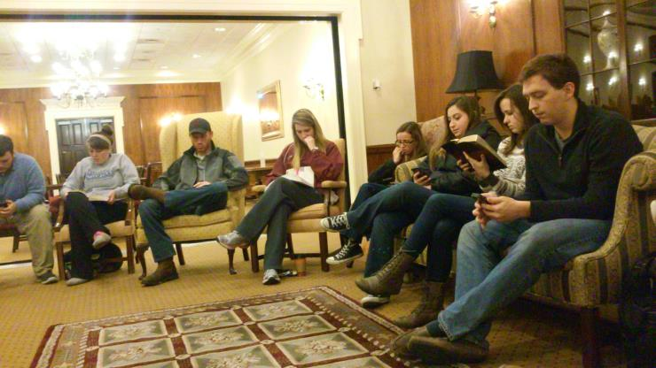
On Campus Study The Ferg, Thursdays at 7:00 pm

Slide 6
Friday, Jan 23
7:00 pm Money Matters
8:00 pm Practical Stewardship
Saturday, Jan 24
10:00 am Understanding Covetousness (Above College)
2:00 pm Diligent Stewardship (H.S. & College)
7:00 pm What About Debt
Sunday, Jan 25
9:00 am Firstfruits: Learning to Trust in God
9:35 am The Virtuous Wife, Her Money, & Her Family
10:30 am Transform Your Life

Slide 7
College Weekend Study March 6-8 with Paul Earnhart

Slide 8
Fall Focus

Slide 9
Auditorium Classes
Spring
Sun: Judges (Grant Mann)
Wed: Gal, 1&2 Thess (????)
Summer
Sun: Understanding the Will of God (Neal Huggins)
Wed: Eph, Phil, Col, Philemon (Levi Pressnell)
Fall
Sun: Sermon on the Mount (Josh Carter)
Wed: 1&2 Tim, Titus (Jim Roberts)

Slide 10
Adult 2 Classes
Spring
Sun: How We Got the Bible (Barry Mason)
Wed: NT Survey (Jim Roberts)
Summer
Wed: NT Survey
Fall
Sun: Teacher Training (David Maxson)
Wed: NT Survey

Slide 11
College Classes
Spring
Sun: Understanding the Will of God (David Maxson)
Wed: Prayer (Wes Wright & others)
Summer
Wed: TBD (Josh Carter)
Fall
Sun: TBD
Wed: Deuteronomy (Josh Carter)

Slide 12
H.S./M.S. Classes
Spring
Sun: TBD (Michael Holt & Brad Cicero)
Wed: How We Got the Bible (David & Steve)
Summer
Sun: TBD (Michael Holt & Josh Carter)
Wed: How to Study the Bible & Enjoy It (David & Steve)
Fall
Sun: TBD (Michael Holt & Josh Carter)
Wed: How to Study the Bible & Enjoy It (David & Steve)

Slide 13
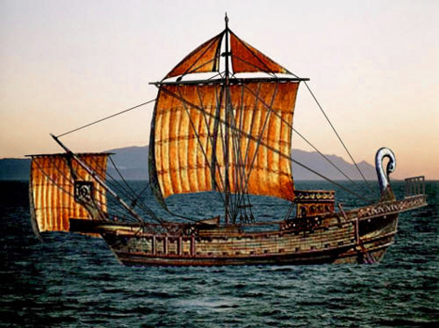
VBS The Journeys of Paul June 29-July 1 (Mon-Wed mornings)

Slide 14
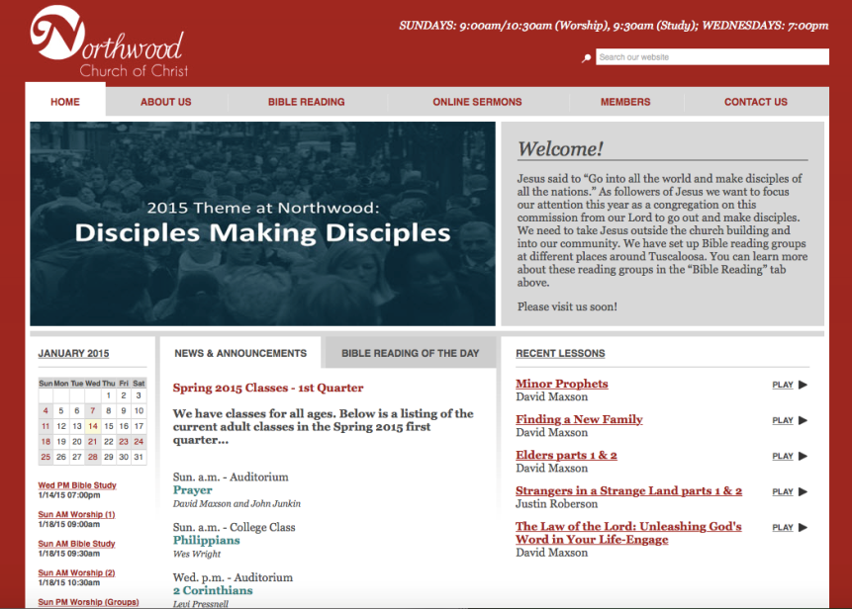
northwoodchurchofchrist.org

Slide 15
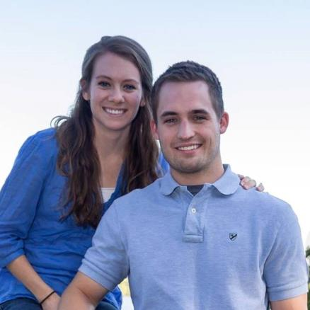
Josh & Katie Carter
Coming in May
Train young men
What can I do?

