Slide 1
Welcome to Northwood!

Slide 2
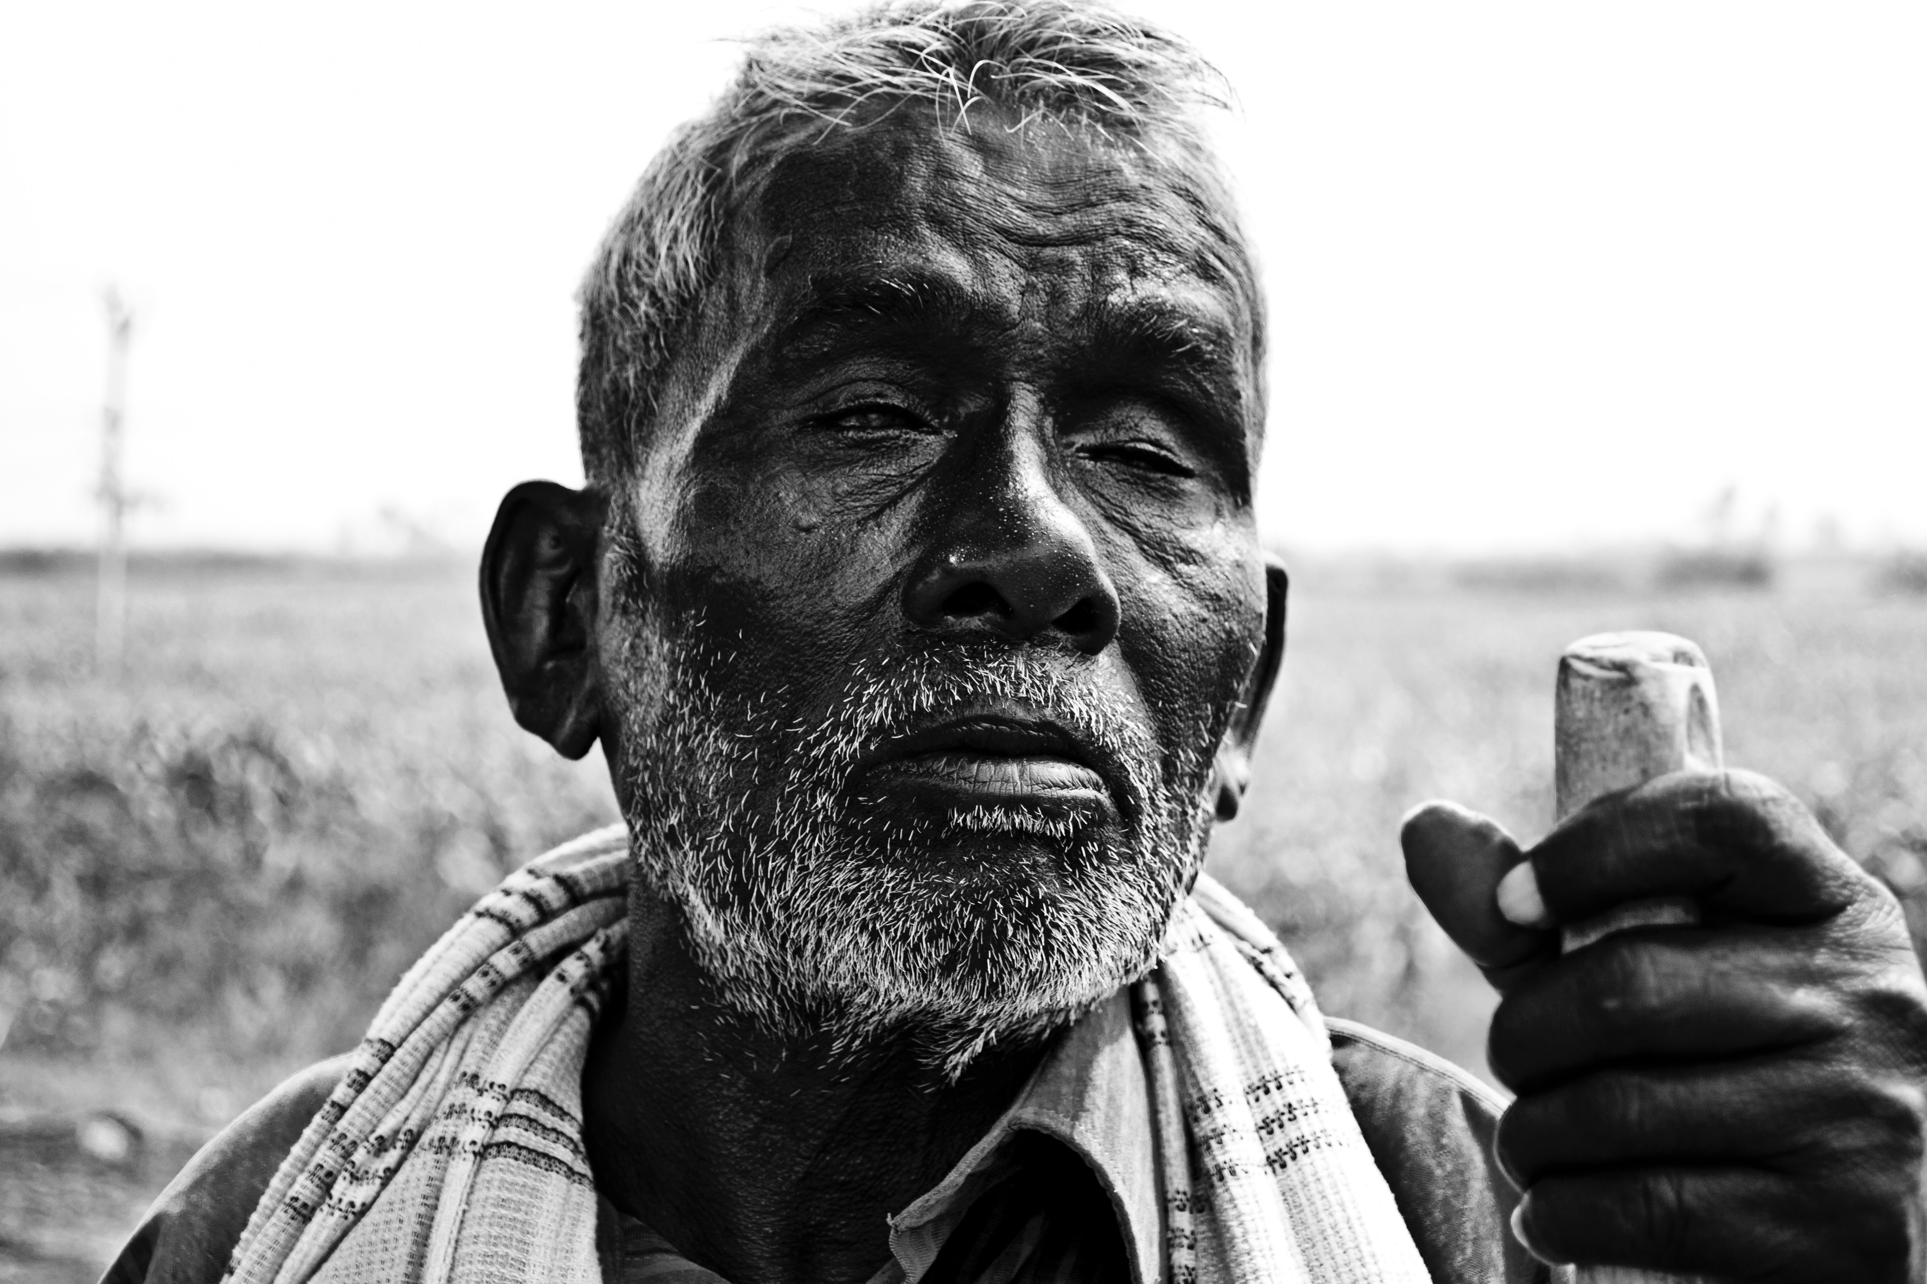
Jesus heals a blind beggar
Luke 18:35-43

Slide 3
How we are blind
Jesus heals a blind beggar

Slide 4
Bring out the people who are blind, yet have eyes, who are deaf, yet have ears! Isaiah 43:8
“But blessed are your eyes, for they see, and your ears, for they hear. Mt 13:16
Jesus said, “For judgment I came into this world, that those who do not see may see, and those who see may become blind.” Jn 9:39

Slide 5
In their case the god of this world has blinded the minds of the unbelievers, to keep them from seeing the light of the gospel of the glory of Christ, who is the image of God. 2 Cor 4:4

Slide 6
How we are beggars
Jesus heals a blind beggar

Slide 7
“For you say, I am rich, I have prospered, and I need nothing, not realizing that you are wretched, pitiable, poor, blind, and naked.” Rev 3:17
“So he went and hired himself out to one of the citizens of that country, who sent him into his fields to feed pigs. And he was longing to be fed with the pods that the pigs ate, and no one gave him anything.” Luke 15:15-16

Slide 8
A certain moneylender had two debtors. One owed five hundred denarii, and the other fifty. When they could not pay, he cancelled the debt of both. Now which of them will love him more?” Luke 7:41-42
“When he began to settle, one was brought to him who owed him ten thousand talents. And since he could not pay, his master ordered him to be sold, with his wife and children and all that he had, and payment to be made.” Matthew 18:24-25

Slide 9
For the wages of sin is death, but the free gift of God is eternal life in Christ Jesus our Lord. Romans 6:23
“Come, everyone who thirsts, come to the waters; and he who has no money, come, buy and eat!” Isaiah 55:1

Slide 10
Lessons from the blind beggar
He didn’t let opposition keep him from Jesus
He had complete faith in Jesus
He knew he was blind and helpless
He glorified God
He followed Jesus

