Slide 1
Welcome to Northwood!

Slide 2
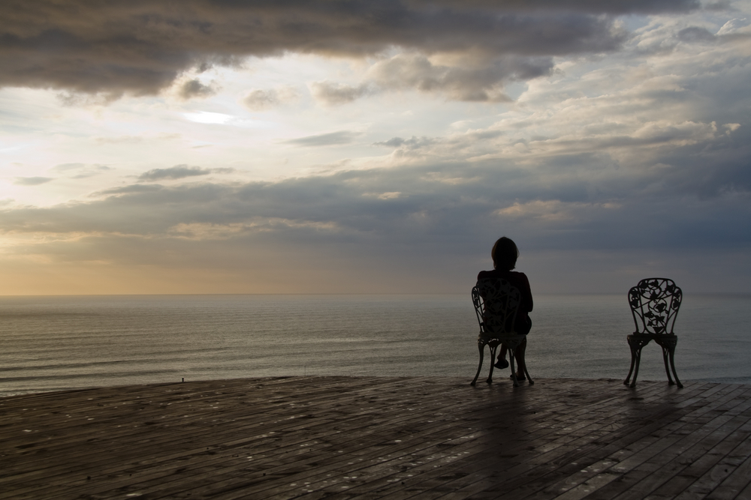
When Friends Fail You

Slide 3
Know You’re not the first
When friends fail you…

Slide 4
For Demas… has deserted me (v 10)
Crescens has gone to Galatia, Titus to Dalmatia (v 10)
Alexander the coppersmith did me great harm (v 14)
At my first defense no one came to stand by me, but all deserted me. (v 16)
Erastus remained at Corinth, and I left Trophimus, who was ill, at Miletus. (v 20)

Slide 5
accept that it’s not you’re fault
When friends fail you…

Slide 6
For Demas, in love with this present world, has deserted me and gone to Thessalonica. (v 10)

Slide 7
For Demas, in love with this present world, has deserted me and gone to Thessalonica. (v 10)

Slide 8
You learn that people are more important than things
When friends fail you…

Slide 9
When you come, bring the cloak that I left with Carpus at Troas, also the books, and above all the parchments. (v 13)

Slide 10
When you come, bring the cloak that I left with Carpus at Troas, also the books, and above all the parchments. (v 13)

Slide 11
Know that they can still be your friends
When friends fail you…

Slide 12
Luke alone is with me. (v 11)

Slide 13
Eubulus sends greetings to you, as do Pudens and Linus and Claudia and all the brothers. (v 21)

Slide 14
Know that there’s a friend who will never fail you
When friends fail you…

Slide 15
But the Lord stood by me and strengthened me… (v 17)

Slide 16
The Lord will rescue me from every evil deed and bring me safely into his heavenly kingdom. (v 18)

Slide 17
Do what you can do to be a friend.
Remember the 70 times 7 rule.
Accept your limitations to change.
Leave the rest to God.
Don’t let one loss turn into two!

