Slide 1
Welcome to Northwood

Slide 2
Reasons for Unbelief

Slide 3
Anger
So the Jews said to him, “What signs do you show us for doing these things?” John 2:18

Slide 4
Anger
Pride
Nicodemus said to him, “How can a man be born when he is old? Can he enter a second time into his mother’s womb and be born?” John 3:4

Slide 5
Anger
Pride
Bad Theology
This is why the Jews were seeking all the more to kill him, because not only was he breaking the Sabbath, but he was even calling God his own Father, making himself equal with God. John 5:18

Slide 6
Anger
Pride
Bad Theology
Wrong Motives
Jesus answered them, “Truly, truly, I say to you, you are seeking me, not because you saw signs, but because you ate your fill of the loaves.” John 6:26

Slide 7
Anger
Pride
Bad Theology
Wrong Motives
Intimidation
While some said, “He is a good man,” others said, “No, he is leading the people astray.” Yet for fear of the Jews no one spoke openly of him. John 7:12-13

Slide 8
Anger
Pride
Bad Theology
Wrong Motives
Intimidation
Closed-Mindedness
About the middle of the feast Jesus went up into the temple and began teaching. The Jews therefore marveled, saying, “How is it that this man has learning, when he has never studied?” John 7:14-15

Slide 9
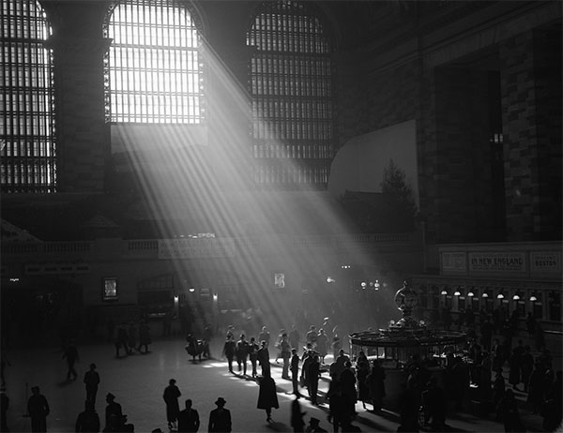
And this is the judgment: the light has come into the world, and people loved the darkness rather than the light because their works were evil.
John 3:19

Slide 10
When doubts arise in your heart, hold on to what you
KNOW!

