Slide 1
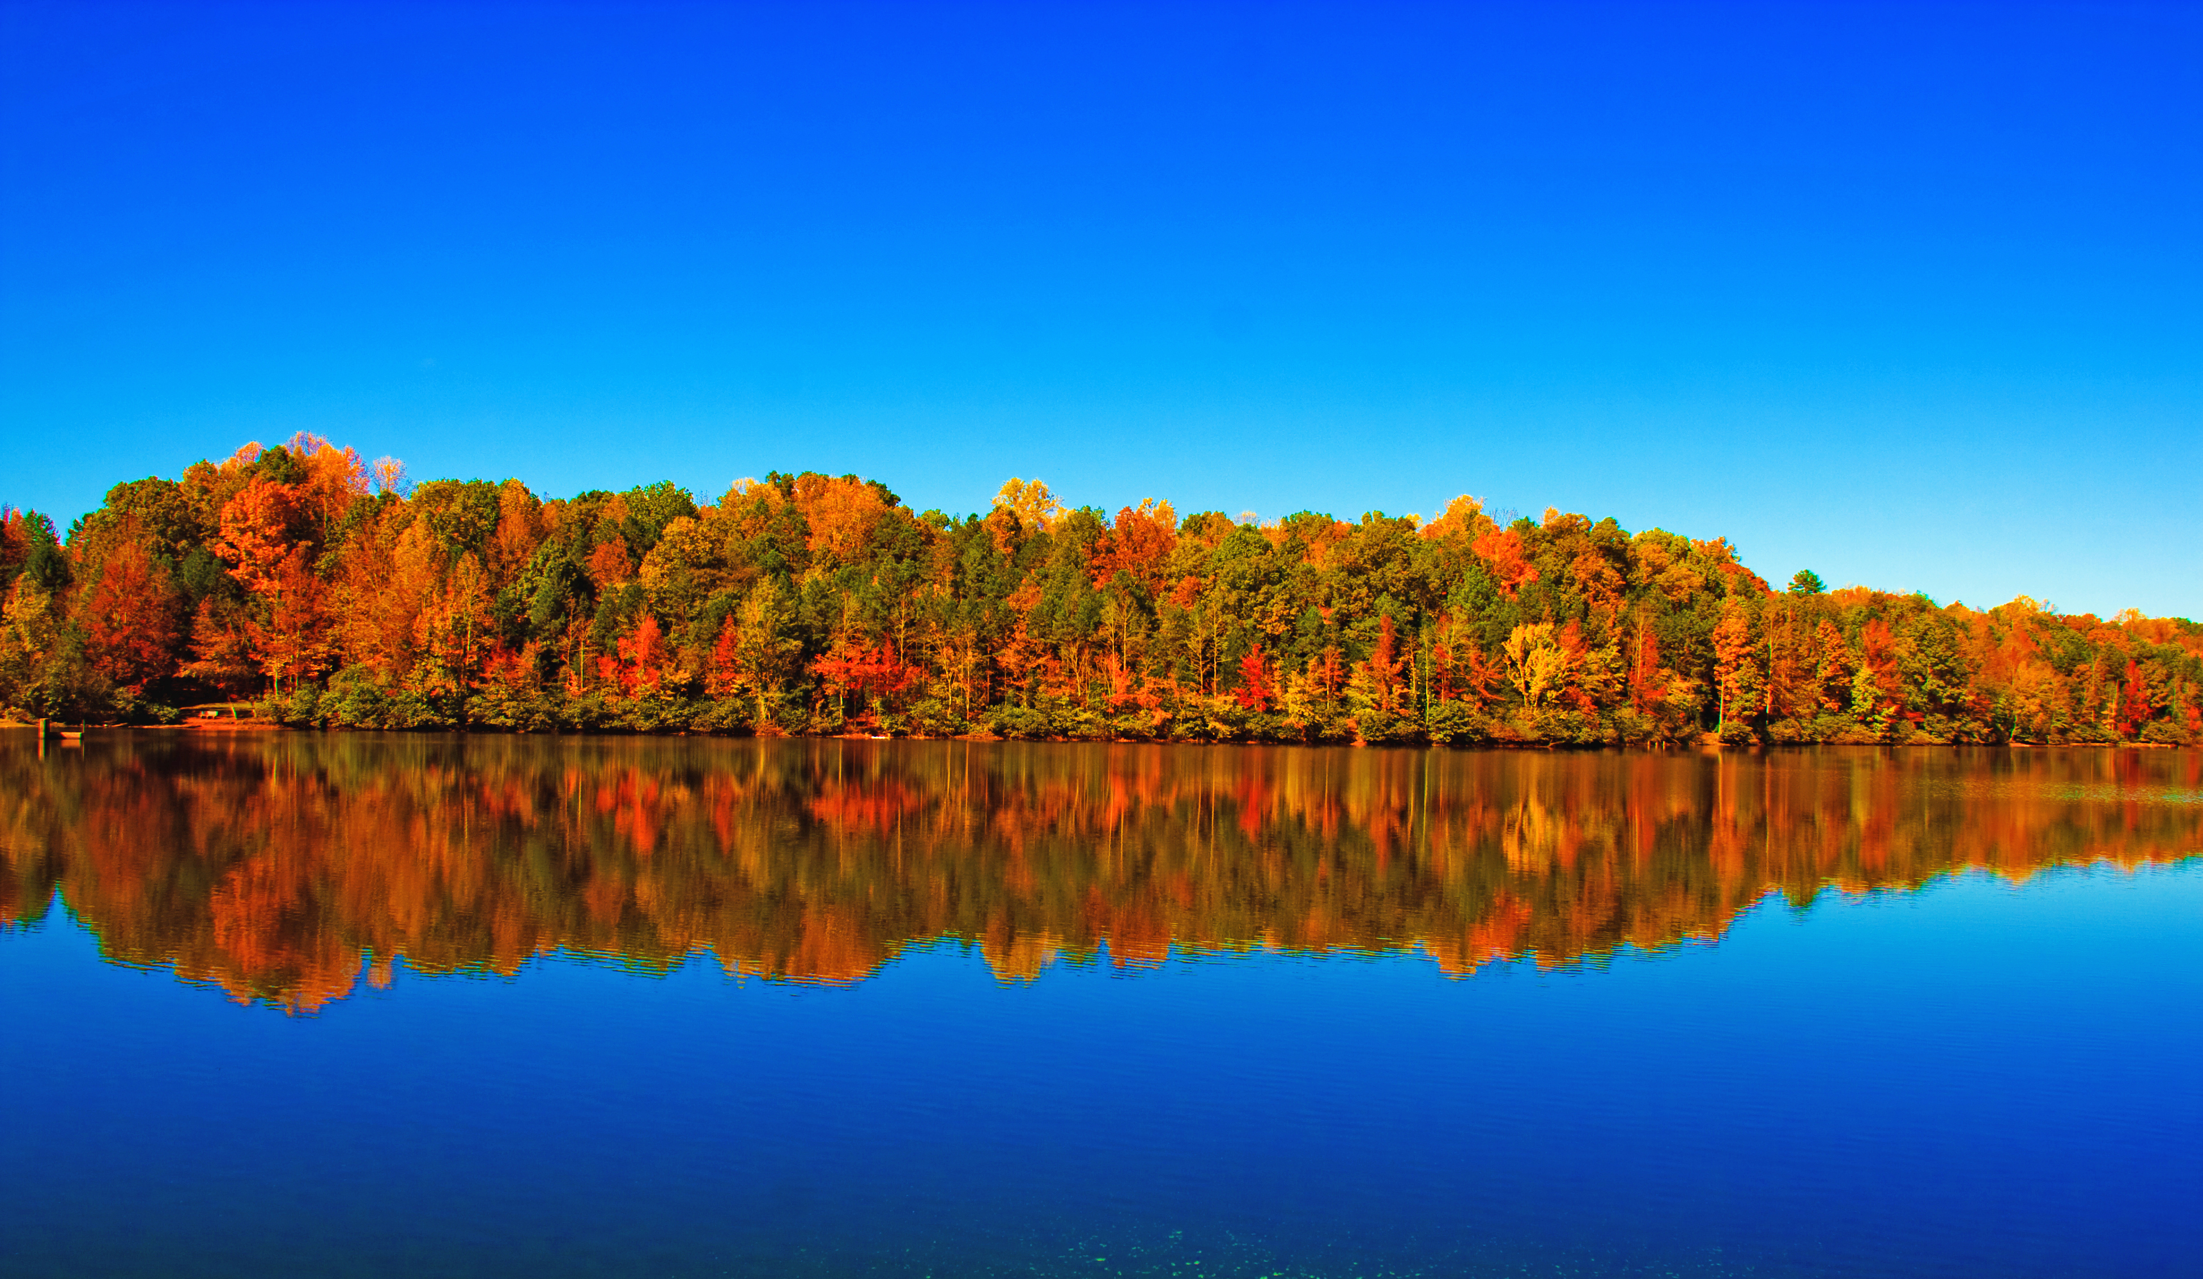
Welcome to Northwood

Slide 2
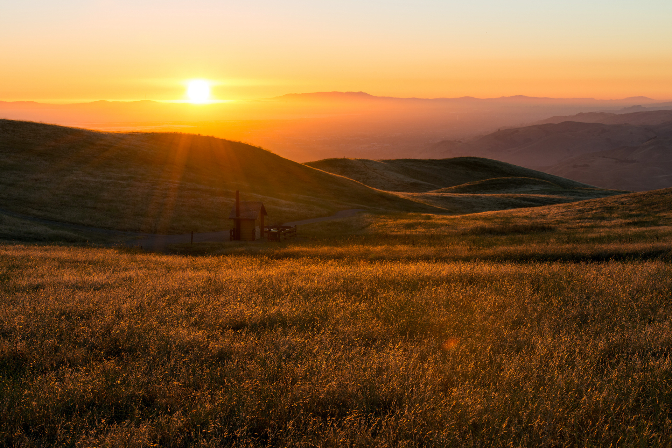
12
minor
Prophets
Hosea Joel Amos Obadiah Jonah Micah
Nahum Habakkuk Zephaniah Haggai Zechariah Malachi

Slide 3
OBADIAH
“Servant of God”
THE MINOR PROPHETS
(who preached a MAJOR message!)
AMOS
“Burden-bearer”
HABAKKUK
“He that embraces”
MICAH
“Who is like God?”
931
721
586
Assyrian captivity
597
539
516
445
605
520
Jerusalem
destroyed
Walls
rebuilt
Kingdom divided
Temple work
resumed
2nd Deportation: Ezekiel
Cyrus’ decree
Temple
completed
1st Deportation: Daniel

Slide 4
Micah
WHEN I FALL,
I SHALL RISE!

Slide 5
Micah
Idolatry & it’s consequences
The requirements of fellowship
The relentless, unfathomable depths of God’s love

Slide 6
Micah
Idolatry & it’s consequences
The requirements of fellowship
The relentless, unfathomable depths of God’s love

Slide 7
Micah 2:1-2
Woe to those who devise wickedness
and work evil on their beds!
When morning dawns they perform it,
because it is in the power of their hand.
They covet fields and seize them,
and houses, and take them away;
they oppress a man and his house,
a man and his inheritance.

Slide 8
Micah 2:1-2
Woe to those who devise wickedness
and work evil on their beds!
When morning dawns they perform it,
because it is in the power of their hand.
They covet fields and seize them,
and houses, and take them away;
they oppress a man and his house,
a man and his inheritance.

Slide 9
Micah 2:1-2
Woe to those who devise wickedness
and work evil on their beds!
When morning dawns they perform it,
because it is in the power of their hand.
They covet fields and seize them,
and houses, and take them away;
they oppress a man and his house,
a man and his inheritance.

Slide 10
Micah 2:6
“Do not preach”—thus they preach—
“one should not preach of such things;
disgrace will not overtake us.”

Slide 11
Micah 2:11
If a man should go about and utter wind and lies,
saying, “I will preach to you of wine and strong drink,”
he would be the preacher for this people!

Slide 12
Micah
Idolatry & it’s consequences
The requirements of fellowship
The relentless, unfathomable depths of God’s love

Slide 13
Micah 6:8
He has told you, O man, what is good;
and what does the LORD require of you
but to do justice, and to love kindness,
and to walk humbly with your God?

Slide 14
Micah 6:8
He has told you, O man, what is good;
and what does the LORD require of you
but to do justice, and to love kindness,
and to walk humbly with your God?

Slide 15
Micah 6:8
He has told you, O man, what is good;
and what does the LORD require of you
but to do justice, and to love kindness,
and to walk humbly with your God?

Slide 16
Micah 6:8
He has told you, O man, what is good;
and what does the LORD require of you
but to do justice, and to love kindness,
and to walk humbly with your God?

Slide 17
Micah
Idolatry & it’s consequences
The requirements of fellowship
The relentless, unfathomable depths of God’s love

Slide 18
Micah 7:8-9
Rejoice not over me, O my enemy;
when I fall, I shall rise;
When I sit in darkness,
the LORD will be a light to me.
I will bear the indignation of the LORD
because I have sinned against him,
until he pleads my cause
and executes judgment for me.
He will bring me out to the light;
I shall look upon his vindication.

Slide 19
Micah 7:8-9
Rejoice not over me, O my enemy;
when I fall, I shall rise;
When I sit in darkness,
the LORD will be a light to me.
I will bear the indignation of the LORD
because I have sinned against him,
until he pleads my cause
and executes judgment for me.
He will bring me out to the light;
I shall look upon his vindication.

Slide 20
Micah 7:8-9
Rejoice not over me, O my enemy;
when I fall, I shall rise;
When I sit in darkness,
the LORD will be a light to me.
I will bear the indignation of the LORD
because I have sinned against him,
until he pleads my cause
and executes judgment for me.
He will bring me out to the light;
I shall look upon his vindication.

Slide 21
Who is a God like you, pardoning iniquity
and passing over transgression
for the remnant of his inheritance?
He does not retain his anger forever,
because he delights in steadfast love.

Slide 22
Who is a God like you, pardoning iniquity
and passing over transgression
for the remnant of his inheritance?
He does not retain his anger forever,
because he delights in steadfast love.

Slide 23
He will again have compassion on us;
he will tread our iniquities underfoot.
You will cast all our sins
into the depths of the sea.

Slide 24
He will again have compassion on us;
he will tread our iniquities underfoot.
You will cast all our sins
into the depths of the sea.

Slide 25
You will show faithfulness to Jacob
and steadfast love to Abraham,
as you have sworn to our fathers
from the days of old.
Micah 7:18-20

Slide 26
You will show faithfulness to Jacob
and steadfast love to Abraham,
as you have sworn to our fathers
from the days of old.
Micah 7:18-20

Slide 27
Recognize your sin for what it is: IDOLATRY!
Give up trying to pay for your sin!
Accept God’s relentless, unfathomable grace!

