Slide 1
Sun. morning #3 Understanding the Priorities & Not Underestimating the Dangers

Slide 2
17. Focusing on home income ($) over home outcome (the children)
“Better is a little with the fear of the Lord than great treasure and turmoil with it. Better is a dish of vegetables where love is than a fattened ox served with hatred” Prv. 15.17
the home, not the house / the family, not the stuff
Do our homes reflect scriptural priorities? Or cultural priorities? older women: “train the young women to love their husbands, to love their children, to be sober minded, chaste, workers at home, kind, being in subjection to their own husbands” Titus 2:3-5

Slide 3
1Tim. 6:6-10

Slide 4
18. underestimating threats
corruption from the entertainment media
corruption from the internet (pornography , etc.)
offenders / predators (old and young)
certain educational agendas (relativism, promotion of homosexuality, evolution)
presuming medication solutions for behavior issues
feminism agendas & blurring of gender roles
declining standards of self-responsibility, conduct, dress, ethics, etc.

Slide 5
extra slides

Slide 6
Biblical examples of parenting (good and bad)
(-) choice of environ. Lot Gen.13:12-13
(-) deceit & favoritism R & I / J. G.25 & 37
(-) not restraining Eli 1S.2:22-23/ 3.13
(-) too approving Samuel 1S.8:1-5
(-) “will not withhold” David 2Sam.13 (2S.19)
(+) lasting influence Jonadab Jer. 35:1-19
(+) raised in the Word L > E > T 2Tim.1:5; 3:15

Slide 7
LOVE
Eph.5.25;
Titus 2.4

Slide 8
husbands & wives
e x a m p l e :

Slide 9
Husband
Gen. 2.18, 24 leave & cleave (Mk.10; Mt.19)
provider:
Gen.3.13-19; 1 Tim. 5.8 provide for physical needs
Eph. 5.25, 28-29; 6.1-4 provide leadership generally

Slide 10
sacrificial leadership Eph.5:23-25 cf. Mt. 20,25-28
Husband
For the husband is the head of the wife, even as Christ is the head of the church: and he is the savior of the body….
Husbands, love your wives, even as Christ also loved the church and gave himself up for her ”

Slide 11
Eph. 5 husband: wife: love her follow him

Slide 12
LOVE
RESPECT

Slide 13
“one” Eph.5:28-31
Husband
Even so ought husbands to love their own wives as their own bodies. He that loves his own wife loves himself, for no man ever hated his own flesh, but nourishes and cherishes it … for this cause shall a man leave his father and mother, and shall cleave to his wife, and the two shall become one flesh”

Slide 14
remembering your vows:
“cherish” Eph.5.28-29
“honor” 1Ptr.3.7 (& dwell w/ here w/ understanding)
“to her and her alone” Job.31.1; Pr.5; Mt.5
“love” Eph. 5.28
“Husbands, love your wives, even as Christ also loved the church and gave himself up for her… Even so ought husbands to love their own wives as their own bodies. He that loves his own wife loves himself”
Husband

Slide 15
Pr. 18.22 “He who finds a wife finds a good thing”

Slide 16
Prov. 14.1 nasb The wise woman builds her house, But the foolish tears it down with her own hands.
Prov. 21:9 & 19

Slide 17
Research shows no long term benefit from ADHD medication – abc.net (australian TV) abc.net.au/worldtoday/content/2007/s2089497.htm
Professor William Pelham from the State University of New York at Buffalo has been involved in a national study on ADHD treatment since the 1990s. WILLIAM PELHAM: We published a report in 1999 that appeared to suggest that medication was the best way to treat children with ADHD. Other treatments were also good, that is a psychosocial approach, training parents and children and teachers how to work together, but medication appeared to be a bit better and we published that. And then a year later did follow up, and two years later did another follow up, and that was just reported. And each time we did follow up, the effects of medication were less and less. And this last follow up, we can no longer detect any beneficial effects of medication.
The explosion in ADHD diagnosis and treatment with stimulants such as Ritalin (Methylphenidate) represents the greatest medical catastrophe since Thalidomide -B.Turner Lecturer in Legal Studies in Forensic Science in the Department of Biological Sciences, University of Lincoln, UK, counselingonlinesite.com/blog/archives/2009_03_01
PBS.COM > search: BRAIN POLITICS

Slide 18
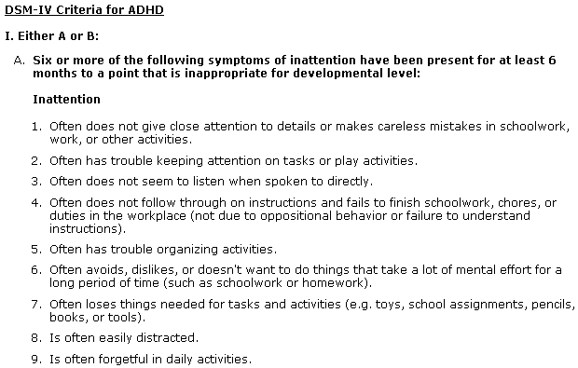
www.cdc.gov
1. Often does not give close attention to details or makes careless mistakes in schoolwork, work, or other activities.
2. Often has trouble keeping attention on tasks or play activities.
3. Often does not seem to listen when spoken to directly.
4. Often does not follow through on instructions and fails to finish schoolwork, chores, or duties in the workplace (not due to oppositional behavior or failure to understand instructions).
5. Often has trouble organizing activities.
6. Often avoids, dislikes, or doesn't want to do things that take a lot of mental effort for a long period of time (such as schoolwork or homework).
7. Often loses things needed for tasks and activities (e.g. toys, school assignments, pencils, books, or tools).
8. Is often easily
distracted
9. Is often forgetful
in daily activities.

Slide 19
The Homes We Need
Built with the Lord Ps. 127:1
Built on the word Mt. 7:24-27
Built in sanctification Josh. 24:15; Dt. 6:4-9; Jas. 4:4

