Slide 1
Welcome to Northwood!

Slide 2
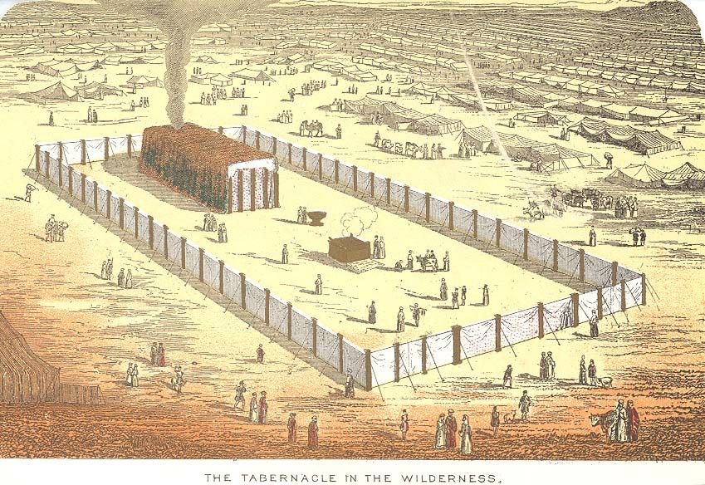
Leviticus
I Will Make My Dwelling Among You

Slide 3
Between
Heaven
& Hell

Slide 4
Hell is necessary because of God’s just nature.
Hell is a consequence of man’s free will.
The evil we witness on earth is a foretaste of hell.

Slide 5
18 For the wrath of God is revealed from heaven against all ungodliness and unrighteousness of men, who by their unrighteousness suppress the truth.

Slide 6
18 For the wrath of God is revealed from heaven against all ungodliness and unrighteousness of men, who by their unrighteousness suppress the truth.

Slide 7
Matthew 5 22 “But I say to you that everyone who is angry with his brother will be liable to judgment; whoever insults his brother will be liable to the council; and whoever says, ‘You fool!’ will be liable to the hell of fire.”

Slide 8
Matthew 23 31 “Thus you witness against yourselves that you are sons of those who murdered the prophets. 32 Fill up, then, the measure of your fathers. 33 You serpents, you brood of vipers, how are you to escape being sentenced to hell?”

Slide 9
Matthew 25 34 “Then the King will say to those on his right, ‘Come, you who are blessed by my Father, inherit the kingdom prepared for you from the foundation of the world.’”

Slide 10
Hebrews 11 16 But as it is, they desire a better country, that is, a heavenly one. Therefore God is not ashamed to be called their God, for he has prepared for them a city.

Slide 11
John 14 2 “In my Father’s house are many rooms. If it were not so, would I have told you that I go to prepare a place for you? 3 And if I go and prepare a place for you, I will come again and will take you to myself, that where I am you may be also.”

Slide 12
2 Peter 3 9 The Lord is not slow to fulfill his promise as some count slowness, but is patient toward you, not wishing that any should perish, but that all should reach repentance.

Slide 13
Matthew 25 41 “Then he will say to those on his left, ‘Depart from me, you cursed, into the eternal fire prepared for the devil and his angels.’”

Slide 14
Hell is necessary because of God’s just nature.
Hell is a consequence of man’s free will.

Slide 15
18 For the wrath of God is revealed from heaven against all ungodliness and unrighteousness of men, who by their unrighteousness suppress the truth. 19 For what can be known about God is plain to them, because has shown it to them.

Slide 16
18 For the wrath of God is revealed from heaven against all ungodliness and unrighteousness of men, who by their unrighteousness suppress the truth. 19 For what can be known about God is plain to them, because has shown it to them.

Slide 17
20 For his invisible attributes, namely, his eternal power and divine nature, have been clearly perceived, ever since the creation of the world, in the things that have been made. So they are without excuse. 21 For although they knew God, they did not honor him as God, or give thanks to him, but they became futile in their thinking, and their foolish hearts were darkened.

Slide 18
20 For his invisible attributes, namely, his eternal power and divine nature, have been clearly perceived, ever since the creation of the world, in the things that have been made. So they are without excuse. 21 For although they knew God, they did not honor him as God, or give thanks to him, but they became futile in their thinking, and their foolish hearts were darkened.

Slide 19
20 For his invisible attributes, namely, his eternal power and divine nature, have been clearly perceived, ever since the creation of the world, in the things that have been made. So they are without excuse. 21 For although they knew God, they did not honor him as God, or give thanks to him, but they became futile in their thinking, and their foolish hearts were darkened.

Slide 20
20 For his invisible attributes, namely, his eternal power and divine nature, have been clearly perceived, ever since the creation of the world, in the things that have been made. So they are without excuse. 21 For although they knew God, they did not honor him as God, or give thanks to him, but they became futile in their thinking, and their foolish hearts were darkened.

Slide 21
22 Claiming to be wise, they became fools, 23 and exchanged the glory of the immortal God for images resembling mortal man and birds and animals and creeping things.

Slide 22
24 Therefore God gave them up in the lusts of their hearts to impurity, to the dishonoring of their bodies among themselves, 25 because they exchanged the truth about God for a lie and worshiped and served the creature rather than the Creator, who is blessed forever! Amen.

Slide 23
24 Therefore God gave them up in the lusts of their hearts to impurity, to the dishonoring of their bodies among themselves, 25 because they exchanged the truth about God for a lie and worshiped and served the creature rather than the Creator, who is blessed forever! Amen.

Slide 24
26 For this reason God gave them up to dishonorable passions. For their women exchanged natural relations for those that are contrary to nature; 27 and the men likewise gave up natural relations with women and were consumed with passion for one another, men committing shameless acts with men and receiving in themselves the due penalty for their error.

Slide 25
26 For this reason God gave them up to dishonorable passions. For their women exchanged natural relations for those that are contrary to nature; 27 and the men likewise gave up natural relations with women and were consumed with passion for one another, men committing shameless acts with men and receiving in themselves the due penalty for their error.

Slide 26
26 For this reason God gave them up to dishonorable passions. For their women exchanged natural relations for those that are contrary to nature; 27 and the men likewise gave up natural relations with women and were consumed with passion for one another, men committing shameless acts with men and receiving in themselves the due penalty for their error.

Slide 27
28 And since they did not see fit to acknowledge God, God gave them up to a debased mind to do what ought not to be done. 29 They were filled with all manner of unrighteousness, evil, covetousness, malice. They are full of envy, murder, strife, deceit, maliciousness. They are gossips…

Slide 28
Hell is necessary because of God’s just nature.
Hell is a consequence of man’s free will.
The evil we witness on earth is a foretaste of hell.

Slide 29
21 For although they knew God, they did not honor him as God or give thanks to him, but they became futile in their thinking, and their foolish hearts were darkened.

Slide 30
21 For although they knew God, they did not honor him as God or give thanks to him, but they became futile in their thinking, and their foolish hearts were darkened.

Slide 31
Light
Darkness
Life
Death
Fellowship
Banishment
Salvation
Fire

