Slide 2
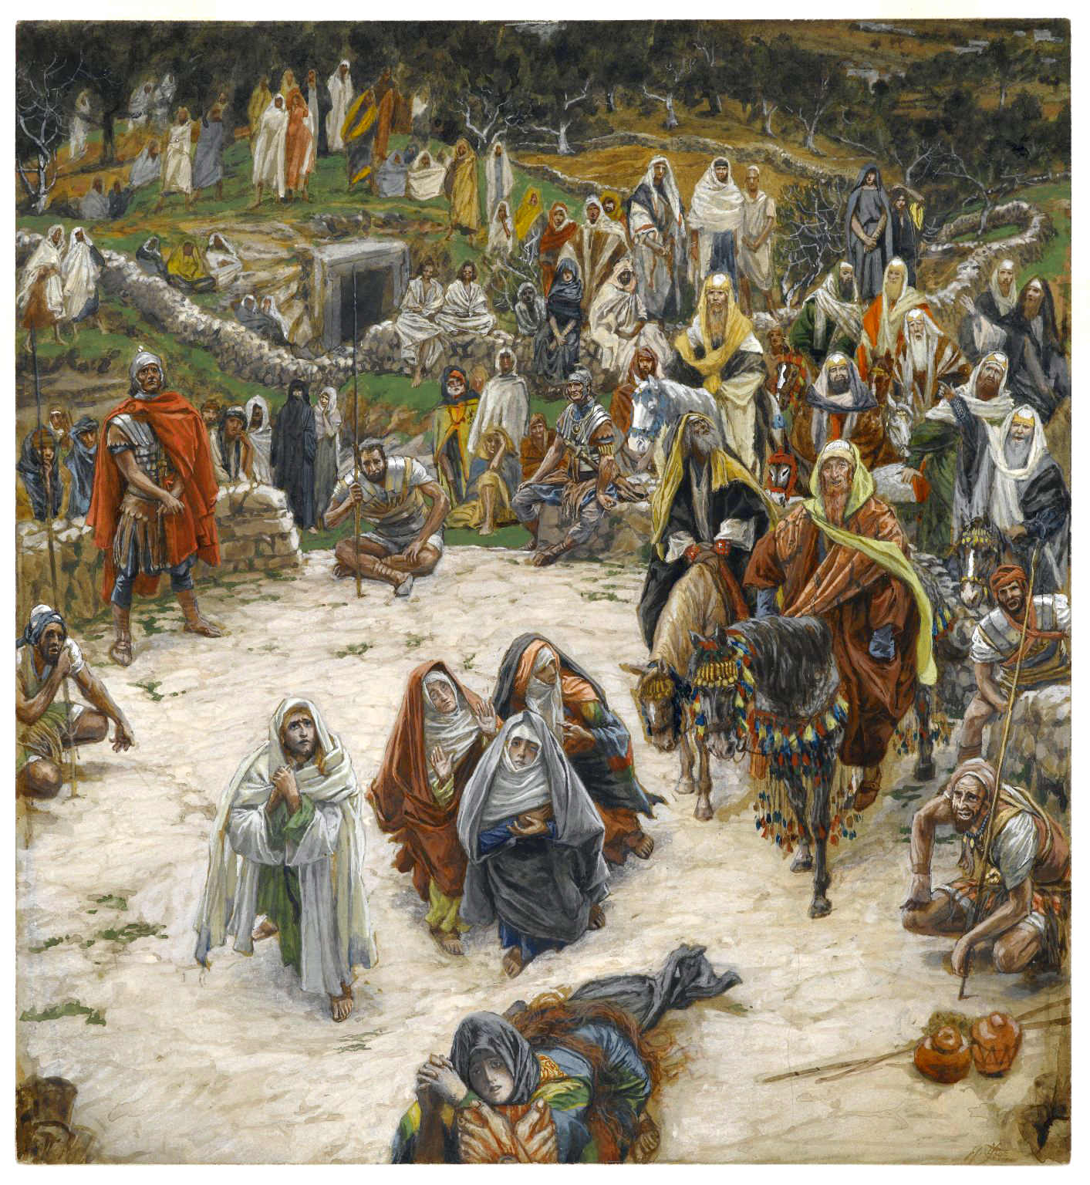

Slide 4
Seven Wondrous Statements
“Father, forgive them, for they know not what they do” (Luke 23:34).
“Truly, I say to you, today you will be with me in Paradise” (Luke 23:43).
“Woman, behold your son!”; “Behold, your mother!” (John 19:26, 27)
“My God, my God, why have you forsaken me?” (Matt. 27:46; Mark 15:34)
“I thirst” (John 19:28).
“It is finished” (John 19:30).
“Father, into your hands I commit my spirit!” (Luke 23:46)

