Slide 2
What Does She Want From Me Anyway?

Slide 3
What Does She Want?
Know What She Needs
Wants & Needs Are Different
3 Things Your Wife Needs
To Feel Secure
To Feel Valued
To Feel Connected
?

Slide 4
What Does She Need?
Men Are Going To Discover That Their Wives Are Driven To Experience Security!
Physical Security
Financial Security
Social Security
Emotional Security

Slide 5
“Emotional Safety Is The Key That Unlocks A Woman’s Heart And Soul”
Barbara DeAngelis

Slide 6
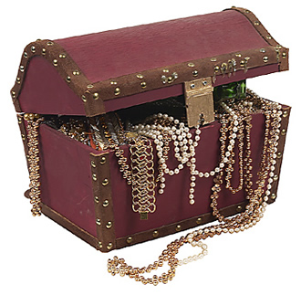
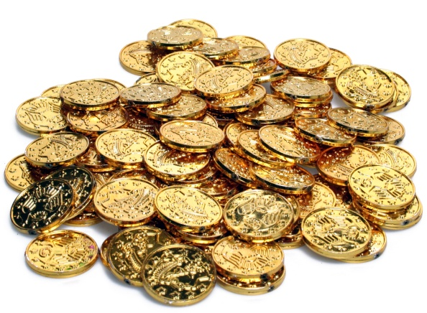
What Makes Her Feel Safe ?
When We Spend Time With Her
When We Allow Entry Into Our World
When We Reassure Her Of Our Love
Am I More Valuable To You Than Anything Else In Your Life?

Slide 7
What Makes Her Feel Safe ?
When We Spend Time With Her
When We Allow Entry Into Our World
When We Reassure Her Of Our Love
She Feels Safest When She Knows That We Value Her Greatly!

Slide 8
Supplying Her Needs
How To Make Her Feel Valued
Four Secrets To Making Her Feel Valued
Show her That her Happiness is a priority to you
Show Interest in her life
Show her you Need her and value her Input
Show her that you don’t Take her for Granted

Slide 9
Demonstrate With Actions And Express With Words

Slide 10
Supplying Her Needs
Kindle The Flame Of Romance
3 Things That Kindle Your Wife’s Fire
Physical Affection
Receiving Compliments
Scheduling Time Specifically For Her

