Slide 1
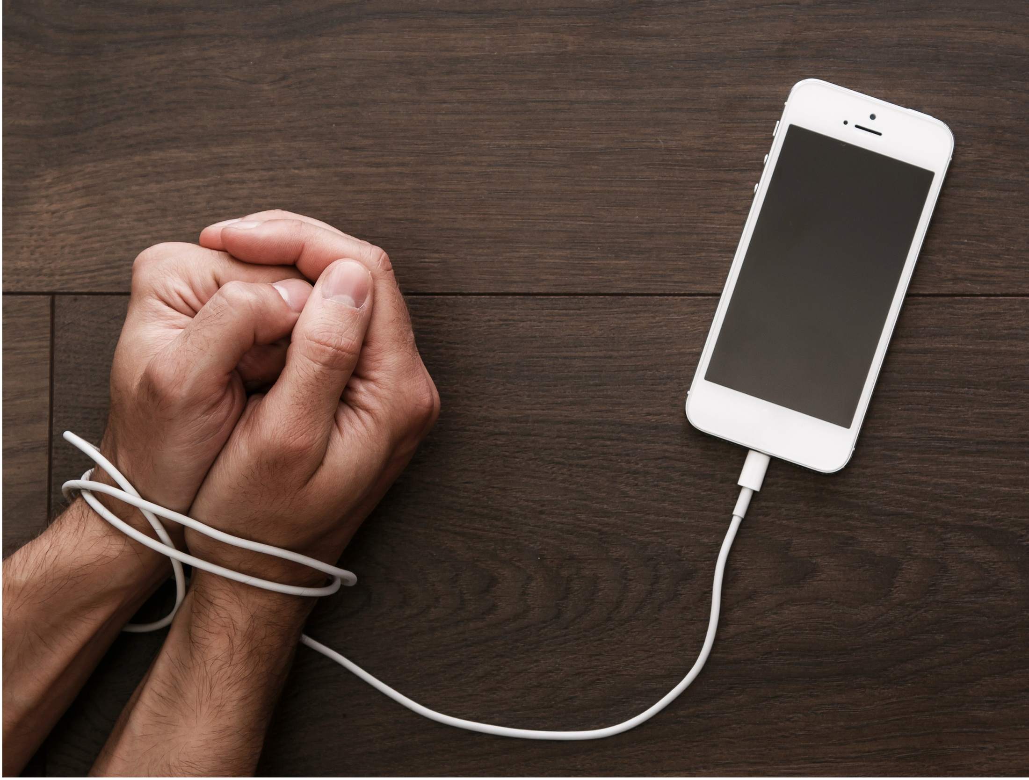
Addiction
Northwood church of Christ
2/19/2017
Source: pamlilak.com

Slide 2
Outline
Identify the problem
What is addiction
Why does addiction happen
Identify solutions
How to know if you are addicted
How we can fight addiction
1 Corinthians 6:12
All things are lawful for me, but all things are not helpful. All things are lawful for me, but I will not be brought under the power of any.

Slide 3
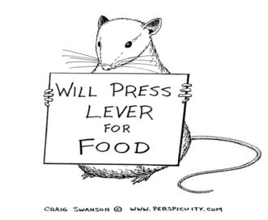
Defining Addiction
A good thing gone bad
Most behavior is “conditioned”
Seeking rewards, avoiding punishment (operant)
Learned pairings between unrelated things (classical)

Slide 4
Defining Addiction
Especially applies to technology
Apps, games, phones themselves exploit our natural tendencies
We even call them “addicting” as a good thing!
“Fight the new drug” – comparing pornography to drugs

Slide 5
Becoming Addicted
We become “addicted” faster when things are unpredictable
Rewards often become harder to find
“slot machine” strategy
“the first hit is free”
Questions to ask ourselves
What has this behavior cost me?
Do I want to stop?
How much time to I spend engaged in this activity?
Have I tried and failed to stop?

Slide 6
What to do to make a change
Matthew 26:41
Watch and pray, lest you enter into temptation. The spirit indeed is willing, but the flesh is weak.”
Be proactive
Set barriers when you are strong
Phone on silent across the room
Internet filters
No chocolate in the house
Remind yourself why you are changing
God, spouse, family, health, etc. is more important
Be extreme when necessary – Matthew 5:29-30

Slide 7
What to do to make change
Do not overestimate your strength
Set yourself up to succeed, not fail. – Ephesians 5:18
“If you hang around a barber shop long enough, sooner or later you're gonna get a haircut.” (also 1 Corinthian 15:33)
Forgive yourself
I’ve already come this far, might as well keep going.
I already messed up this much, so what is a little more?
Everyone is already going to be disappointed, I should at least enjoy myself
At least I can stop before I go farther.
I’m happy I realized what I was doing before things got worse.
Everyone is going to be disappointed in what I did, but at least I can do better next time.

Slide 8
Conclusion
1 Corinthians 10:13
No temptation has overtaken you except such as is common to man; but God is faithful, who will not allow you to be tempted beyond what you are able, but with the temptation will also make the way of escape, that you may be able to bear it.
You never have to sin, even when “addicted”.
By learning about how we behave, examining ourselves, and making changes, we can keep God as the sole “master” over us.

