Slide 1
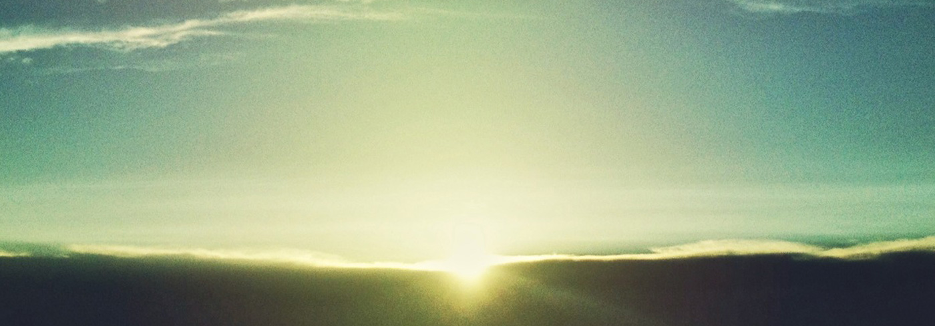
THE HOLY ONE OF ISRAEL

Slide 2
The definition of God’s holiness
The demands of God’s holiness

Slide 3
The definition of God’s holiness

Slide 4
Isaiah 6
1 In the year that King Uzziah died I saw the Lord sitting upon a throne, high and lifted up; and the train of his robe filled the temple. 2 Above him stood the seraphim. Each had six wings: with two he covered his face, and with two he covered his feet, and with two he flew. 3 And one called to another and said:
“Holy, holy, holy is the LORD of hosts;
the whole earth is full of his glory!”

Slide 5
Isaiah 6
1 In the year that King Uzziah died I saw the Lord sitting upon a throne, high and lifted up; and the train of his robe filled the temple. 2 Above him stood the seraphim. Each had six wings: with two he covered his face, and with two he covered his feet, and with two he flew. 3 And one called to another and said:
“Holy, holy, holy is the LORD of hosts;
the whole earth is full of his glory!”

Slide 6
Isaiah 6
1 In the year that King Uzziah died I saw the Lord sitting upon a throne, high and lifted up; and the train of his robe filled the temple. 2 Above him stood the seraphim. Each had six wings: with two he covered his face, and with two he covered his feet, and with two he flew. 3 And one called to another and said:
“Holy, holy, holy is the LORD of hosts;
the whole earth is full of his glory!”

Slide 7
Isaiah 5
16 But the LORD of hosts is exalted in justice,
and the Holy God shows himself holy in righteousness.

Slide 8
Isaiah 17
7 In that day man will look to his Maker, and his eyes will look on the Holy One of Israel. 8 He will not look to the altars, the work of his hands, and he will not look on what his own fingers have made, either the Asherim or the altars of incense.

Slide 9
Isaiah 17
7 In that day man will look to his Maker, and his eyes will look on the Holy One of Israel. 8 He will not look to the altars, the work of his hands, and he will not look on what his own fingers have made, either the Asherim or the altars of incense.

Slide 10
Isaiah 17
7 In that day man will look to his Maker, and his eyes will look on the Holy One of Israel. 8 He will not look to the altars, the work of his hands, and he will not look on what his own fingers have made, either the Asherim or the altars of incense.

Slide 11
The demands of God’s holiness

Slide 12
Isaiah 10
20 In that day the remnant of Israel and the survivors of the house of Jacob will no more lean on him who struck them, but will lean on the LORD, the Holy One of Israel, in truth.

Slide 13
Isaiah 30
15 For thus said the Lord GOD, the Holy One of Israel,
“In returning and rest you shall be saved;
In quietness and in trust shall be your strength.”

Slide 14
Isaiah 30
15 For thus said the Lord GOD, the Holy One of Israel,
“In returning and rest you shall be saved;
In quietness and in trust shall be your strength.”

Slide 15
Isaiah 30
15 For thus said the Lord GOD, the Holy One of Israel,
“In returning and rest you shall be saved;
In quietness and in trust shall be your strength.”

Slide 16
Isaiah 12
6 “Shout, and sing for joy, O inhabitant of Zion,
for great in your midst is the Holy One of Israel.”

Slide 17
Isaiah 29
19 The meek shall obtain fresh joy in the LORD,
and the poor among mankind shall exult in the Holy One of Israel.

Slide 18
Isaiah 29:23-24
“For when he sees his children,
the work of my hands, in his midst,
they will sanctify my name;
they will sanctify the Holy One of Jacob
and will stand in awe of the God of Israel.
And those who go astray in spirit will
come to understanding,
and those who murmur will accept instruction.”

