Slide 1
A SERMON SERIES THROUGH THE BOOK OF EPHESIANS

Slide 3
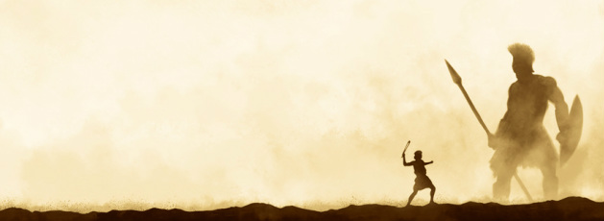
All life is war.

Slide 4
Ephesians 6
16 In all circumstance take up the shield of faith…

Slide 5
Ephesians 6
18 To that end, keep alert with all perseverance…

Slide 6
This war is against super-natural forces of evil.

Slide 7
Ephesians 6
12 For we do not wrestle against flesh and blood, but against the rulers, against the authorities, against the cosmic powers over this present darkness, against the spiritual forces of evil in the heavenly places.

Slide 8
Ephesians 6
12 For we do not wrestle against flesh and blood, but against the rulers, against the authorities, against the cosmic powers over this present darkness, against the spiritual forces of evil in the heavenly places.

Slide 9
Ephesians 6
12 For we do not wrestle against flesh and blood, but against the rulers, against the authorities, against the cosmic powers over this present darkness, against the spiritual forces of evil in the heavenly places.

Slide 10
There is a danger of falling in this battle.

Slide 11
Ephesians 6
13 Therefore take up the whole armor of God, that you may be able to withstand in the evil day, and having done all, to stand firm. 14 Stand therefore…

Slide 12
Ephesians 6
13 Therefore take up the whole armor of God, that you may be able to withstand in the evil day, and having done all, to stand firm. 14 Stand therefore…

Slide 13
Ephesians 6
13 Therefore take up the whole armor of God, that you may be able to withstand in the evil day, and having done all, to stand firm. 14 Stand therefore…

Slide 14
Ephesians 6
13 Therefore take up the whole armor of God, that you may be able to withstand in the evil day, and having done all, to stand firm. 14 Stand therefore…

Slide 15
God has supplied all we need for victory.

Slide 16
Ephesians 6
10 Finally, be strong in the Lord and in the strength of his might.

Slide 17
We must use the resources God supplies.

Slide 18
Ephesians 6
11 Put on the whole armor of God, that you may be able to stand against the schemes of the devil.

Slide 19
There is strength in numbers.

Slide 20
Ephesians 6
18 To that end, keep alert with all perseverance, making supplication for all the sants…

Slide 21
Evangelism is an integral part of spiritual warfare.

Slide 22
Ephesians 6
15 and, as shoes for your feet, having put on the readiness given by the gospel of peace.

Slide 23
Wake up! This is war!
Put on your armor!
Help your brothers and sisters!
Preach the gospel!

