Slide 1
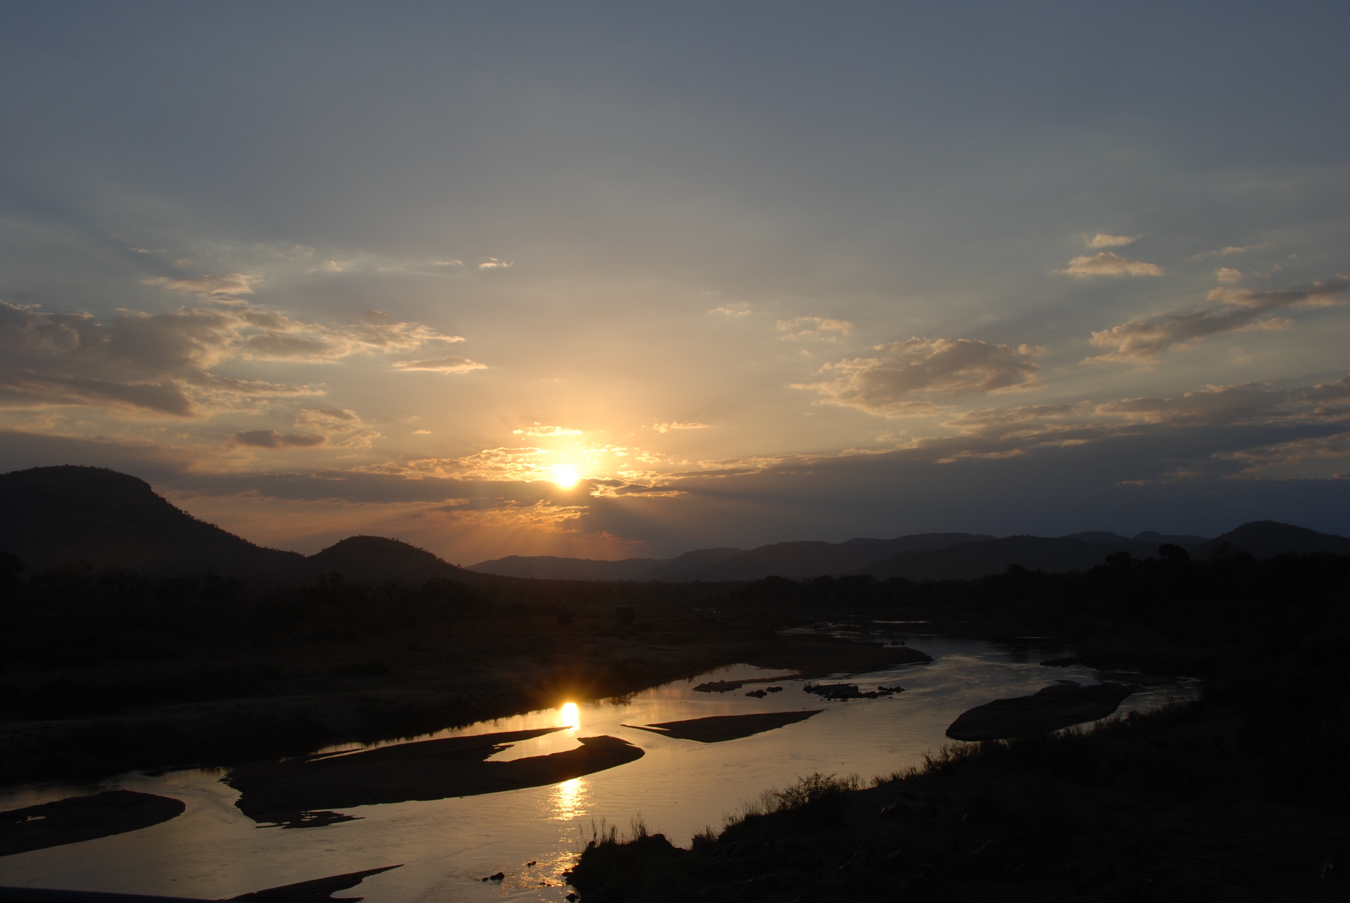
RELENTLESS
GRACE

Slide 2
7 Our fathers, when they were in Egypt,
did not consider your wondrous works;
they did not remember the abundance of your steadfast love,
but rebelled by the sea, at the Red Sea.

Slide 3
13 But they soon forgot his works;
they did not wait for his counsel.
14 But they had a wanton craving in the wilderness,
and put God to the test in the desert;
15 he gave them what they asked,
but sent a wasting disease among them.

Slide 4
19 They made a calf in Horeb
and worshiped a metal image.
20 They exchanged the glory of God
for the image of an ox that eats grass.
21 They forgot God, their Savior,
who had done great things in Egypt,
22 wondrous works in the land of Ham,
and awesome deeds by the Red Sea.

Slide 5
24 Then they despised the pleasant land,
having no faith in his promise.
25 They murmured in their tents,
and did not obey the voice of the Lord.

Slide 6
28 Then they yoked themselves to the Baal of Peor,
and ate sacrifices offered to the dead;
29 they provoked the Lord to anger with their deeds,
and a plague broke out among them.

Slide 7
32 They angered him at the waters of Meribah,
and it went ill with Moses on their account,
33 for they made his spirit bitter,
and he spoke rashly with his lips.

Slide 8
39 Thus they became unclean by their acts,
and played the whore in their deeds.
40 Then the anger of the Lord was kindled against his people,
and he abhorred his heritage

Slide 9
8 Yet he saved them for his name's sake,
that he might make known his mighty power.
9 He rebuked the Red Sea, and it became dry,
and he led them through the deep as through a desert.
10 So he saved them from the hand of the foe
and redeemed them from the power of the enemy.

Slide 10
43 Many times he delivered them,
but they were rebellious in their purposes
and were brought low through their iniquity.

Slide 11
44 Nevertheless, he looked upon their distress,
when he heard their cry.
45 For their sake he remembered his covenant,
and relented according to the abundance of his steadfast love.
46 He caused them to be pitied
by all those who held them captive.

Slide 12
1 Praise the Lord!
Oh give thanks to the Lord, for he is good,
for his steadfast love endures forever!

Slide 13
3 Blessed are they who observe justice,
who do righteousness at all times!

Slide 14
4 Remember me, O Lord, when you show favor to your people;
help me when you save them,
5 that I may look upon the prosperity of your chosen ones,
that I may rejoice in the gladness of your nation,
that I may glory with your inheritance.

