Slide 2
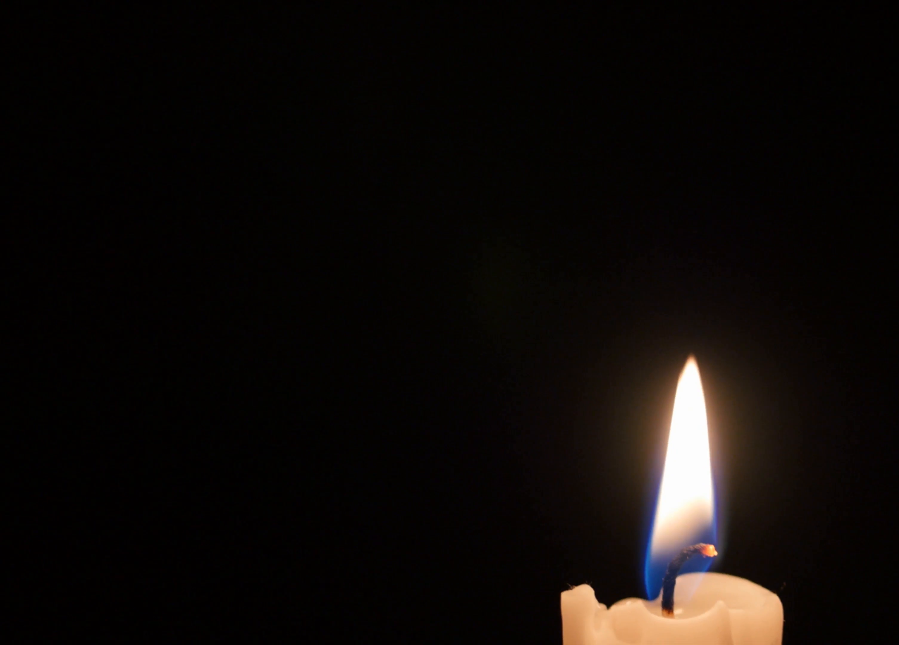
Meekness
Overcoming Evil with Good

Slide 3
“Tame, timid, mild, bland, unambitious, retiring, docile, acquiescent, repressed, suppressed, spiritless, broken, wimpish”
(Reader’s Digest Oxford Complete Word Finder)

Slide 4
“…the ability to bear reproaches and slights with moderation, and not to embark on revenge quickly, and not to be easily provoked to anger, but to be free from bitterness and contentiousness, having tranquility and stability in the spirit.”
(Aristotle)

Slide 5
“…on the right grounds, and against the right persons, and in the right manner, and at the right moment, and for the right length of time.”
(Aristotle)

Slide 6
Examples of Meekness
Moses (Num 12)
Paul (2 Tim 2:24-25)
Jesus (2 Cor 10:1; Matt 11:29)

Slide 7
Refuse to be their enemy.
Do not be overcome by evil... Romans 12:21

Slide 8
Change the label.
…so we, though many, are one body in Christ, and individually members one of another. Romans 12:5

Slide 9
Seek first to understand, then to be understood.
Never be wise in your own sight. Romans 12:16

Slide 10
Change your feelings, not just your behavior.
Rejoice with those who rejoice, weep with those who weep. Romans 12:15

Slide 11
Defend them in private.
Outdo one another in showing honor. Romans 12:10

Slide 12
Take the high road.
Repay no one evil for evil, but give thought to do what is honorable in the sight of all. Romans 12:17

Slide 13
Don’t forget who you used to be.
I appeal to you, therefore, brothers by the mercies of God… Romans 12:1

Slide 14
Overwhelm them with kindness.
Do not be overcome by evil, but overcome evil with good. Romans 12:21

Slide 15
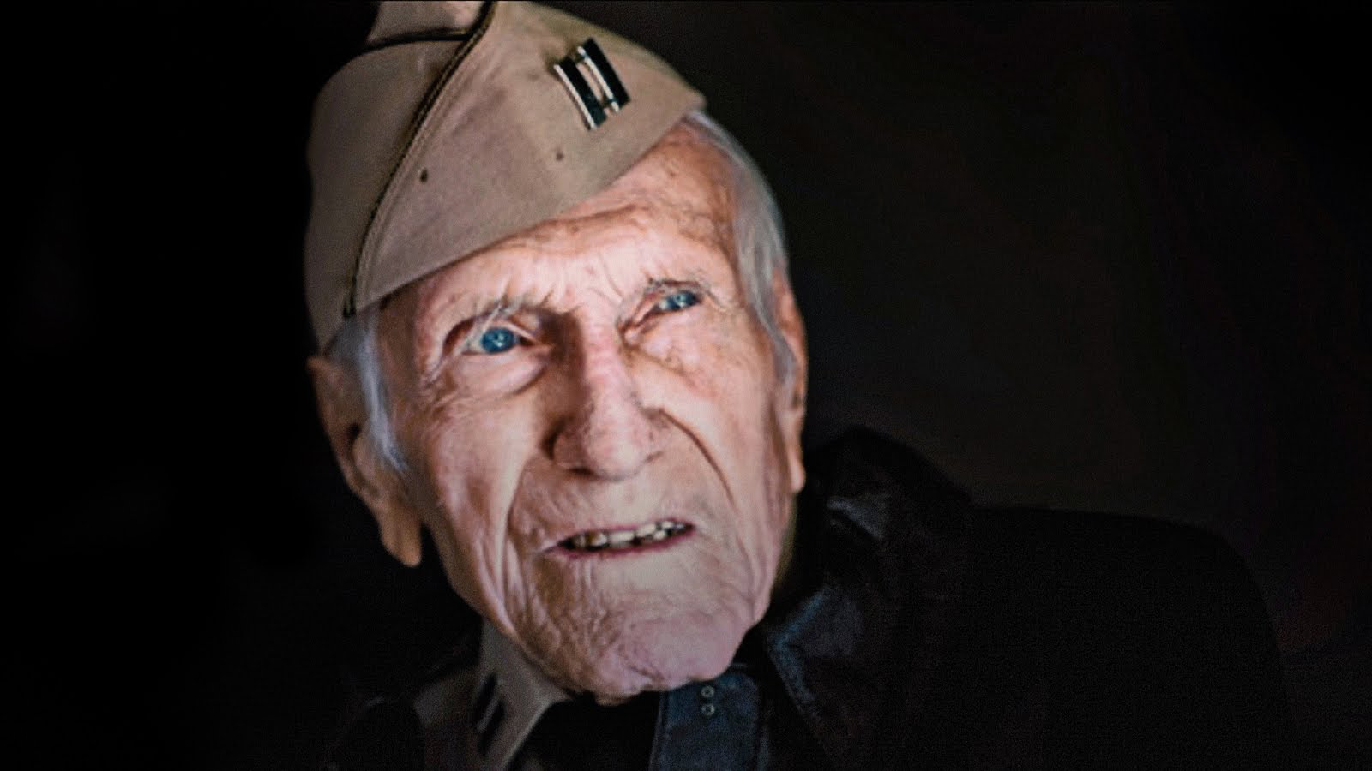
“I think the hardest thing in life is to forgive. Hate is self destructive. If you hate somebody, you’re not hurting the person you hate, you’re hurting yourself. It’s a healing, actually, it’s a real healing… forgiveness.”

