Slide 1
The Gospel of Mark

Slide 3
Mark 12:10-11
“Have you not read this Scripture: ‘The stone that the builders rejected has become the cornerstone; this was the Lord’s doing, and it is marvelous in our eyes’?”

Slide 5
Mark 12:17
“Render to Caesar the things that are Caesar’s, and to God the things that are God’s.”

Slide 6
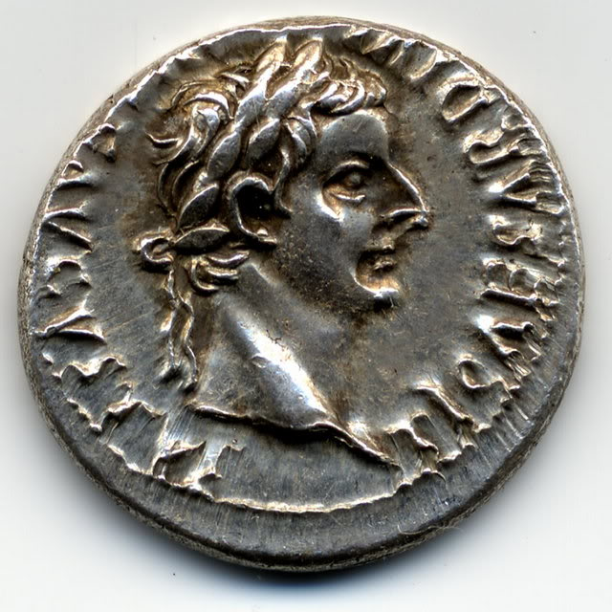

Slide 8
Mark 12:26-27
“And as for the dead being raised, have you not read in the book of Moses, in the passage about the bush, how God spoke to him, saying, ‘I am the God of Abraham, and the God of Isaac, and the God of Jacob’? He is not God of the dead, but of the living. You are quite wrong.”

Slide 10
Mark 12:29-31
“The most important is, ‘Hear, O Israel: The Lord our God, the Lord is one. And you shall love the Lord your God with all your heart and with all your soul and with all your mind and with all your strength.’ The second is this: ‘You shall love your neighbor as yourself.’ There is no other commandment greater than these.”

Slide 12
Mark 12:43-44
“Truly, I say to you, this poor widow has put in more than all those who are contributing to the offering box. For they all contributed out of their abundance, but she out of her poverty has put in everything she had, all she had to live on.”

Slide 13
Am I honest?
Am I sincere?
Have I fully surrendered?

