Slide 1
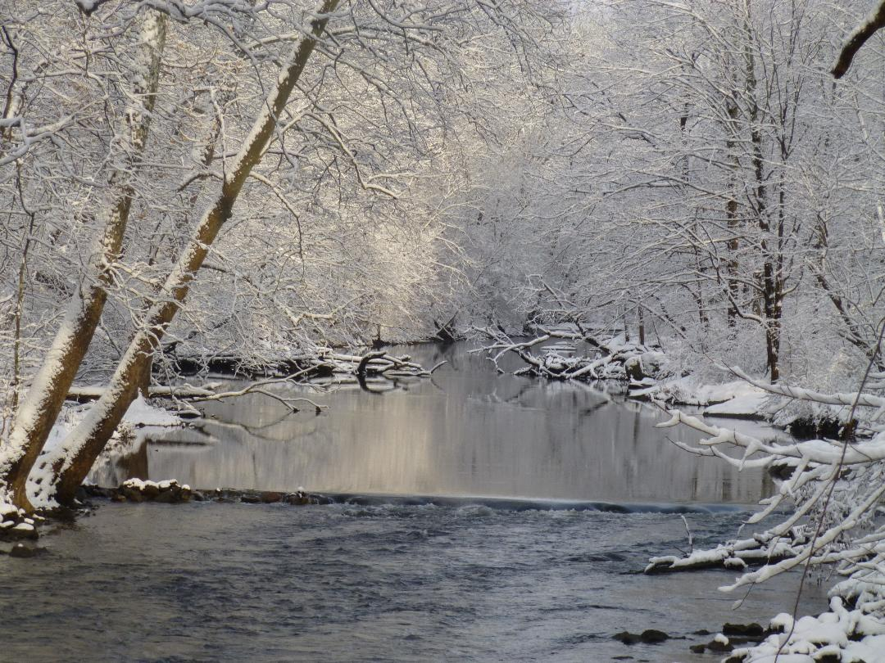
Winter
Inevitable Genesis 8:22

Slide 2
Time to Enjoy the Fruit of Our Labor
Harvest Precious Memories of Life in the Lord.
Retirement—freedom
Less responsibility
Family
“Children’s children are the crown of old men.” (Proverbs 17:6)
Observing Christians we have seen grow to maturity
“my beloved and longed- for brethren, my joy and crown” (Philippians 4:1)
But it’s not all pleasant!

Slide 3
Ecclesiastes 12 Picture of Aging
“the sun and the light, the moon and the stars are darkened”
“clouds return after the rain;”
“the watchmen of the house tremble”
“mighty men stoop”
“the grinding ones stand idle because they are few”
“those who look through windows grow dim”
“When the doors are shut in the streets,”
“sound of the grinding mill is low”
Dull impressions
Sickness that returns after improving
Hands tremble
Legs are weakened or back bent
Teeth are few
Eyes failing
Doors once open are now closed
Hearing fails

Slide 4
Ecclesiastes 12 Picture of Aging
“one will arise at the sound of the bird”
“the daughters of song will sing softly” (or “are brought low”)
“afraid of a high place and of terrors on the road”
“the almond tree blossoms”
“grasshopper drags himself along”
“silver cord is broken and the golden bowl is crushed”
“wheel at the cistern is crushed” (or broken”)
“man goes to his eternal home while mourners go about in the street”
Either wake up early or frightened even by bird’ song
Voice cracks
Fear of falling
Gray hairs
Crippled
\Cord that holds body & soul or cord that binds us to family, life
Heart ceases to function
Death

Slide 5
Burdens of Aging (provided by class)
Being dependent on others for care and financial resources (7)
Fear of dementia, Alzheimer’s, etc. (7)
Physical deterioration and loss of strength (6)
Death of family and friends (4)
Loneliness (4)
Responsibility of making decisions alone (2)
Fear of Irrelevance Uncertain about ability to provide benefits to others and even to participate as a peer (1)
Concern about how my death will affect family (1)
Inability to do what we once did (1)
Not being useful in the Lord’s work (1)
Inability to sleep (1)
Pain (1)

Slide 6
How are we to cope with all of this?

Slide 7
Unworthy Ways of Coping
Constant complaining
Alcohol and illegal drugs
Misuse of prescribed drugs.
Giving up on life because “I’m just too old.”
Some of the greatest accomplishments in history have been achieved by individuals over 80.
How old is old?

Slide 8
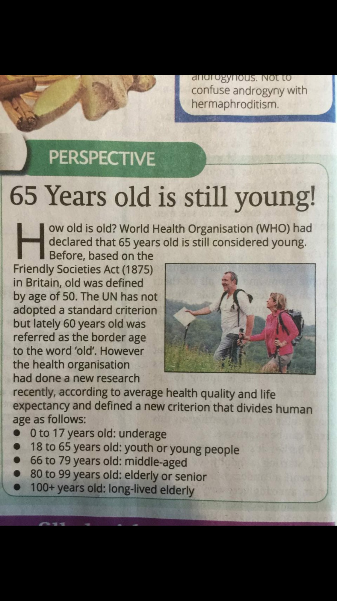
Mind over Matter
“If you don’t mind, it doesn’t matter.”

Slide 9
Golden Text for Seniors: 2 Corinthians 4:16-18
¹⁶ Therefore we do not lose heart. Even though our outward man is perishing, yet the inward man is being renewed day by day. ¹⁷ For our light affliction, which is but for a moment, is working for us a far more exceeding and eternal weight of glory, ¹⁸ while we do not look at the things which are seen, but at the things which are not seen. For the things which are seen are temporary, but the things which are not seen are eternal.

Slide 10
We are Dual Beings
Our Complaints Involve the Outward Man!
^{Genesis 2:7} And the Lord God formed man of the dust of the ground, and breathed into his nostrils the breath of life; and man became a living being.
^{Eccl. 12:7} Then the dust will return to the earth as it was, And the spirit will return to God who gave it.
“Therefore we do not lose heart.
Even though our outward man is perishing, yet the inward man is being renewed day by day.”
The solution: Concentrate on the Inward man.

Slide 11
On a scale of 1-10 how would you rate the health of your—
OUTWARD MAN? 3? 5? 8?
Whatever it is, it will decline to 0!
INWARD MAN? 3? 5? 8?
Whatever it is, it can be raised!
When someone asks “How are you?” which health do you report? Inner or Outer?
^{3 John 2 “}Beloved, I pray that you may prosper in all things and be in health, just as your soul prospers.”
Would this be good or bad for you?

Slide 12
Winter
Offers some valuable opportunities.

Slide 13
Some new activities possible for those who are older
What then? Shall we sit idly down and say,
The night hath come; it is no longer day?
The night hath not yet come; we are not quite
Cut off from labor by the failing light;
Something remains for us to do or dare;
Even the oldest tree some fruit may bear.
-. . . . . . . . .
For age is opportunity no less
Than youth itself, though in another dress.
And as the evening twilight fades away
The sky is filled with stars, invisible by day.
-- Longfellow

Slide 14
Some activities possible for those who are older
Put past experience to work for the Lord as Moses did at 80.
Undertake to take a mountain as Caleb did and get help if needed.
As a loving father/mother- in-law be a saving influence as Naomi.
Help the next generation do what you couldn’t do as David did.
Read scripture, understand it, share it and PRAY as Daniel did.
Pray “night and day” and tell others of Jesus as Anna did.
Mentor others and prepare them for the future as Paul did Timothy.

Slide 15
Some activities now possible for those who are older
Serve as an Elder, Deacon
Time to read scripture
Time to pray
Time to read good books.
Time to listen to good sermons on Internet
Time to make visits
Time to write letters
Time to send cards
Time to make phone calls
Watch some active Senior for an Example.

Slide 16
But whatever good we may see in
Winter
We all look forward to
Spring

Slide 17
For the Christian There is something after Winter!
“Jesus said…, ‘I am the resurrection and the life. He who believes in Me, though he may die, he shall live. ²⁶ And whoever lives and believes in Me shall never die. Do you believe this?.” (John 11:25-26)
“For the things which are seen [the outward man] are temporary,
but the things which are not seen [the inward man]
are eternal.”

Slide 18
Winter vs. Spring
“Our light
affliction,
“which is but for a moment,
Far more exceeding Weight
Glory
Eternal
“is working for us a far more exceeding and eternal weight of glory”.
“For I consider that the sufferings of this present time are not worthy to be compared with the glory which shall be revealed in us.” (Rom. 8:18)

Slide 19
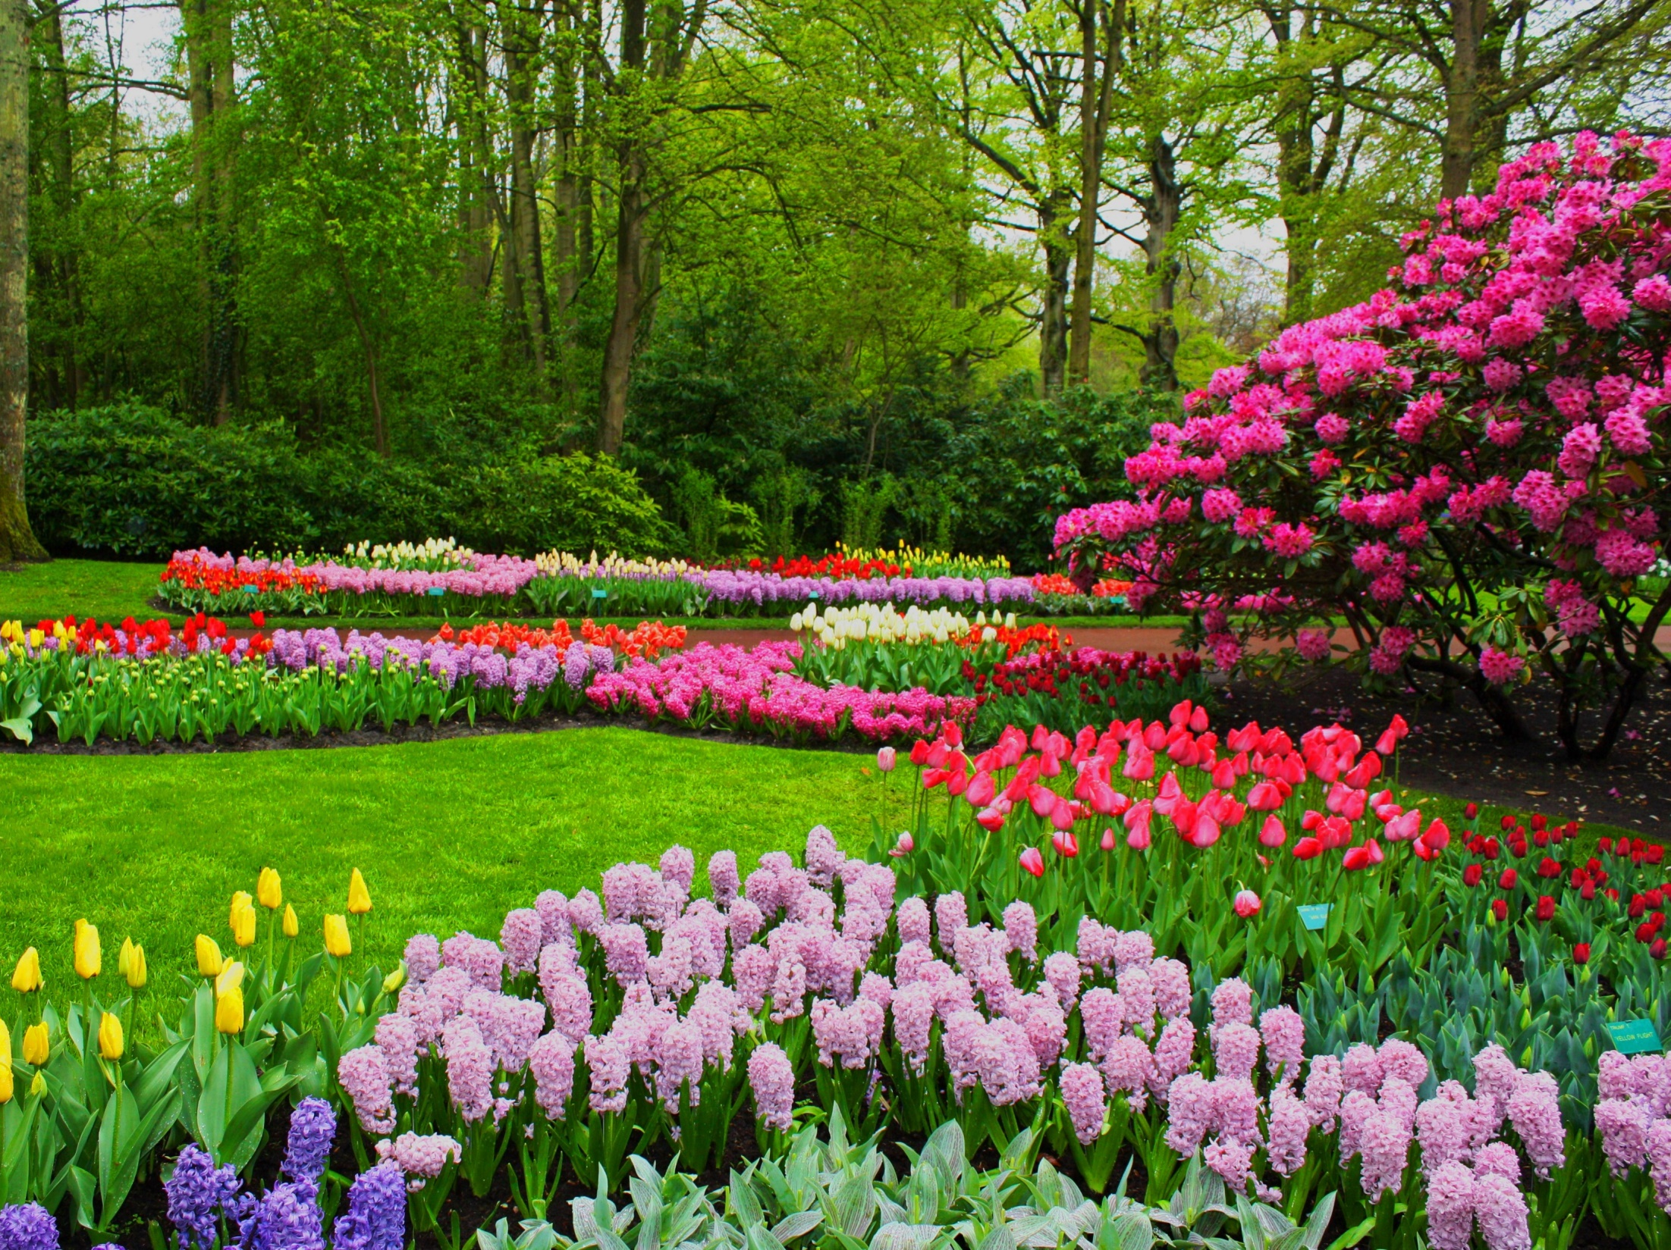
Come Spring!
“When He is revealed, we shall be like Him, for we shall see Him as He is.” 1 John 3:3

Slide 20
One Sweetly Solemn Thought
One sweetly solemn thought comes to me o’er an o’er: Today I’m nearer to my home Than e’er I’ve been before.
Nearer my Father’s house, where many mansions be; And nearer to the great white throne, Nearer the Crystal Sea.
Nearer the bound of life, where falls my burden down; Nearer to where I leave my cross; And where I gain my crown.
Savior, confirm my trust, Complete my faith in Thee; And let me feel as if I stood Close to Eternity.
Feel as if now my feet were slipping o’er the brink; For I may now be nearer home, Much nearer than I think. -- Phoebe Cary

