Slide 1
The Book of Daniel

Slide 2
“And your house and your kingdom shall be made sure forever before me. Your throne shall be established forever.” 2 Samuel 7:16
931 BC
722 BC
Northern Kingdom:
ISRAEL
586 BC
597 BC
Saul
David
Solomon
605 BC
Southern Kingdom:
JUDAH

Slide 3
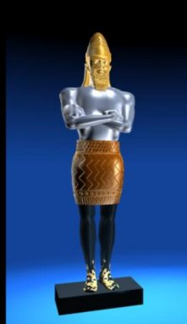
1 2 3 4 5 6 7 8 9 10 11 12
The Book of Daniel
Four empires will rise & fall before the everlasting kingdom.
2
3
4
5
6
7
God rescues & exalts those who are faithful.
Babylonian
Medo-Persian
Grecian
Roman
Aramaic
God humbles the proud.
Fiery Furnace
Lion’s Den
Nebuchad-nezzar
Belshazzar
2
3
4
5
6
7

Slide 4
The Eternal Kingdom

Slide 5
Daniel 2:1
Nebuchadnezzar had dreams; his spirit was troubled, and his sleep left him.

Slide 6
Daniel 2:10-11
There is not a man on earth who can meet the king’s demand… no one can show it to the king except the gods, whose dwelling is not with flesh.

Slide 7
Daniel 2:27-28
“No wise men, enchanters, magicians, or astrologers can show to the king the mystery that the king has asked, but there is a god in heaven who reveals mysteries…”

Slide 8
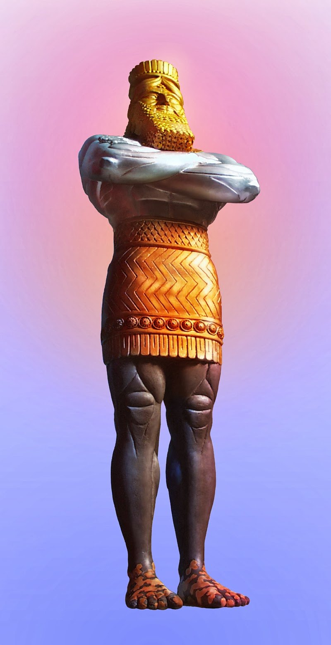
Babylonian
Medo-Persian
Grecian
Roman

Slide 9
Four kingdoms, v 35 | Kingdom of God, v 44-45
Broken in pieces | Shall never be destroyed
Became like chaff | Break in pieces these kingdoms
Not a trace could be found | Shall stand forever

Slide 10
Daniel 2:37
“You, O king, the king of kings, to whom the God of heaven has given the kingdom, the power, and the might, and the glory…”

Slide 11
Daniel 2:38
“…and into whose hand he has given, wherever they dwell, the children of man…”

Slide 12
Daniel 2:34
“And as you looked, a stone was cut out by no human hand…”

Slide 13
Daniel 2:38
“And in the days of those kings the God of heaven will set up a kingdom that shall never be destroyed…”

Slide 14
2 Samuel 7:13
“He shall build a house for my name, and I will establish the throne of his kingdom forever.”

Slide 15
Matthew 1:1
The book of the genealogy of Jesus Christ, the son of David…

Slide 16
Luke 1:32-33
“…the Lord God will give to him the throne of his father David, and he will reign over the house of Jacob forever, and of his kingdom there will be no end.”

Slide 17
Seek God’s guidance, not man’s
Trust in God’s power, not man’s

