Slide 1
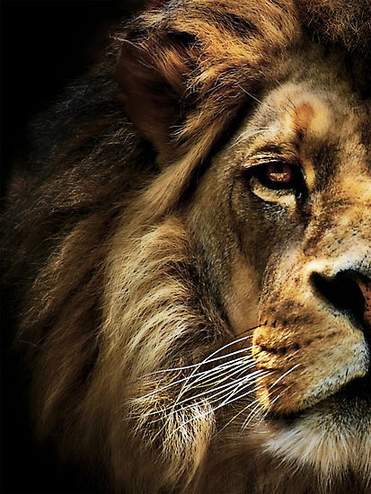
The Book of Daniel

Slide 2
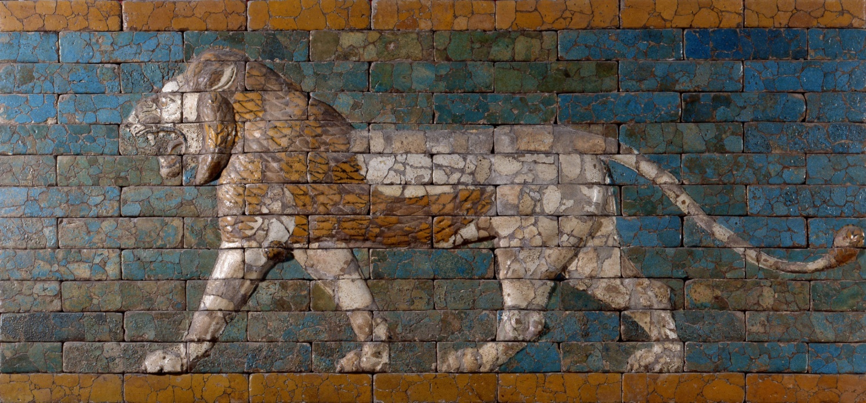
The Beasts

Slide 3
Daniel 7:4
“The first was like a lion and had eagles wings. Then as I looked its wings were plucked off, and it was lifted up from the ground and made to stand on two feet like a man, and the mind of a man was given to it.”

Slide 4
Daniel 7:5
“And behold, another beast, a second one, like a bear. It was raised up on one side. It had three ribs in its mouth between its teeth; and it was told, ‘Arise, devour much flesh.’”

Slide 5
Daniel 7:6
“After this I looked, and behold, another, like a leopard, with the four wings of a bird on its back. And the beast had four heads, and dominion was given to it.”

Slide 6
Daniel 7:7
“After this I saw in the night visions, and behold, a fourth beast, terrifying and dreadful and exceedingly strong. It had great iron teeth; it devoured and broke in pieces and stamped what was left with its feet. It was different from all the beasts that were before it, and it had ten horns.”

Slide 7
The Judgment of the Beasts

Slide 8
Daniel 7:9
“As I looked, thrones were placed, and the Ancient of Days took his seat his clothing was white as snow, and the hair of his head like pure wool; his throne was fiery flames; its wheels burning fire.”

Slide 9
Daniel 7:9
“As I looked, thrones were placed, and the Ancient of Days took his seat his clothing was white as snow, and the hair of his head like pure wool; his throne was fiery flames; its wheels burning fire.”

Slide 10
Daniel 7:10
“A stream of fire issued before him; a thousand thousands served him, and ten thousand times ten thousand stood before him; the court sat in judgment, and the books were opened.”

Slide 11
Daniel 7:11
“I looked then because of the sound of the great words that the horn was speaking. And as I looked, the beast was killed, and its body destroyed and given over to be destroyed with fire.”

Slide 12
Daniel 7:14
“I saw in the night visions, and behold, with the clouds of heaven there came one like a son of man, and he came to the Ancient of Days and was presented before him.”

Slide 13
Daniel 7:14
“And to him was given dominion and glory and a kingdom, that all peoples, nations, and languages should serve him; his dominion is an everlasting dominion, which shall not pass away, and his kingdom one that shall not be destoyed.”

Slide 14
The Saints Possess the Kingdom

Slide 15
Daniel 7:17-18
“‘These four great beasts are four kings who shall arise out of the earth. But the saints of the Most High shall receive the kingdom and possess the kingdom forever, forever and ever.’”

Slide 16
Daniel 7:21-22
“As I looked, this horn made war with the saints and prevailed over them, until the Ancient of Days came, and judgment was given for the saints of the Most High, and the time came when the saints possessed the kingdom.”

Slide 17
Daniel 7:27
“‘And the kingdom and the dominion and the greatness of the kingdoms under the whole heaven shall be given to the people of the saints of the Most High; his kingdom shall be an everlasting kingdom, and all dominions shall serve and obey him.’”

