Slide 1
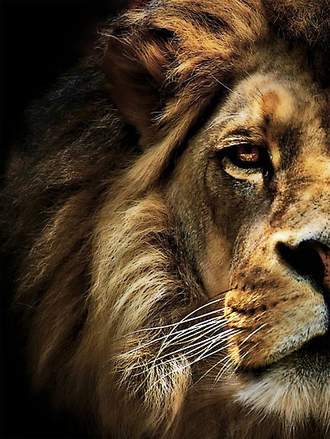
The Book of Daniel

Slide 2
Outline of Daniel
1 – Intro
2 – Four Empires
3 – Fiery Furnace
4 – Beast
5 – Fall of Bbln
6 – Lions’ Den
7 – Four Empires
8 – Medo-Persia & Greek Empires
9 – 70 Yrs & Weeks
10-12 – Jewish Destiny in Latter Days

Slide 3
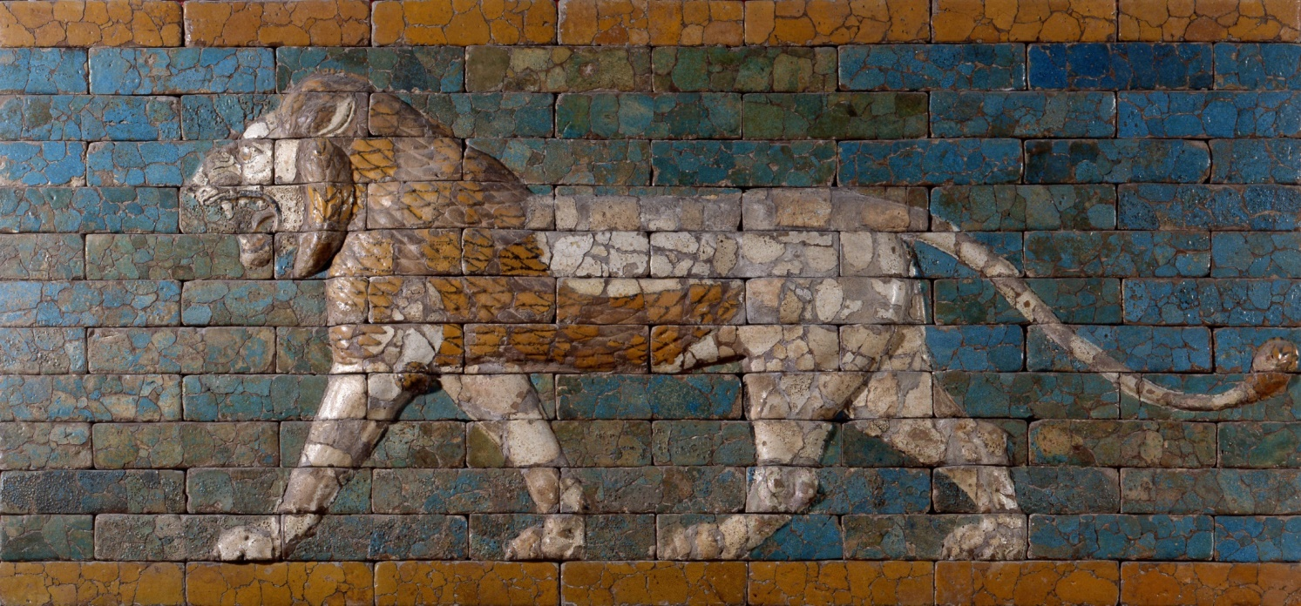
Daniel’s Terrifying Vision

Slide 4
Daniel 10:6
His body was like beryl, his face like the appearance of lighting, his eyes like flaming torches, his arms and legs like the gleam of burnished bronze, and the sound of his words like the sound of a multitude.

Slide 5
Prince of Persia & Greece

Slide 6
Daniel 10:12
Then he said to me, “Fear not, Daniel, for from the first day that you set your heart to understand and humbled yourself before your God, your words have been heard, and I have come because of your words.”

Slide 7
Daniel 10:12
“But now I will return to fight against the prince of Persia; and when I go out, behold, the prince of Greece will come.”

Slide 8
Antiochus Epiphanes

Slide 9
Daniel 11:21
“In his place shall arise a contemptible person to whom royal majesty has not been given. He shall come in without warning and obtain the kingdom by flatteries.”

Slide 10
Daniel 11:31
“Forces from him shall appear and profane the temple and fortress, and shall take away the regular burnt offering. And they shall set up the abomination that makes desolate.”

Slide 11
Daniel 11:36
“And the king shall do as he wills. He shall exalt himself and magnify himself above every god, and shall speak astonishing things against the God of gods.”

Slide 12
Resurrection Hope

Slide 13
Daniel 12:2
“And many of those who sleep in the dust of the earth shall awake, some to everlasting life, and some to shame and everlasting contempt.”

Slide 14
Trust that God is in control
Be faithful in the face of persecution
Don’t let Babylon define you

