Slide 1
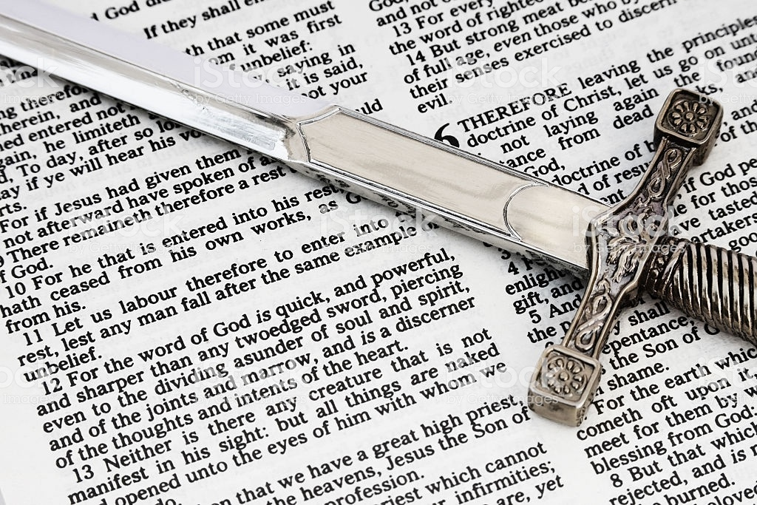
Hebrews 4:12

Slide 2
Cut to the Heart
Hebrews 4:12

Slide 3
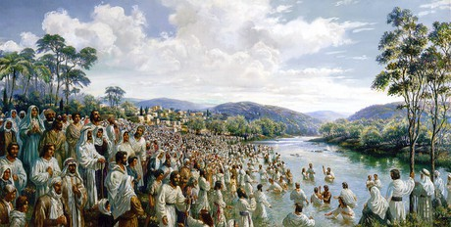
Cut to the Heart
Hebrews 4:12
Day of Pentecost — Acts 2
YOU KILLED YOUR KING!
WHAT SHALL WE DO?

Slide 4
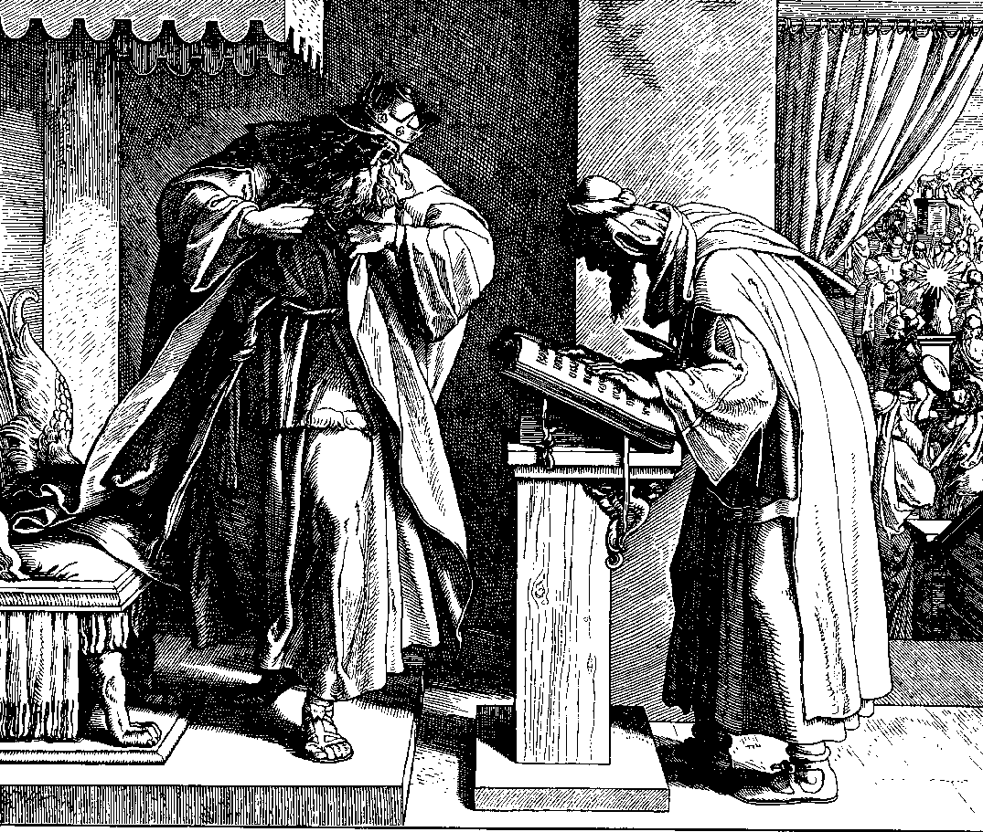
Cut to the Heart
Hebrews 4:12
JOSIAH — 2 Kings 22

Slide 5
Cut to the Heart
Hebrews 4:12
JOSIAH — 2 Kings 22
v8 ….“I’ve found the Book of the Law in the house of the Lord.”
v11 …he tore his clothes.
v19 …because your heart was tender…

Slide 6
Cut to the Heart
Hebrews 4:12
Psalm 51
16 For You do not desire sacrifice, or else I would give it;
You do not delight in burnt offering.
17 The sacrifices of God are a broken spirit,
A broken and a contrite heart—
These, O God, You will not despise.

Slide 7
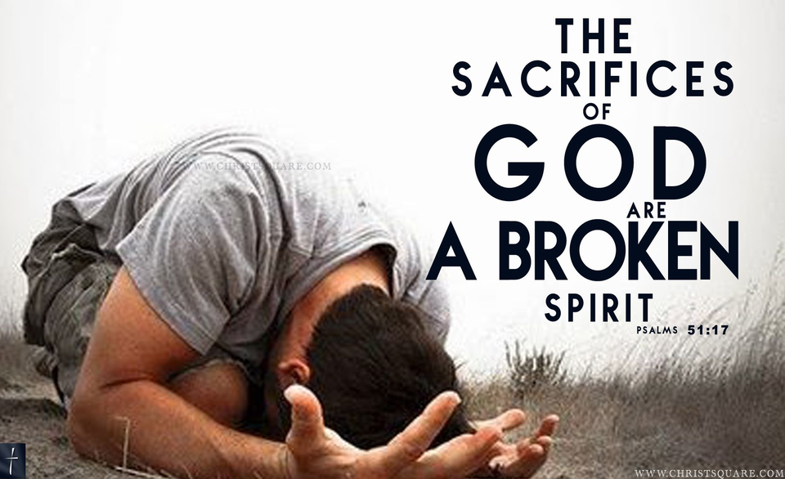
Cut to the Heart
Hebrews 4:12
Psalm 51

Slide 8
Cut to the Heart
Hebrews 4:12
Jeremiah 36 21-25
21 So the king sent Jehudi to bring the scroll, and he took it from Elishama the scribe’s chamber and Jehudi read it in the hearing of the king and in the hearing of all the princes who stood beside the king. 22 Now the king was sitting in the winter house in the ninth month, with a fire burning on the hearth before him. 23 And it happened, when Jehudi had read three or four columns, that the king cut it with the scribe’s knife and cast it into the fire that was on the hearth, until all the scroll was consumed in the fire that was on the hearth. 24 Yet they were not afraid, nor did they tear their garments, the king nor any of his servants who heard all these words. 25 Nevertheless Elnathan, Delaiah, and Gemariah implored the king not to burn the scroll; but he would not listen to them.

Slide 9
Cut to the Heart
Hebrews 4:12
Jeremiah 36 21-25
21 So the king sent Jehudi to bring the scroll, and he took it from Elishama the scribe’s chamber and Jehudi read it in the hearing of the king and in the hearing of all the princes who stood beside the king. 22 Now the king was sitting in the winter house in the ninth month, with a fire burning on the hearth before him. 23 And it happened, when Jehudi had read three or four columns, that the king cut it with the scribe’s knife and cast it into the fire that was on the hearth, until all the scroll was consumed in the fire that was on the hearth. 24 Yet they were not afraid, nor did they tear their garments, the king nor any of his servants who heard all these words. 25 Nevertheless Elnathan, Delaiah, and Gemariah implored the king not to burn the scroll; but he would not listen to them.

Slide 10
Cut to the Heart
Hebrews 4:12
Jeremiah 36 21-25

Slide 11
Cut to the Heart
Hebrews 4:12
Blade to the MESSENGER
Acts 7
54 When they heard these things they were cut to the heart, and they gnashed at him with their teeth. 55 But he, being full of the Holy Spirit, gazed into heaven and saw the glory of God, and Jesus standing at the right hand of God, 56 and said, “Look! I see the heavens opened and the Son of Man standing at the right hand of God!”
57 Then they cried out with a loud voice, stopped their ears, and ran at him with one accord; 58 and they cast him out of the city and stoned him. And the witnesses laid down their clothes at the feet of a young man named Saul. 59 And they stoned Stephen as he was calling on God and saying, “Lord Jesus, receive my spirit.” 60 Then he knelt down and cried out with a loud voice, “Lord, do not charge them with this sin.” And when he had said this, he fell asleep.

Slide 12
Cut to the Heart
Hebrews 4:12
Blade to the MESSENGER
Acts 7
54 When they heard these things they were cut to the heart, and they gnashed at him with their teeth. 55 But he, being full of the Holy Spirit, gazed into heaven and saw the glory of God, and Jesus standing at the right hand of God, 56 and said, “Look! I see the heavens opened and the Son of Man standing at the right hand of God!”
57 Then they cried out with a loud voice, stopped their ears, and ran at him with one accord; 58 and they cast him out of the city and stoned him. And the witnesses laid down their clothes at the feet of a young man named Saul. 59 And they stoned Stephen as he was calling on God and saying, “Lord Jesus, receive my spirit.” 60 Then he knelt down and cried out with a loud voice, “Lord, do not charge them with this sin.” And when he had said this, he fell asleep.

Slide 13
Cut to the Heart
Hebrews 4:12
Blade to the MESSENGER
Acts 7
54 When they heard these things they were cut to the heart, and they gnashed at him with their teeth. 55 But he, being full of the Holy Spirit, gazed into heaven and saw the glory of God, and Jesus standing at the right hand of God, 56 and said, “Look! I see the heavens opened and the Son of Man standing at the right hand of God!”
57 Then they cried out with a loud voice, stopped their ears, and ran at him with one accord; 58 and they cast him out of the city and stoned him. And the witnesses laid down their clothes at the feet of a young man named Saul. 59 And they stoned Stephen as he was calling on God and saying, “Lord Jesus, receive my spirit.” 60 Then he knelt down and cried out with a loud voice, “Lord, do not charge them with this sin.” And when he had said this, he fell asleep.

Slide 14
Cut to the Heart
Hebrews 4:12
CUT it out of our lives….
Acts 28:26
‘Go to this people and say:
“Hearing you will hear, and shall not understand;
And seeing you will see, and not perceive;
27 For the hearts of this people have grown dull.
Their ears are hard of hearing,
And their eyes they have closed,
Lest they should see with their eyes and hear with their ears,
Lest they should understand with their hearts and turn,
So that I should heal them.” ’

Slide 15
Cut to the Heart
Hebrews 4:12
CUT it out of our lives….
Acts 28:26
‘Go to this people and say:
“Hearing you will hear, and shall not understand;
And seeing you will see, and not perceive;
27 For the hearts of this people have grown dull.
Their ears are hard of hearing,
And their eyes they have closed,
Lest they should see with their eyes and hear with their ears,
Lest they should understand with their hearts and turn,
So that I should heal them.” ’

Slide 16
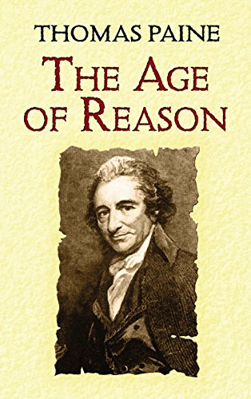
Cut to the Heart
Hebrews 4:12
Trust our OWN wisdom?

Slide 17
Cut to the Heart
Hebrews 4:12
Trust our OWN wisdom?
I Cor 1:25
Because the foolishness of God is wiser than men, and the weakness of God is stronger than men.

Slide 18
Cut to the Heart
Hebrews 4:12

