Slide 1
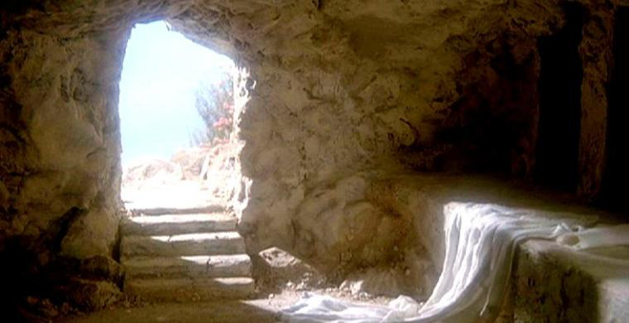
The Reality of the Resurrection

Slide 2
The Known Historical Facts
Jesus died by crucifixion.
Jesus was buried.
Jesus’ death caused the disciples to despair and lose hope, believing that his life was ended.
Christ died for our sins in accordance with the Scriptures…
1 Corinthians 15:3

Slide 3
The Known Historical Facts
Jesus died by crucifixion.
Jesus was buried.
Jesus’ death caused the disciples to despair and lose hope, believing that his life was ended.
…that he was buried…
1 Corinthians 15:4

Slide 4
The Known Historical Facts
Jesus died by crucifixion.
Jesus was buried.
Jesus’ death caused the disciples to despair and lose hope, believing that his life was ended.
“But we had hoped that he was the one to redeem Israel.”
Luke 24:21

Slide 5
The Known Historical Facts
The tomb in which Jesus was buried was discovered to be empty just a few days later.
The disciples had experiences which they believed were literal appearances of the risen Jesus.
And he said to them, “Do not be alarmed. You seek Jesus of Nazareth, who was crucified. He has risen; he is not here. See the place where they laid him.”
Mark 16:6

Slide 6
The Known Historical Facts
The tomb in which Jesus was buried was discovered to be empty just a few days later.
The disciples had experiences which they believed were literal appearances of the risen Jesus.
…and that he appeared to Cephas, then to the twelve. Then he appeared to more than five hundred brothers at one time, most of whom are still alive, though some have fallen asleep. Then he appeared to James, then to all the apostles.
1 Corinthians 15:5-7

Slide 7
The Known Historical Facts
The disciples were transformed from doubters who were afraid to identify themselves with Jesus to bold proclaimers of his death and resurrection.
“Rulers of the people and elders… let it be known to all of you and to all the people of Israel that by the name of Jesus Christ of Nazareth, whom you crucified, whom God raised from the dead—by him this man is standing before you well.
Acts 4:8, 10

Slide 8
The Known Historical Facts
This message was the center of preaching in the early church.
This message was especially proclaimed in Jerusalem, where Jesus died and was buried shortly before.
“This Jesus God raised up, and of that we all are witnesses.”
Acts 2:32

Slide 9
The Known Historical Facts
This message was the center of preaching in the early church.
This message was especially proclaimed in Jerusalem, where Jesus died and was buried shortly before.
“Brothers, I may say to you with confidence about the patriarch David that he both died and was buried, and his tomb is with us to this day.”
Acts 2:29

Slide 10
The Known Historical Facts
The church was born and grew.
Sunday was the primary day of worship.
And the word of God continued to increase, and the number of the disciples multiplied greatly in Jerusalem, and a great many of the priests became obedient to the faith.
Acts 6:7

Slide 11
The Known Historical Facts
The church was born and grew.
Sunday was the primary day of worship.
On the first day of the week, when we were gathered together to break bread…
Acts 20:7

Slide 12
The Known Historical Facts
James, who had been a skeptic, was converted to the faith when he also believed that he saw the resurrected Jesus.
Then after three years I went up to Jerusalem to visit Cephas and remained with him fifteen days. But I saw none of the other apostles except James the Lord’s brother.
Galatians 1:18-19

Slide 13
The Known Historical Facts
A few years later, Paul was converted by an experience which he, likewise, believed to be an appearance of the risen Jesus.
Last of all, as to one untimely born, he appeared also to me.
1 Corinthians 15:8

Slide 14
What will YOU do with this evidence?

