Slide 1
A Marriage Made in Heaven
Personal Transformation in Marriage Through the Fruit of the Spirit

Slide 2
Proverbs on Self Control
Overeating (Prov 23:21)
Lust (Prov 5:15)
Money (Prov 22:7)
Alcohol (Prov 20:1)
Work (Prov 23:4)
Anger (Prov 29:11)

Slide 3
The Power of Vision
But one thing I do: forgetting what lies behind and straining forward to what lies ahead, I press on toward the goal for the prize of the upward call of God in Christ Jesus.
Philippians 3:13-14

Slide 4
Strategies
Bible Study (Psa 119:104; Heb 4:12-13)
Prayer (Phil 4:5-7; Rom 6:12-13; Lk 11:24-26)
Flight (1 Cor 10:12-13; Gen 39)
Protect the Eyes (Job 31:1)
Protect the Heart (Prov 4:23)
Godly Friends (2 Tim 2:22)

Slide 5
Profile of a Friend
Always there (Prov 18:24)
Listen without judging (Prov 10:12)
Keep confidence (Prov 17:9)
Wise counsel (Prov 13:20)
Tell truth (Prov 27:6)
Lift you up (Eccl 4:9-10)
Inspire you (Prov 27:17)
Stay with you (Prov 17:17)
Pray for you (2 Thess 3:1)

Slide 6
One Another Commands
Love (Jn 13:34)
Be devoted (Rom 12:10)
Not judge (Rom 14:13)
Accept (Rom 15:7)
Admonish (Rom 15:14)
Serve (Gal 5:13)
Bear burdens (Gal 6:2)
Forgive (Eph 4:32)
Regard more important (Phil 2:3)
Be honest (Col 3:9)
Encourage (1 Thess 5:11)
Exhort (Heb 10:25)
Confess sins (Jas 5:16)
Be hospitable (1 Pet 4:9)

Slide 7
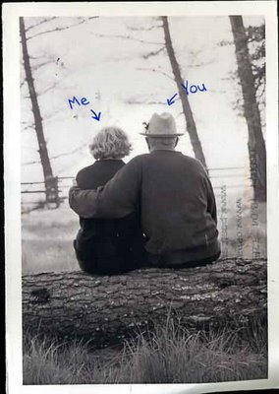
But one thing I do:
forgetting what lies behind and straining forward to what lies ahead,
I press on toward the
goal for the prize
of the upward call
of God in Christ Jesus.
Philippians 3:13-14

