Slide 2
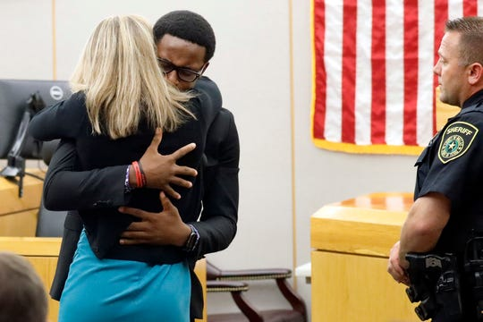

Slide 6
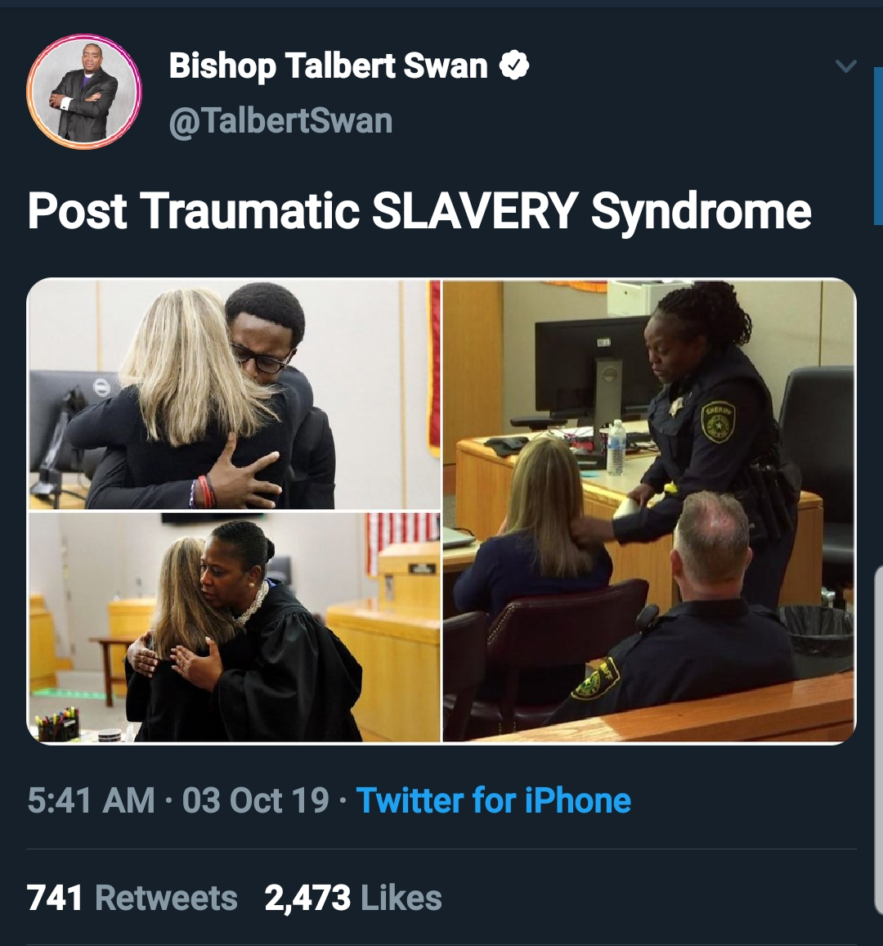

Slide 7
Where is the God of Justice?
Malachi 2.17 – 3.5
Our judgements are unjust:
Matthew 23.23 - 28
The Ultimate Injustice
Luke 23.32 – 49
God is the Just One
Romans 12.9 - 21

