Slide 1
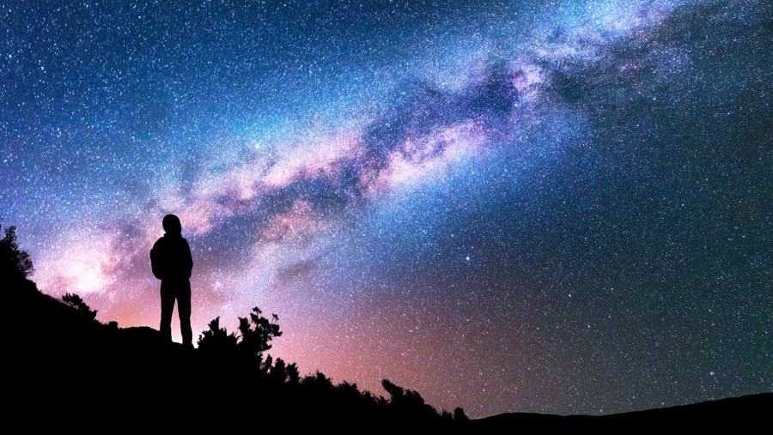
Genesis 17.1 - 8
אֵל שַׁדַּי
(El Shaddai)
“God Almighty”
אבראברהםהם
(Abraham)
“Father of Multitudes”

Slide 2
Genesis 32.22 - 32
יִשְׂרָאֵל
(Israel)
“God Fights”
פְּנוּאֵל
(Peniel)
“The Face of God”

Slide 3
Judges 3.7 – 11
עָתְנִיאֵל
(Othniel)
“The Strength of God”
כּוּשַׁן רִשְׁעָתַיִם
(Cushan-Rishathaim)
“Double Evil”

Slide 4
1 Samuel 7.3 - 13
אֶבֶן הָעֵזֶר
(Ebenezer)
“Stone of Help”

Slide 5
Hosea 1.4 - 9
יִזְרְעֶאל
(Jezreel)
“God Sows”
לֹא עַמִּי
(Lo-ammi)
“Not My People”
לֹא רֻחָמָה
(Lo-Ruhama)
“No Mercy”

Slide 6
John 8.48 - 49
יהוה
(Yahweh)
“I AM”

