Slide 1
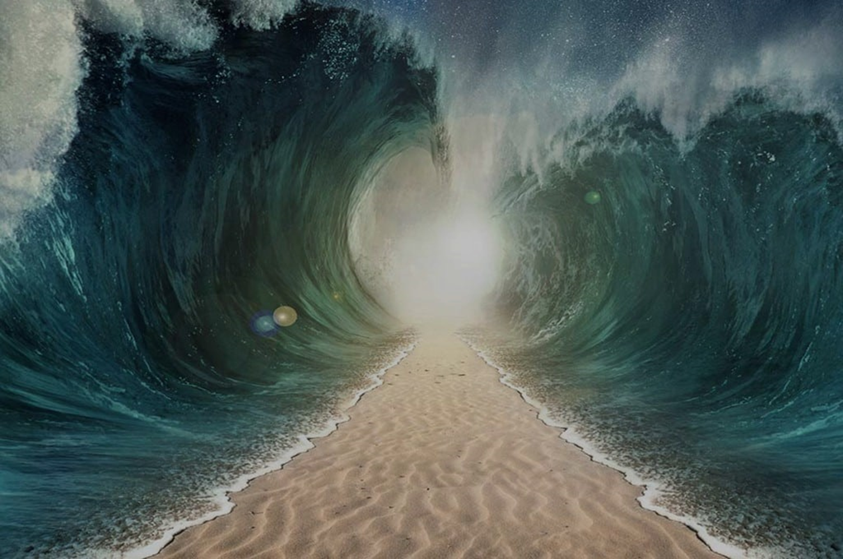
HEROES
OF THE FAITH

Slide 2
Isaac – Faith That Can See
Hebrews 11.20
“By faith, Isaac provoked future blessings on Jacob and Esau.

Slide 3
Isaac – Faith That Can See
The Old Blind Man
Genesis 27.1 – 4

Slide 4
Isaac – Faith That Can See
Rebekah’s Plan
Genesis 27.5 – 17

Slide 5
Isaac – Faith That Can See
Isaac Trusts His Senses
Genesis 27.18 – 29

Slide 6
Isaac – Faith That Can See
Esau Receives a Blessing
Genesis 27.30 – 40

