Slide 1
Dwell on these things
05/30/2020

Slide 2
Philippians 4:8
Finally, brethren, whatever things are true, whatever things are noble, whatever things are just, whatever things are pure, whatever things are lovely, whatever things are of good report, if there is any virtue and if there is anything praiseworthy—meditate on these things.
Powerful words as Paul concludes this letter of encouragement and joy

Slide 3
Philippians 4:8
true - focus on things of truth, not things that are lies or wrong
noble - honorable, upright
just - right, fair, righteous
pure - undefiled, without blemish
lovely - beautiful, pleasing
Good report - reputable, spoken highly of
virtue - excellent or right, moral
praiseworthy - things that can be praised or look on as positive
Think/dwell/meditate on these things

Slide 4
Purpose of instruction
Many possibilities
Our minds form connections
We cannot completely control our minds
The inner man affects the outer man
Look into these reasons and apply to daily life

Slide 5
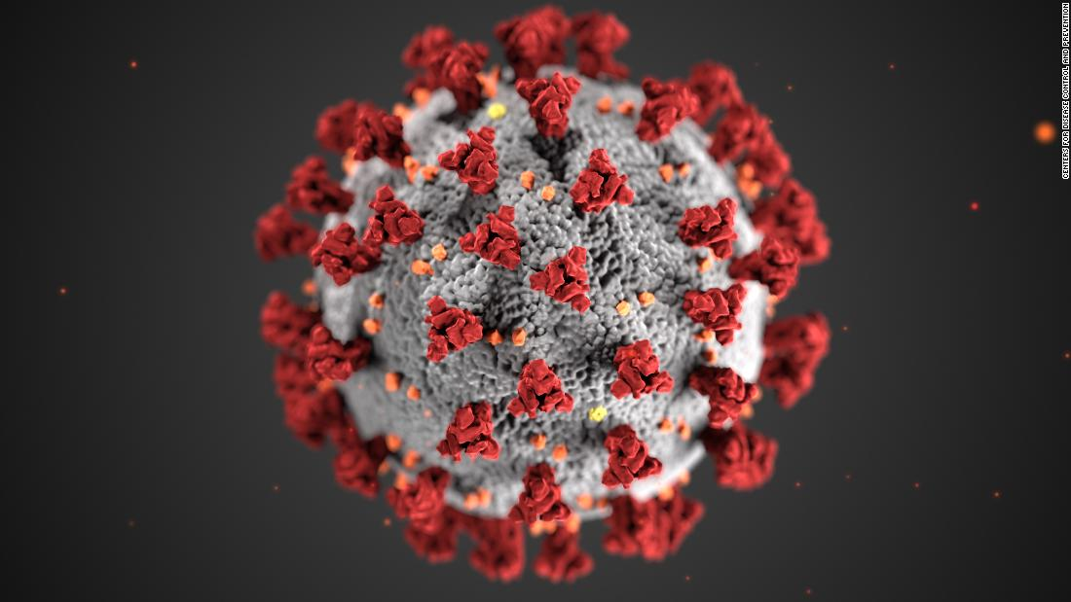
Forming connections

Slide 6
Forming connections
A few months ago, picture had little meaning
Now, has very specific meaning to many people
Not only meaning, also many feelings and beliefs
Terror of a pandemic: fear/anxiety, loss, sadness, powerlessness
Overblown risk: anger, frustration, annoyance
Our brains are quick to make connections
Not a bad thing
Something to be careful about
Can ‘poison’ your thoughts
Following Paul’s instruction helps

Slide 7
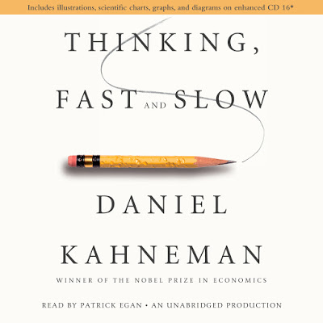
Imperfect control
We can control our minds, but not completely
Songs stuck in head
Take mental shortcuts, especially for immediate reactions or quick decisions

Slide 8
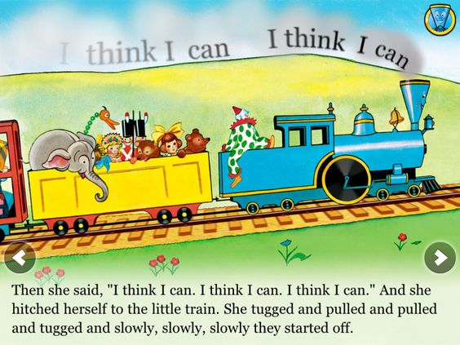
Outer man reflects inner man
Matthew 15:11
Our inner self can defile us
Inverse of Philippians 4:8 – keeping bad inside
Self-fulfilling prophecies
“I think I can”
Studying
Helpful or unhelpful thoughts
Possible does not mean helpful

Slide 9
Summary
Paul instructs us to make an effort to focus on true, upright, virtuous things
Without such effort, we can focus on false things that are ugly and evil – and our lives will reflect that
We can form unhelpful connections
Our minds will drift to unfruitful topics
Our inner thoughts will affect our lives negatively

Slide 10
Application
Great reason to read the Bible
True, righteous, noble, praiseworthy
Great reason to pray
True, righteous, noble, praiseworthy
Spending time with other Christians
So much out there that is not helpful
“but it’s true” is not always enough – must be righteous, noble, praiseworthy
Does not mean we cannot think about negative things
Bible often speaks about sinful behavior
We cannot allow our minds to meditate and dwell on these things

Slide 11
Conclusion
Finally, brethren, whatever things are true, whatever things are noble, whatever things are just, whatever things are pure, whatever things are lovely, whatever things are of good report, if there is any virtue and if there is anything praiseworthy—meditate on these things.

