Slide 1
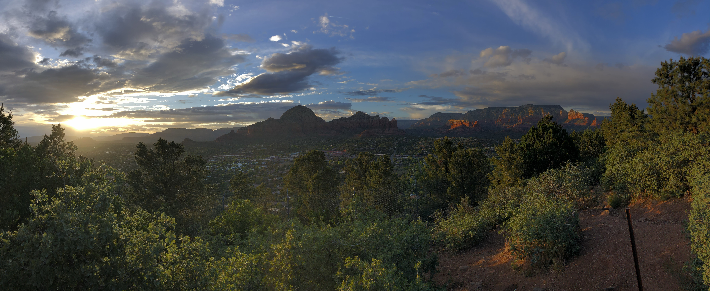
Elisha

Slide 2
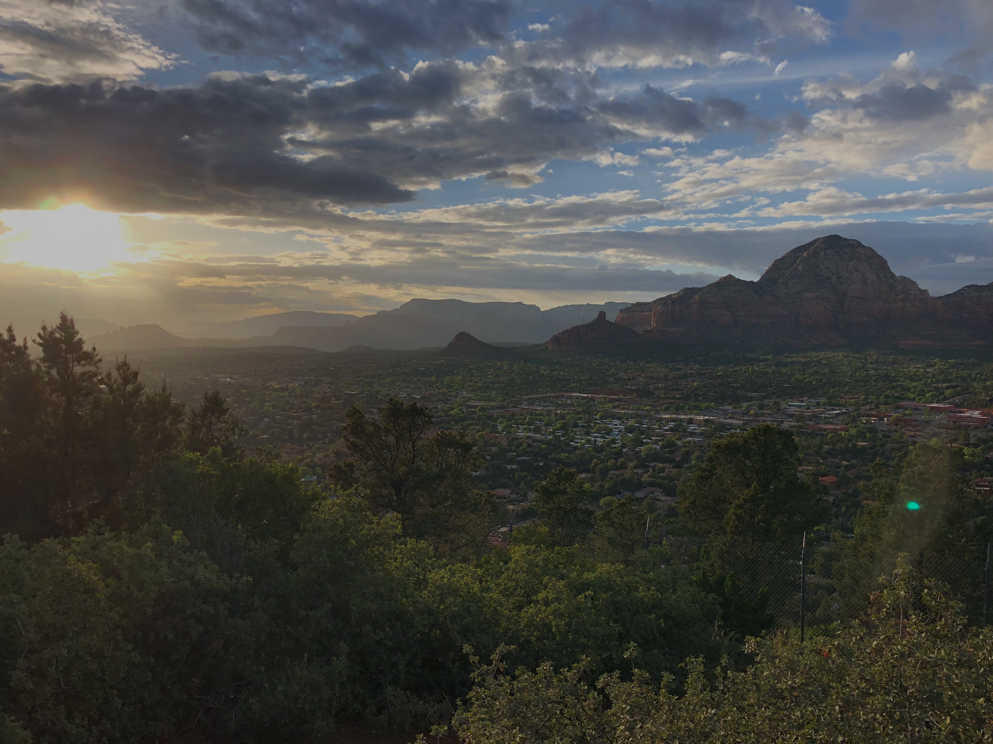
A worldly diet leaves us empty.

Slide 3
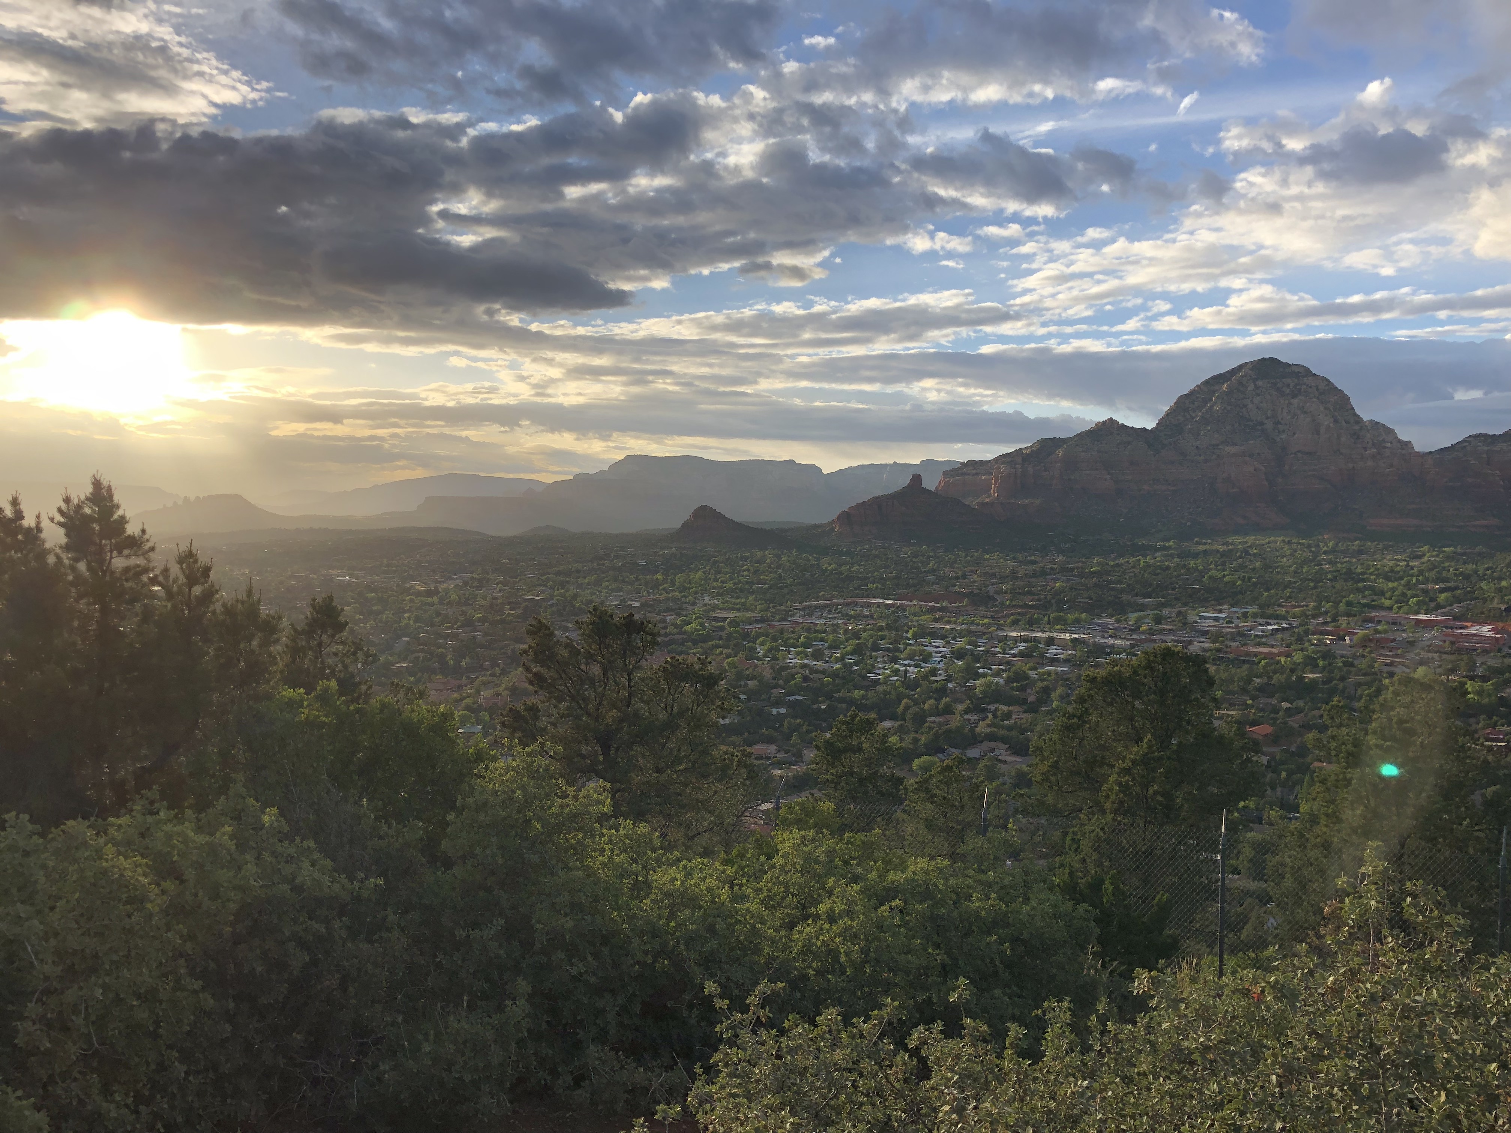
And Elisha came again to Gilgal when there was a famine in the land.
2 Kings 4:38

Slide 4
False teaching can seem like good food.

Slide 5
One of them went out into the field to gather herbs, and found a wild vine and gathered from it his lap full of wild gourds, and came and cut them up into the pot of stew, not knowing what they were.
2 Kings 4:39

Slide 6
God’s wisdom is greater than human wisdom.

Slide 7
And they ate and had some left, according to the word of the LORD.
2 Kings 4:44

