Slide 1
If I had only five scriptures…

Slide 2
What is the church?

Slide 3
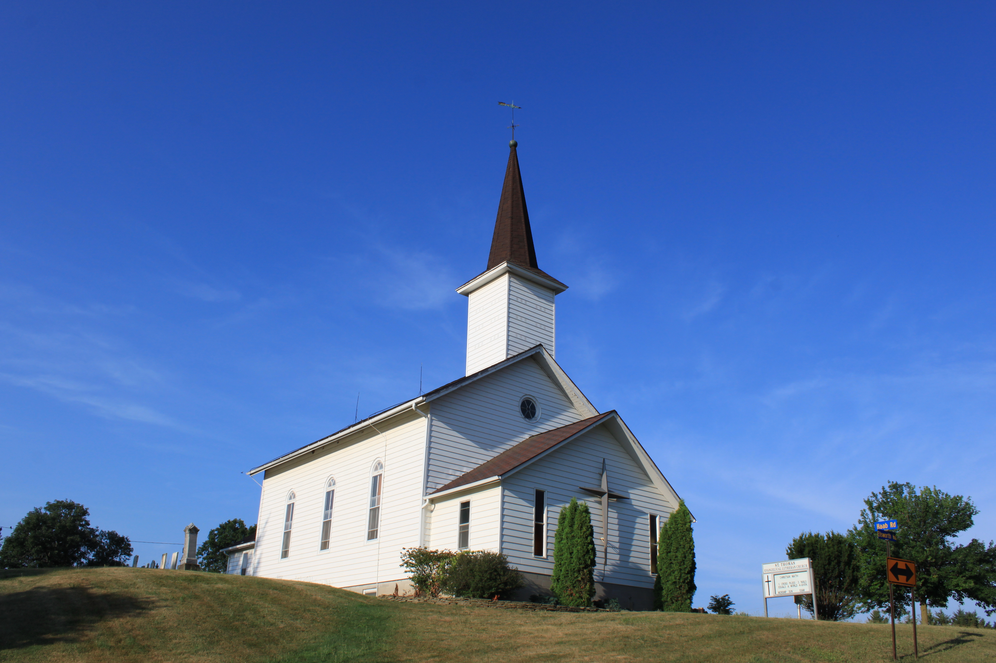
What is the church?

Slide 4
What is the church?

Slide 5
What is the church?

Slide 6
What is the church?

Slide 7
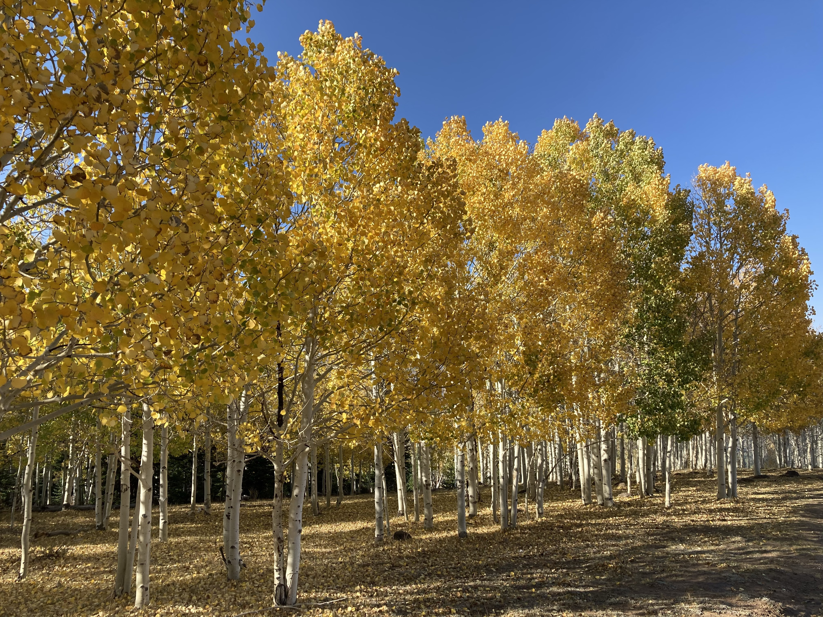

Slide 8
A people 1 Pet 2:9-10
A family Acts 2:42-48
A body Eph 4:11-16
A movement Mt 13:31-33
A hospital Isa 61:1-4

