Slide 2
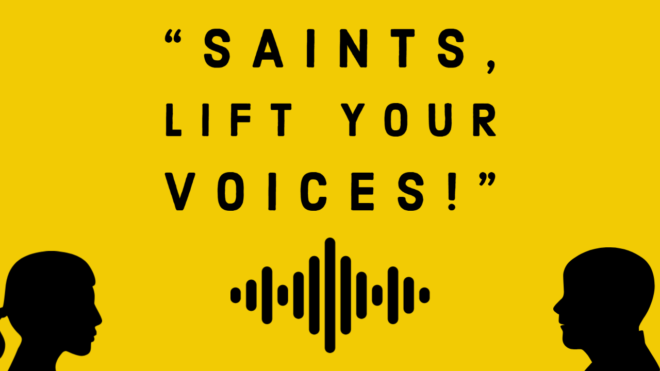

Slide 3
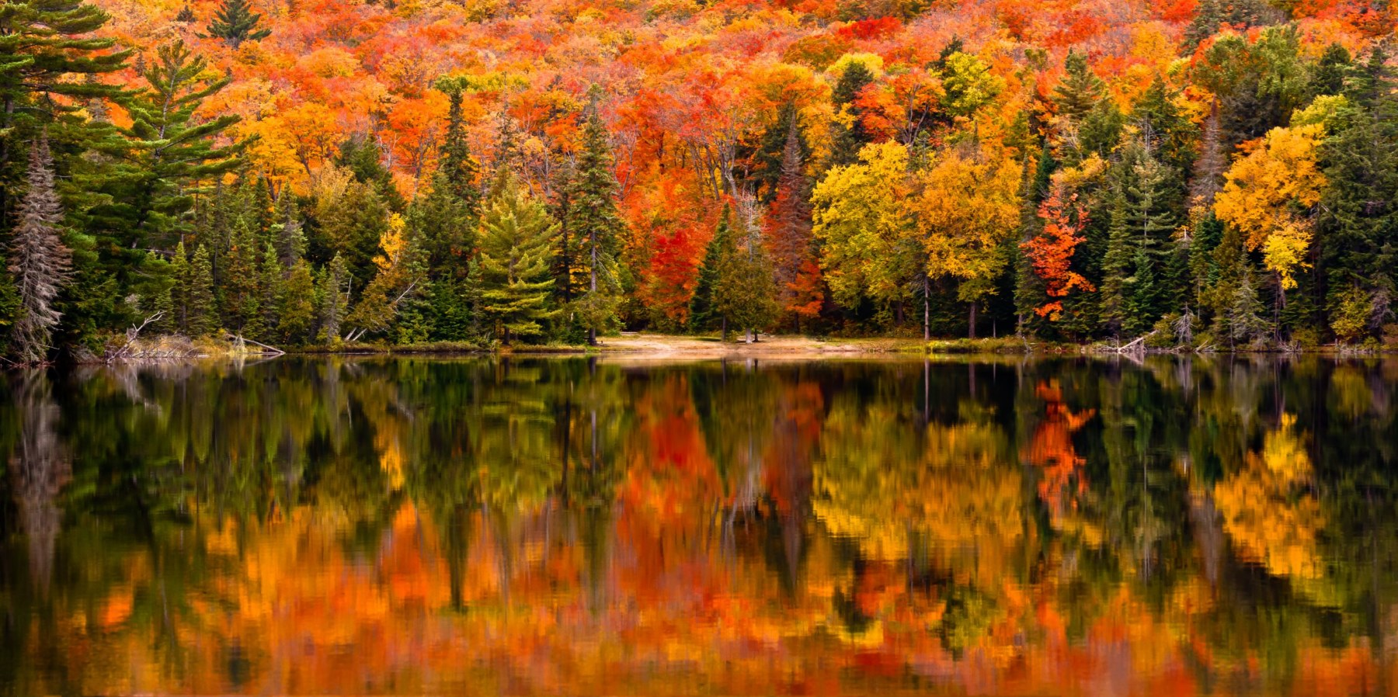

Slide 4
“This is my Father’s world, and to my listening ears. All nature sings, and round me rings, the music of the spheres. This is my Father’s world: I rest me in the thought, of rocks and trees, of skies and seas; his hand the wonders wrought.”
Psalm 65
“By awesome deeds you answer us with righteousness, O God of our salvation, the hope of all the ends of the earth, and of the farthest seas. (v. 8, ESV)

Slide 5
“This is my Father’s world. The birds their carols raise; the morning light, the lily white, declare their maker’s praise. This is my Father’s world: He shines in all that’s fair; in the rustling grass, I hear him pass, He speaks to me everywhere.”
Psalm 104
“O LORD, how manifold are your works! In wisdom you have made them all; the earth is full of your creatures.” (v. 24, ESV)

Slide 6
“This is my Father’s world. O let me never forget, that though the wrong seems oft so strong, God is the ruler yet. This is my Father’s world: why should my heart be sad? The Lord is King: let heaven ring! God reigns; let earth be glad.”
Matthew 5.1-12
“Blessed are those who mourn, for they shall be comforted.” (vs. 4 ESV)

