Slide 1
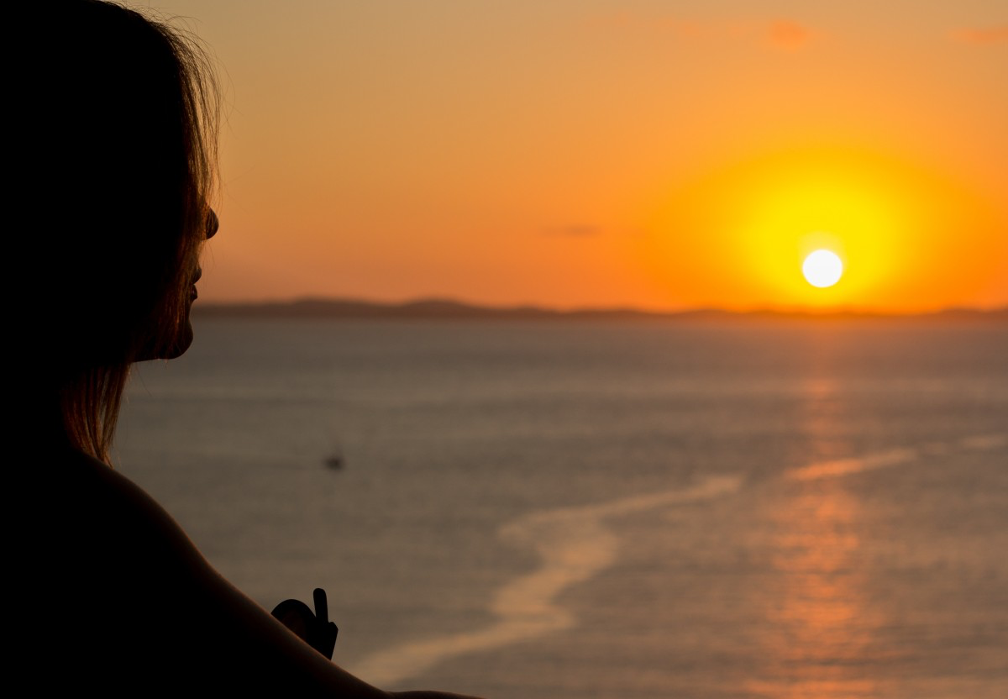
Mary’s Story

Slide 2
Gabriel’s announcement
Visiting Elizabeth
Birth of Jesus
Presentation in the Temple
Leaving Jesus at the Passover
The Wedding Feast at Cana
Opposing Jesus
At the Cross
The upper room

Slide 3
Being a disciple demands we allowing our kids to suffer.

Slide 4
God doesn’t need our talent to do great things through us.

Slide 5
We must accept Jesus for who he is, not who we want him to be.

Slide 6
We need to obey, whatever Jesus tells us to do.

Slide 7
Being a disciple of Jesus’ means accepting the family into which we have been adopted.

Slide 8
Though our heart may be broken, there is an upper room where we eagerly wait.

