Slide 1
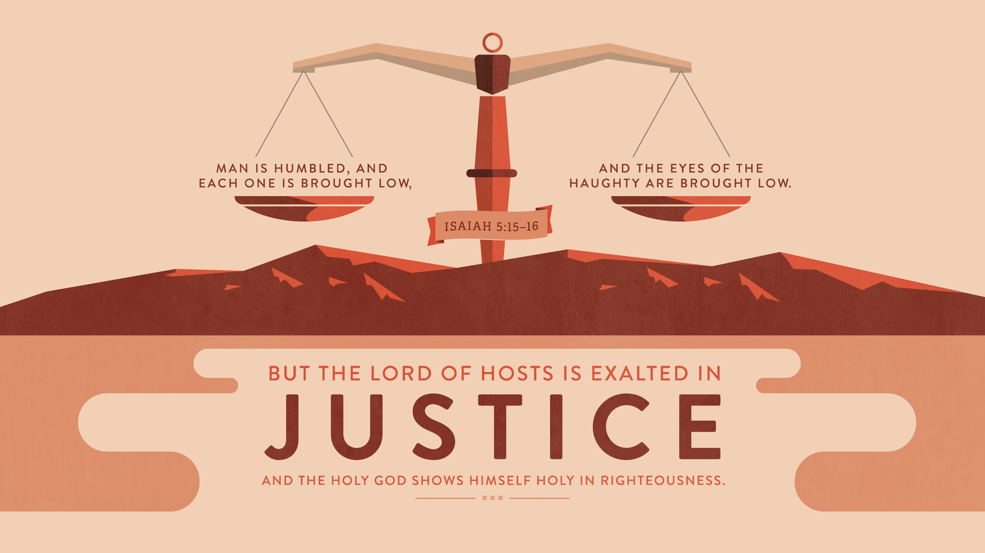
THE LORD STOOD WITH ME

Slide 2
The LORD is with Us through Doubt and Fear
Jeremiah provides a compelling example of one whose service to the LORD was punctuated with severe doubt and anxiety.
The despair that threatened to overtake him was kept at bay through his knowledge of the LORD’s promises.
God’s presence does not mean doubt will never come, but our remembrance of His faithfulness can dispel it.

Slide 3
The LORD is Present in the Face of Impossible Odds:
God put Israel to the test to see where their focus was placed.
Those like Jonathan and David held God above what they faced.
The challenges to our discipleship are nothing before Him.

Slide 4
The LORD Abides When Others Cannot or Will Not
Most will face a time when they must stand for the truth on their own.
Our Lord is the only one who can truly be ever present—He will not forsake us or leave us.

Slide 5
Thinking Ahead
Don’t Allow Doubt to Push God Out
Don’t Underestimate God
Respond with Devotion

