Slide 1
Mark 9.14-29

Slide 2
“O faithless generation, how long am I to be with you?” (v. 19)
A problem in first century Jewish culture was their constant faith in tradition or the laws of men, rather than having a faith in what God had already revealed.
If Jesus came today – why would he call us faithless? What have we chosen to trust rather than him?

Slide 3
“But if you can do anything, have compassion on us and help us!” (vs. 22)
This father was probably out of options. He’d done everything in his power, and he was close to his wits end.
What he underestimated was both Jesus’ power and his care. Don’t we often find ourselves in a similar spot?

Slide 4
“’If you can!’ All things are possible for him believes.” (vs. 23)
Does Jesus mean that everything you believe in can be possible? No.
When you trust in Jesus and his promises, things that were impossible are now possible. For instance – heaven. A place of rest with the Lord forever. For free. On our own, that’s impossible. But with a trust in Him, it is.

Slide 5
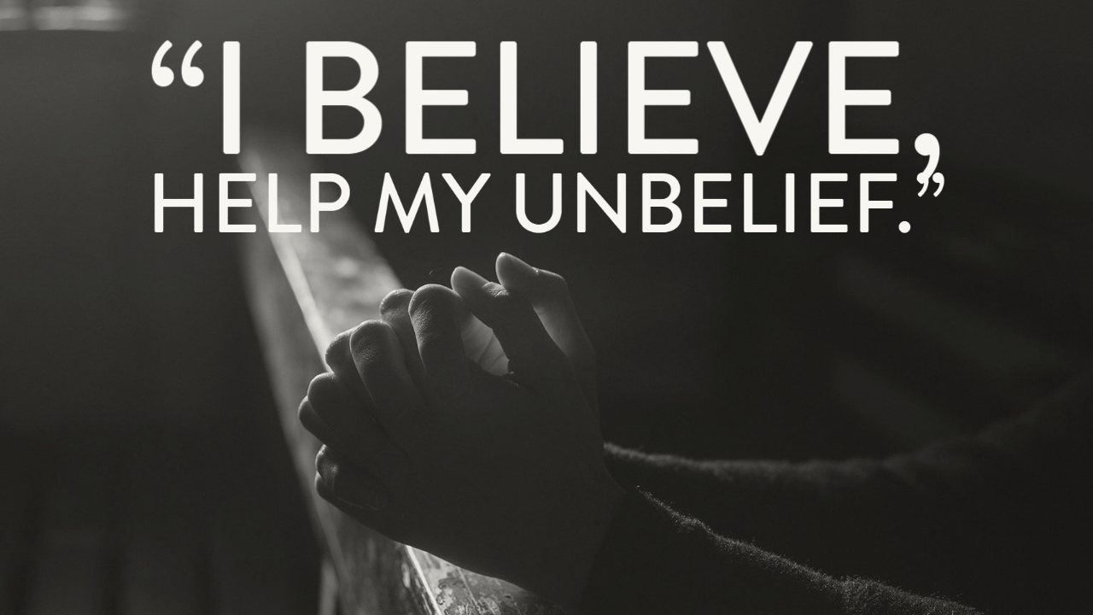

Slide 6
Dealing with doubt (In a healthy Way)

Slide 7
1. Remember what Jesus has already done.
In Mark 9, these are the miracles Jesus has already done: casting out demons, healing a village, cleansing a leper, healing a paralytic, healing a man with a withered hand, calming a storm, casting out another demon, healing a woman of her internal bleeding, healing Jarius’ daughter, feeding 5,000, walking on water, ending a storm, healing the Syrophoenician’s daughter, deals the deaf man, feeds 4,000, heals a blind man (which is the first time that’s ever happened) and then he was transfigured. 17 miracles!
In distress, we tend to forget what Jesus has already done.
Think of what the Lord has done in your life – the hope, light, strength, unconditional love: all things the Lord has blessed you with.

Slide 8
2. Ask questions! Acts 8.26-31
How much different would this story be if the Eunuch would’ve never asked?
If you have a question about something taught here, in class, in personal reading – ask questions! Especially if you have doubts!
Have someone you can trust – doubt festers in the dark.

Slide 9
3. Study for yourself! Acts 17.10-15
The Bereans listened to Paul’s words – but they didn’t just accept them without investigating for themselves.
Preachers and teachers can (and do) mess things up. Are you making sure what is being taught is true?
Are you investigating for yourself? Are you putting in effort to study and understand things for yourself?

Slide 10
4. Jesus loves and cares about you. 1st John 2.28-3.3
You may be doubting and struggling. Thankfully, Jesus’ love isn’t based on that condition.
Jesus has called us to be his children. We can trust him with our lives, and he is worth trusting.

Slide 11
CRM
Challenge: This week, whenever something happens that blesses you: encouragement from a friend, strength in a difficult time, a strangers kindness – write it down as a reminder for when things are tough. Perhaps referring to that list will remind you of the things God has blessed you with.
Reminder: If you struggle with doubt – you’re not the only one and you’re loved regardless. Seek out help, and we’ll do whatever we can to help.
Meditation: If someone I know is struggling with doubt, how can I be a good brother or sister to them? If am the one struggling, who do I trust to reach out to and they’ll care about me?

