Slide 1
Themes of our series
Jesus is the center of the gospel
The effect of love: God’s love towards us and us towards him
Walking with the lord means to listen to his wisdom
Walking as Jesus did in compassion, love, and truth.

Slide 2
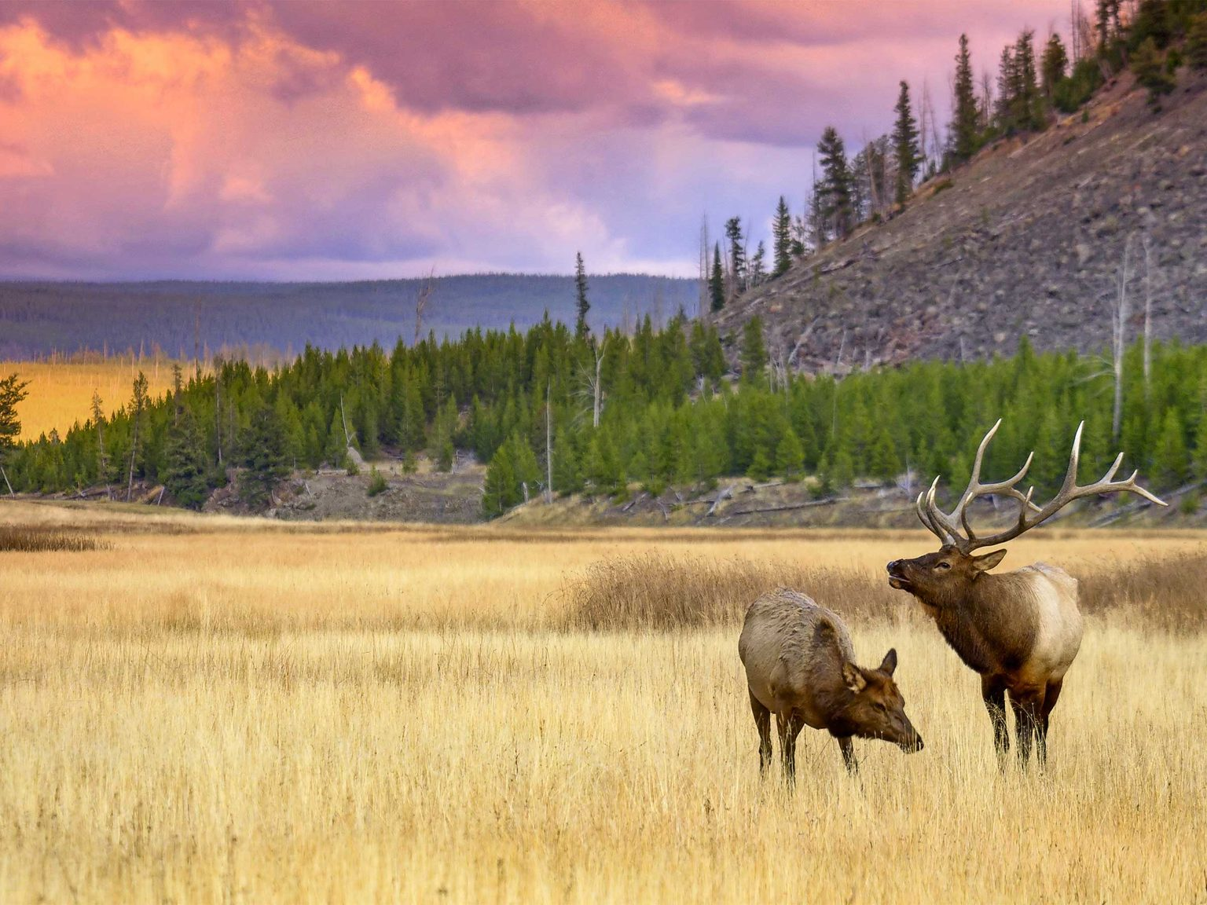
Walking as family

Slide 3
the children of God (1st John 2.28-3.3)
We do not shrink when thinking of the Lord’s return – we take confidence in his return.
vs. 29 – “If you know that he is righteous, you may be sure that everyone who practices righteousness has been born of him.”
As broken as we are – God has made us his children. What a blessing.
Be pure to the according to God’s standard of purity.

Slide 4
the children of The devil (1st John 3.4-10)
To defy God’s rules is to be “lawless”. We are all lawbreakers. But “lawlessness” is defined in vs. 8: “Whoever makes a practice of sinning is of the devil…”
To continue to practice sinning means you are not born of God. Why would you continue to participate in for what Christ died to destroy?
Vs. 10: “By this it is evident who are the children of God, and who are the children of the devil: whoever does not practice righteousness is not of God, nor is the one who does not love his brother.” Is this evident in you?
What Jesus came to do:
He appeared to take away sins. (3.5)
To destroy the works of the devil. (3.8)
Show how we show love. (3.16)

Slide 5
The ballad of love and hate (1st John 3.11-18)
Two Ways to Hate:
Despise those who practice righteousness – to want to see their downfall. (3.12)
To see a need and refuse to help or assist. (3.17)
From the beginning, our call has been to love. Hatred, however, reigns. The sin of Cain continues to this day.
The world is going to hate those who practice of righteousness. But we are striving for the love of God and his approval.
We have died to sin to live to new life – it was through the love of God.
So if God’s love is not just words – neither should our love be.
Two Ways to Love:
To encourage those living righteously. (3.14)
To serve in all our efforts, not just in our words. (3.18)

Slide 6
Confidence in being his child (1st John 3.19-24)
To love “in deed and in truth” assures us that we are walking as God has called to us.
“We have confidence before God”. To keep his commandments means we can take confidence before him.
Our life should be dedicated, not trying to test the bounds of God love, but seeking please Him. And when our life is dedicated to that we know he hears us.
Believe in Jesus. Love one another. Abide in Him. Have confidence.

Slide 7
CRM
Challenge: Write out John 2.28 – 3.24. Pretty long, but your own hand giving you these reminds will help them stick more – I assure you. Additionally: go up to someone this week at our congregation and tell them how much you appreciate their example. Don’t fake it. Take the time to genuinely thank someone for what they do for our family here.
Reminder: A child of God has died to darkness and hate, and lives to light and love. Show the love of God to all.
Mediation: “Little children, let us not love in word or talk, but in deed and truth.” What does this mean for how you operate in the family? How does this differentiate a Christian from the world? Has it differentiated you from the world?

