Slide 1
Hampering the Next Generation

Slide 2
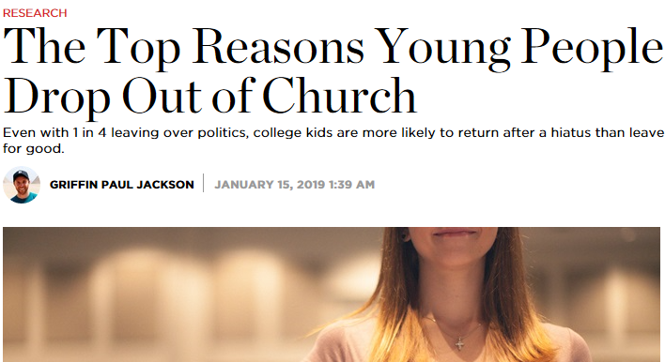
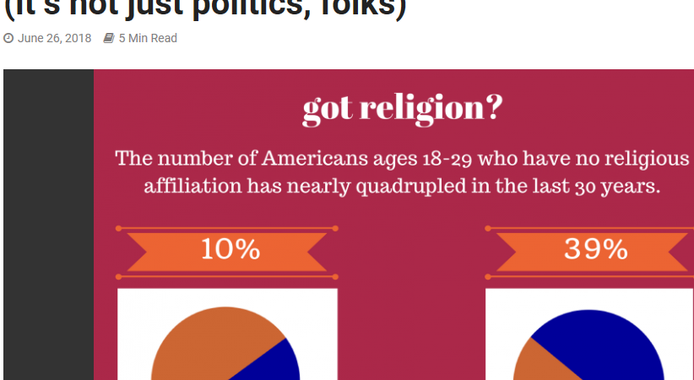
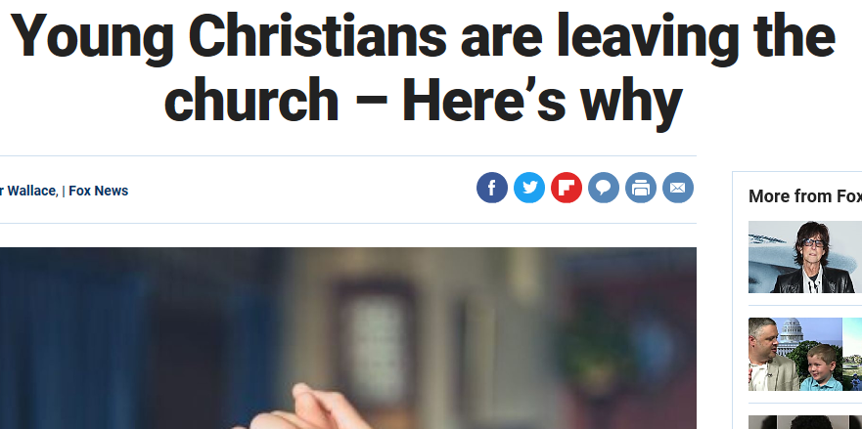
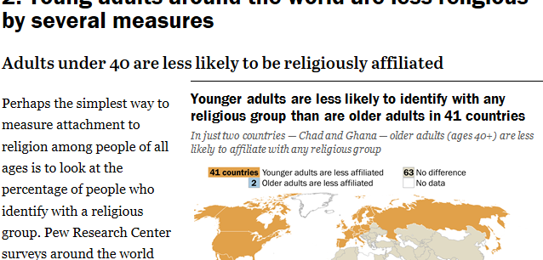

Slide 3
Are We Setting a Low Bar?
Are We Stifling Their Zeal?
How Do We View Baptism?
Are We Giving Them Our Best?

Slide 4
Thinking Ahead
Reach Out to Someone Younger
Help to Channel Someone’s Zeal
Exceed Expectations and Desire More

