Slide 1
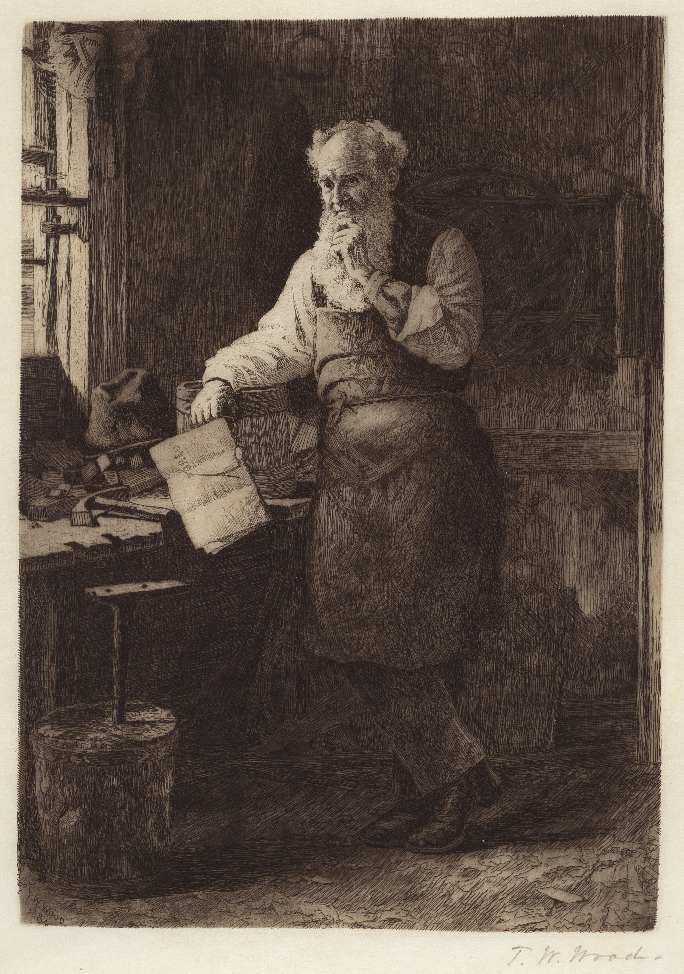
“My brethren, whatever is true, whatever is honorable, whatever is just, whatever is pure, whatever is lovely, whatever is commendable, if there is any excellence, if there is anything worthy of praise, think about these things.”
Philippians 4.8

Slide 2
Psalm 1
God, Our Righteousness
The righteous abandon the way of wickedness for the way of the Lord.
To know the Lord and his way is our cause of strength and hope. There is not a true follower who doesn’t bear fruit.
The way of the wicked leads to judgement and punishment. There will be judgement for sin.

Slide 3
Psalm 77
God, Our Helper
Vs. 1-9 is a reminder of the pain or thoughts we sometimes have: does God no longer care? Does He no longer show grace? Has he forgotten me?
The reminder of God drawing his people out of Egypt with compassion and power reminds the Psalmist that the same God is near him.

Slide 4
Psalm 143
God, Our Hope
Without God’s mercy, there would be no person on this Earth.
David finds his strength in the forgiveness of the Lord, His works of old, and his faithfulness to His creation.
David knows God will judge those who are against him, while preserving those who serve Him.

Slide 5
Mindfulness and Meditation
Know God’s word well enough to call it to mind in the midst of struggle, suffering, everyday encounters, or your battle with sin.
2. Meditation should make you strive to be more like Christ and live according to God’s righteousness. The way of the wicked will fail, but the way of the righteous is given and embraced by God.

Slide 6
“Homework”
What are battles and struggles you often face? (Be honest)
What verse can you think about to remind you of how you’re supposed to think and walk?

