Slide 1
Spending Time with the King

Slide 2
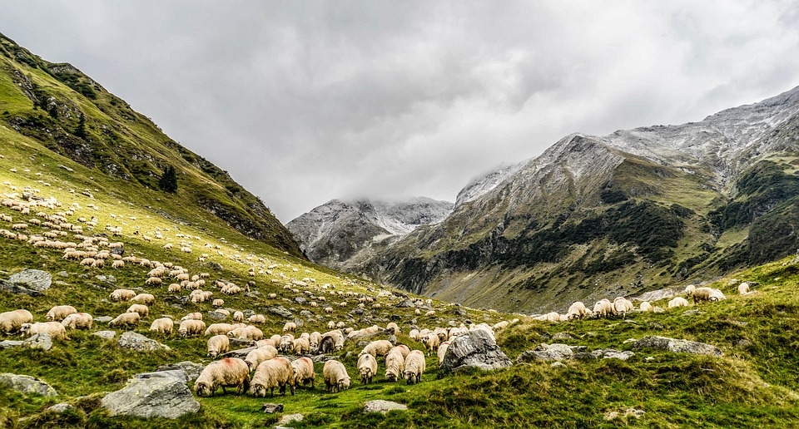
God’s Providence at Work
The story of the birth of Christ is rooted in reality.
The details included by Luke are markers of history.
But more than this, they are God’s providence at work.

Slide 3
The Arrival of the King
Were Jesus’ story written by men, we might have expected luxury…
But Jesus came in the midst of no fanfare or comfort.
Even His arrival was announced to the most humble of men.

Slide 4
The King Proclaimed
The greatest message ever delivered was given to simple shepherds.
They were told of God’s enduring love for His creation…
And of the ultimate peace that was offered to the world.

Slide 5
Reacting to Royalty
The shepherds made reacted to the news with great urgency.
Others, like Mary, took this announcement to heart.

Slide 6
Thinking Ahead
Changes
Blessings
Reaction

