Slide 1
WHAT JESUS THINKS OF THE CHURCH
A STUDY OF THE SEVEN CHURCHES OF ASIA
REVELATION 2-3

Slide 2
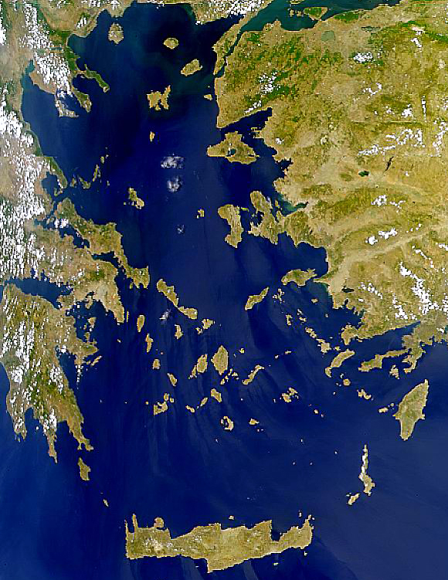
Satellite View
x
Patmos
Size:
About 22 sq. miles
of land area.
10 miles N-S
6 miles E-W at
north end
Crete
NASA Photo

Slide 3
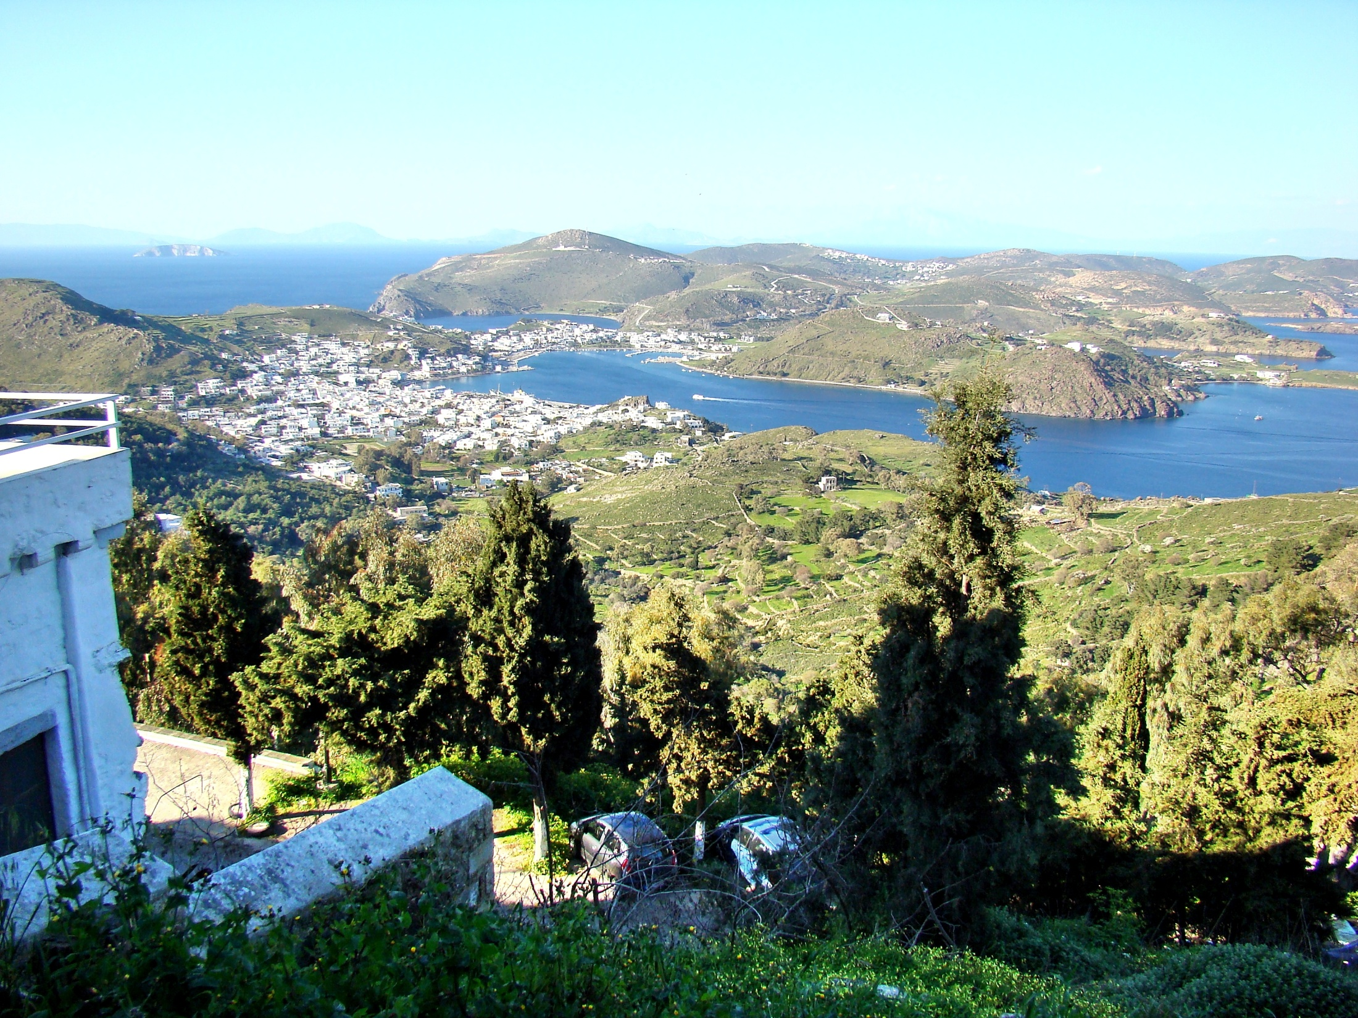
Notes:
Bolen notes: The island of Patmos is located in the Aegean Sea, 37 miles (60 km) southwest of Miletus and 28 miles (45 km) south of the island of Samos. It is about 7.5 miles (12 km) long from north to south and its width varies up to 6 miles (10 km) from east to west. Patmos has an area of 13 square miles (34 sq km) and a circumference of 25 miles (40 km). The island is divided into three parts by two narrow isthmuses, and also includes a few small islets. This photo was taken from the center part of the island, looking toward the northern part.
The acropolis on Mt. Kastelli has remains from the Hellenistic period, dating to the 3rd century BC. The main town of Patmos is Skala, located on the isthmus just below the ancient acropolis, and north of Chora where the Monastery of St. John the Theologian is located. While Skala is a modern town (founded in the 1820s), its harbor is natural and was likely the place where John was taken to and from the island. In the far distance (upper right), the outline of Samos is faintly visible.

Slide 4
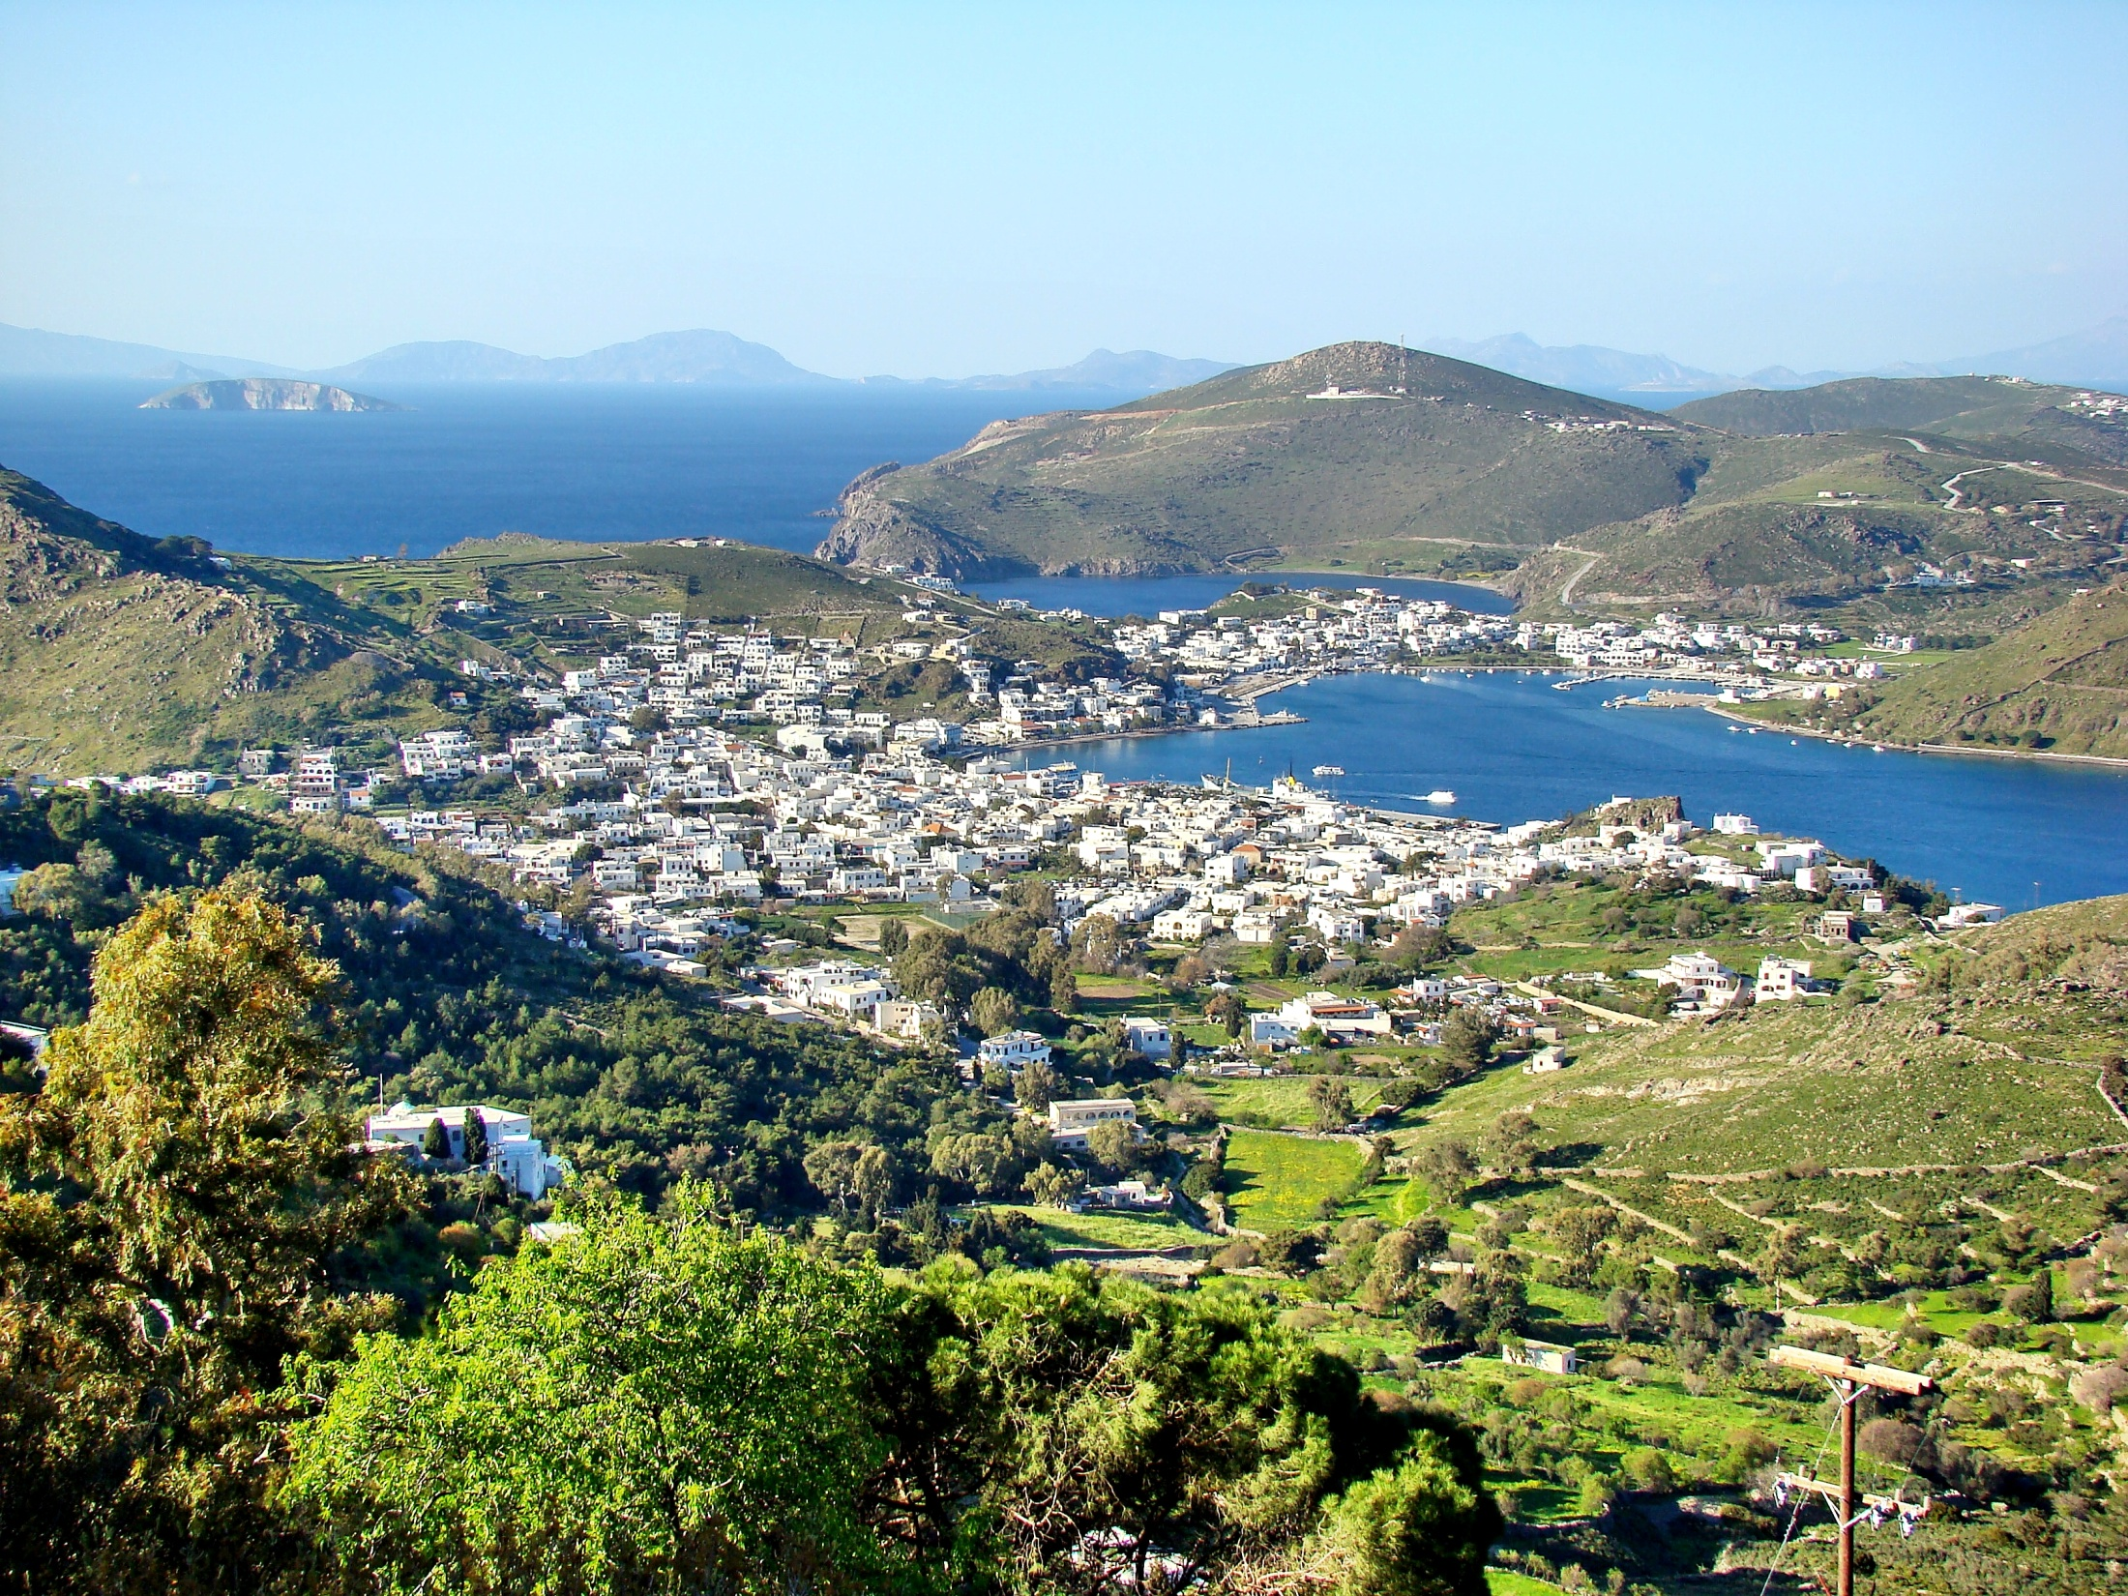

Slide 5
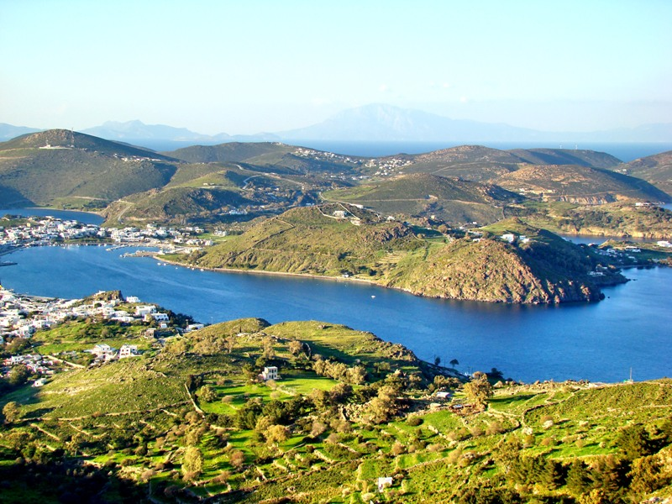

Slide 6
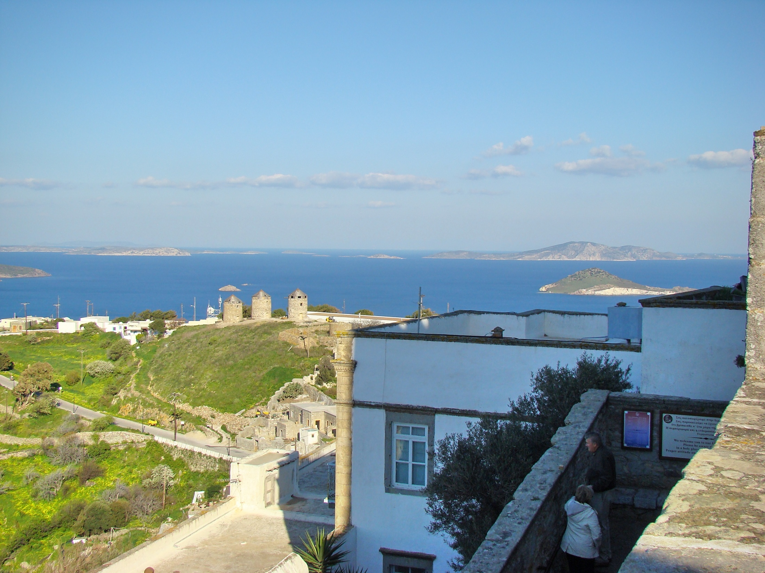

Slide 7
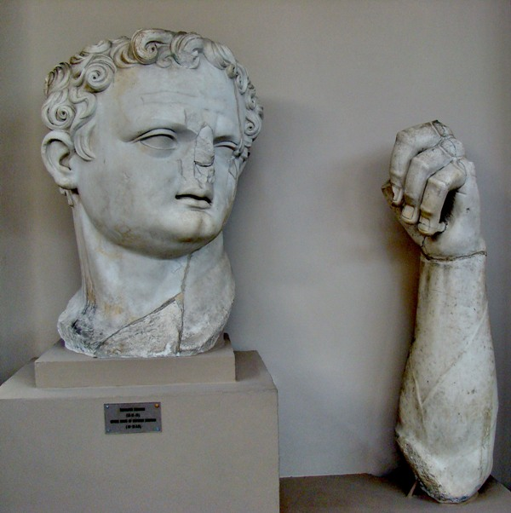
Notes:
To show their gratitude for being designated as the Temple Warden, the Ephesians built a statue of Domitian which stood five meters tall, portions of which may be seen at the Ephesus Museum.

Slide 8
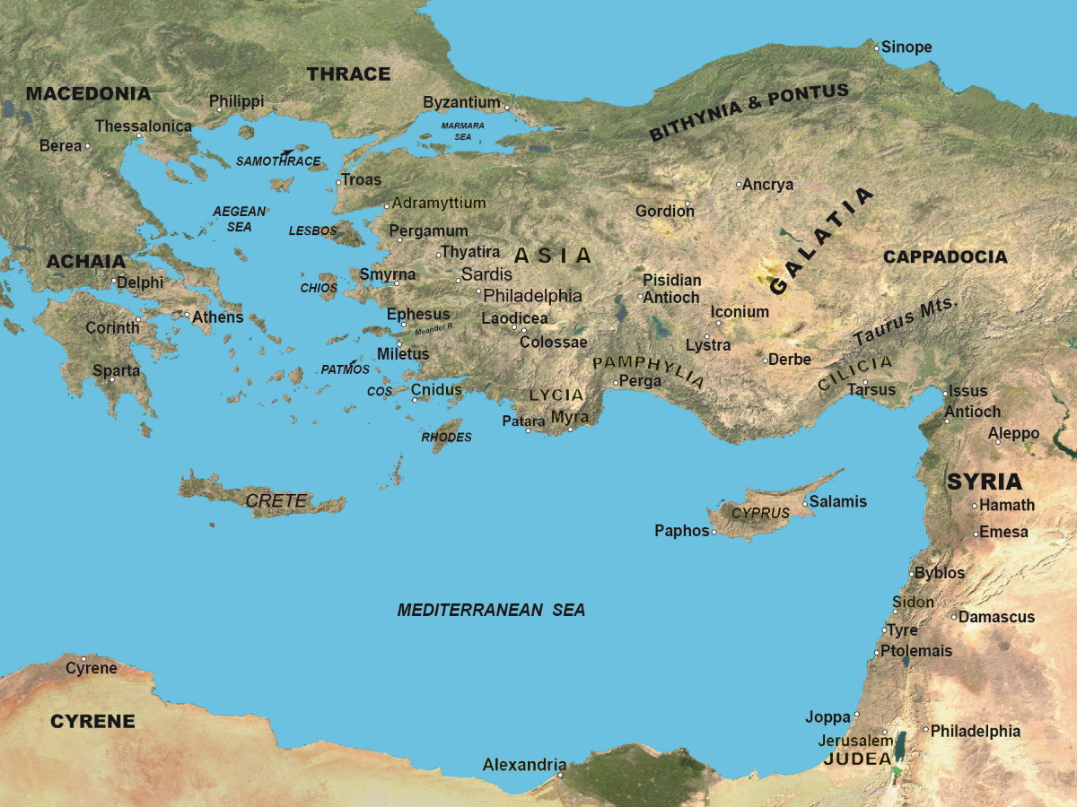
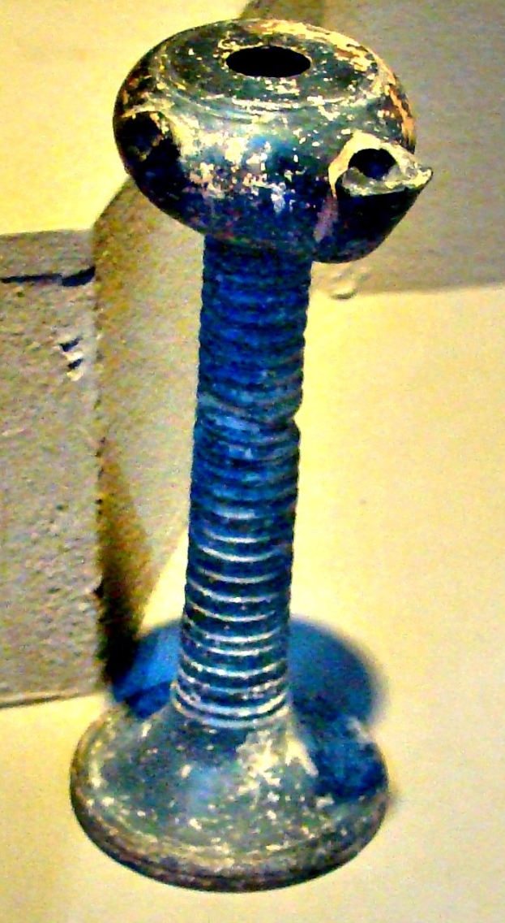
In the Middle of the Lampstands
Rev. 1:20: and the seven lampstands which you saw are the seven churches.
Lamp on Stand – Ephesus Museum

Slide 9
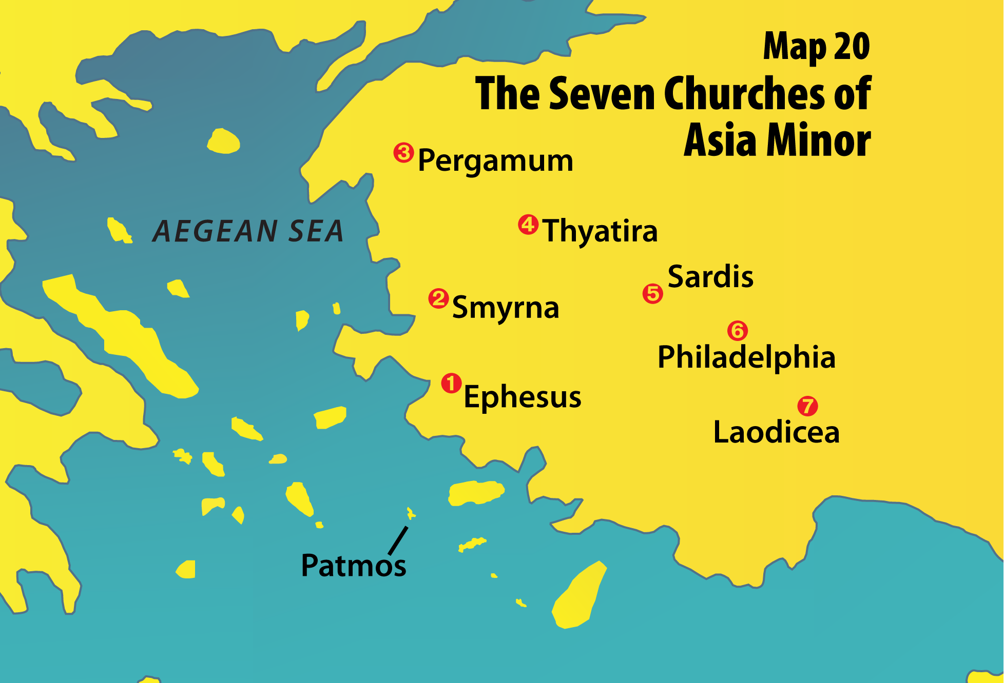

Slide 10
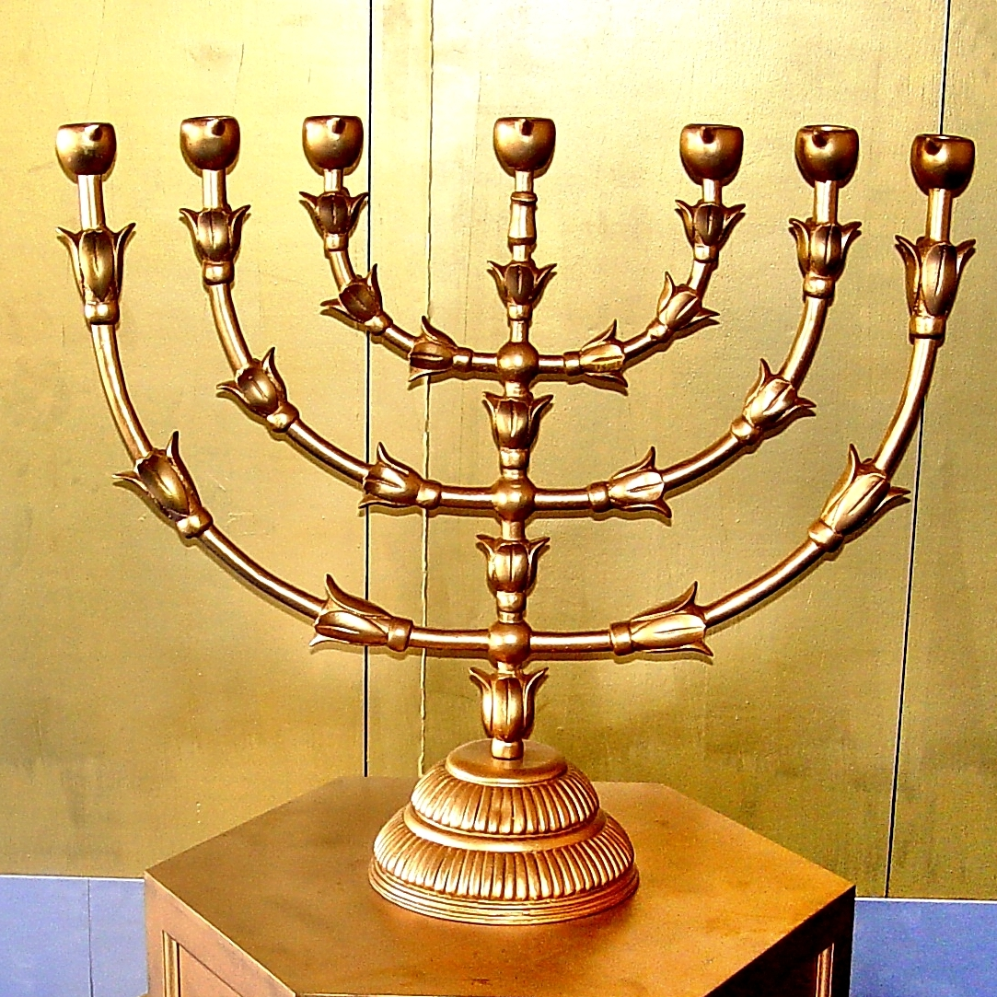
In the Middle of the Lampstands
Not this:
Lamp on Stand – Ephesus Museum

Slide 11
In the Middle of the Lampstands
Not this:
This:
Lamp on Stand – Ephesus Museum

Slide 12
Rev. 2:1-7: "To the angel of the church of Ephesus write, ' These things says He who holds the seven stars in His right hand, who walks in the midst of the seven golden lampstands: 2 "I know your works, your labor, your patience, and that you cannot bear those who are evil. And you have tested those who say they are apostles and are not, and have found them liars; 3 "and you have persevered and have patience, and have labored for My name's sake and have not become weary.

Slide 13
4 "Nevertheless I have this against you, that you have left your first love. 5 "Remember therefore from where you have fallen; repent and do the first works, or else I will come to you quickly and remove your lampstand from its place -- unless you repent. 6 "But this you have, that you hate the deeds of the Nicolaitans, which I also hate. 7 "He who has an ear, let him hear what the Spirit says to the churches. To him who overcomes I will give to eat from the tree of life, which is in the midst of the Paradise of God."

Slide 14
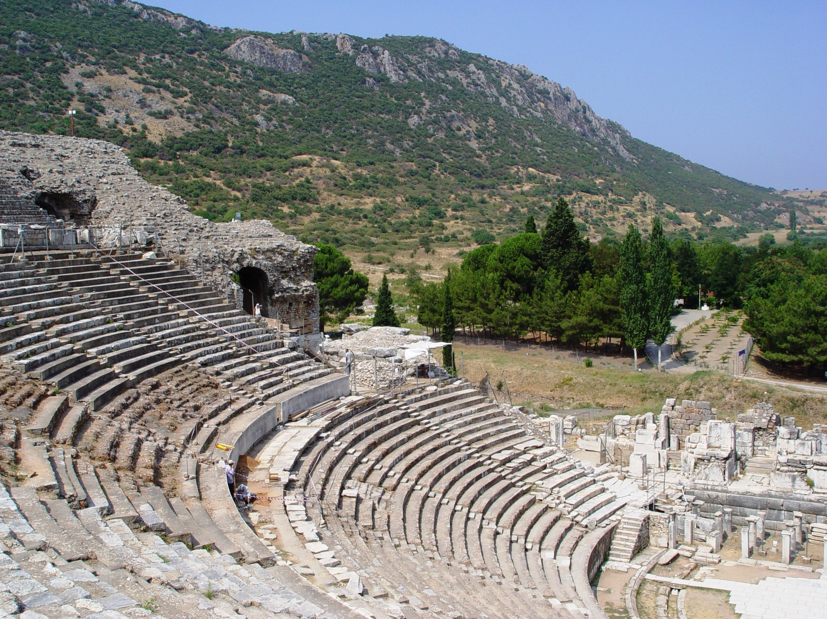

Slide 15
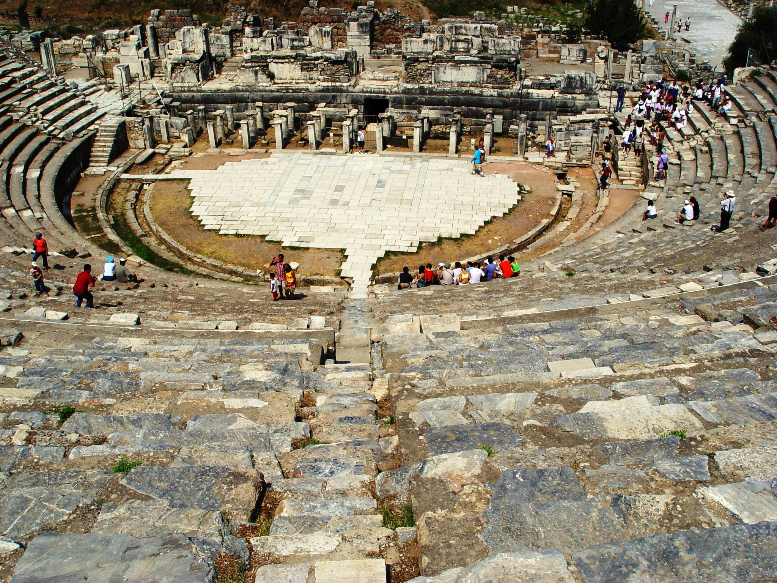

Slide 16
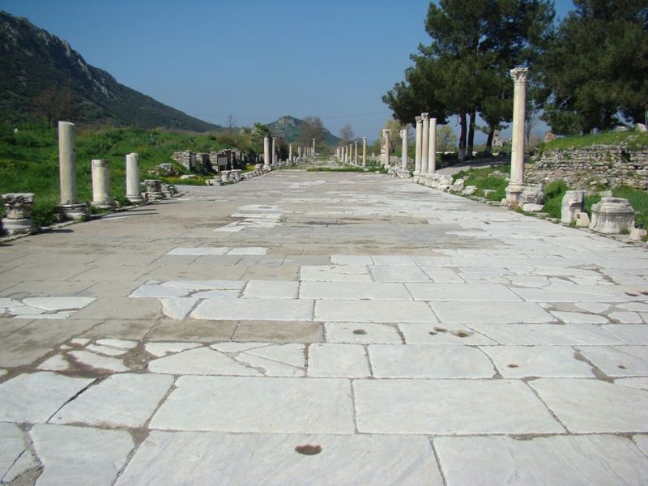

Slide 17
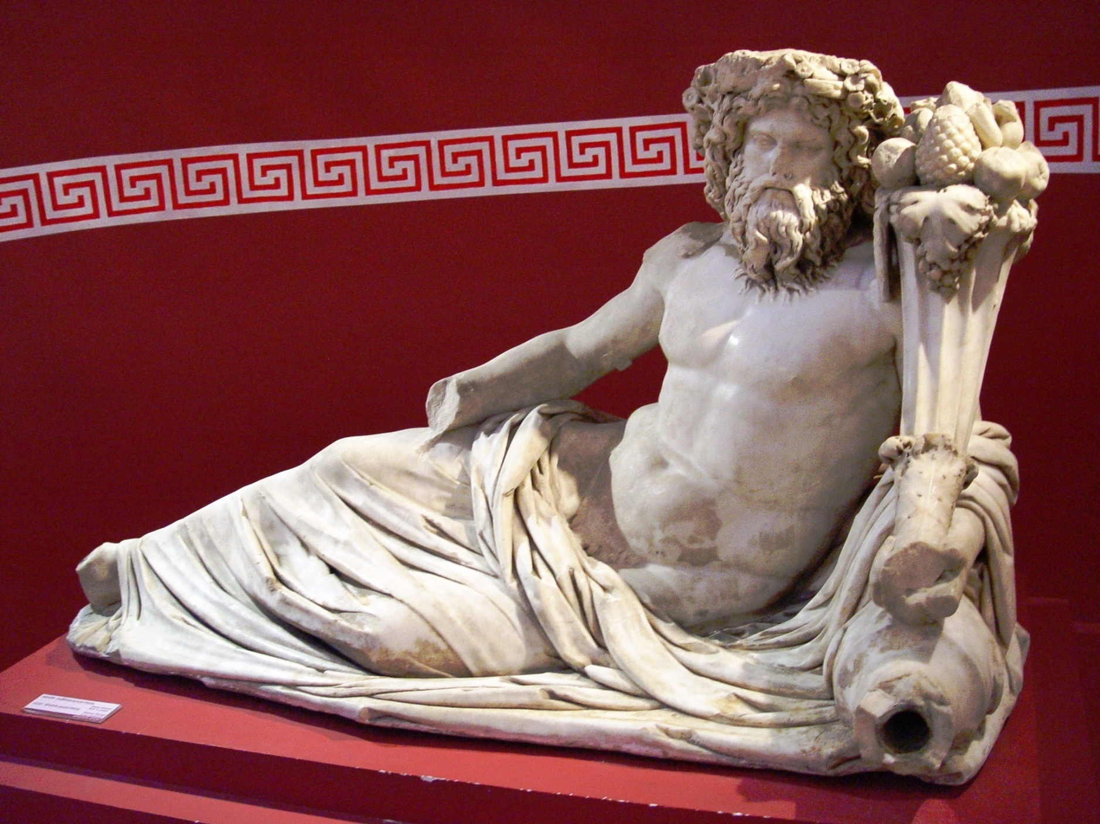
Location
  Three miles from Aegean Sea in
  the Cayster River valley
  A great seaport – but the
  harbor silted up
  Major roads converged
  on Ephesus
The god
Cayster
Notes:
Izmir Museum

Slide 18
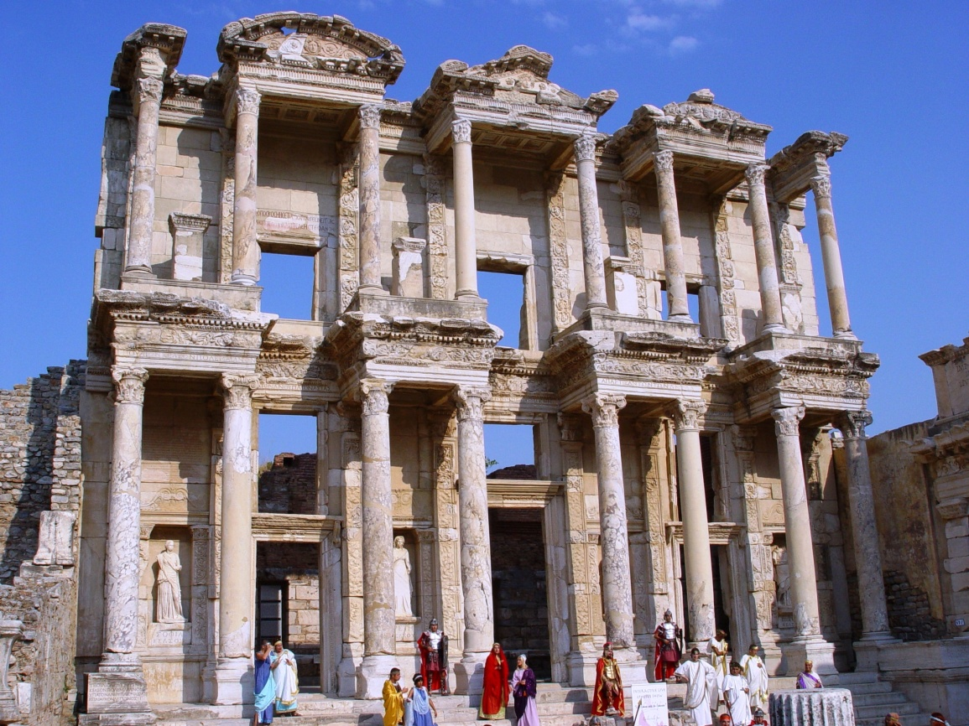
The City of Ephesus
Vanity fair of Greco-Roman world
Supreme metropolis of Asia
Fourth greatest city in world
  Rome, Alexandria,
  Antioch, Ephesus
Population of
about 250,000

Slide 19
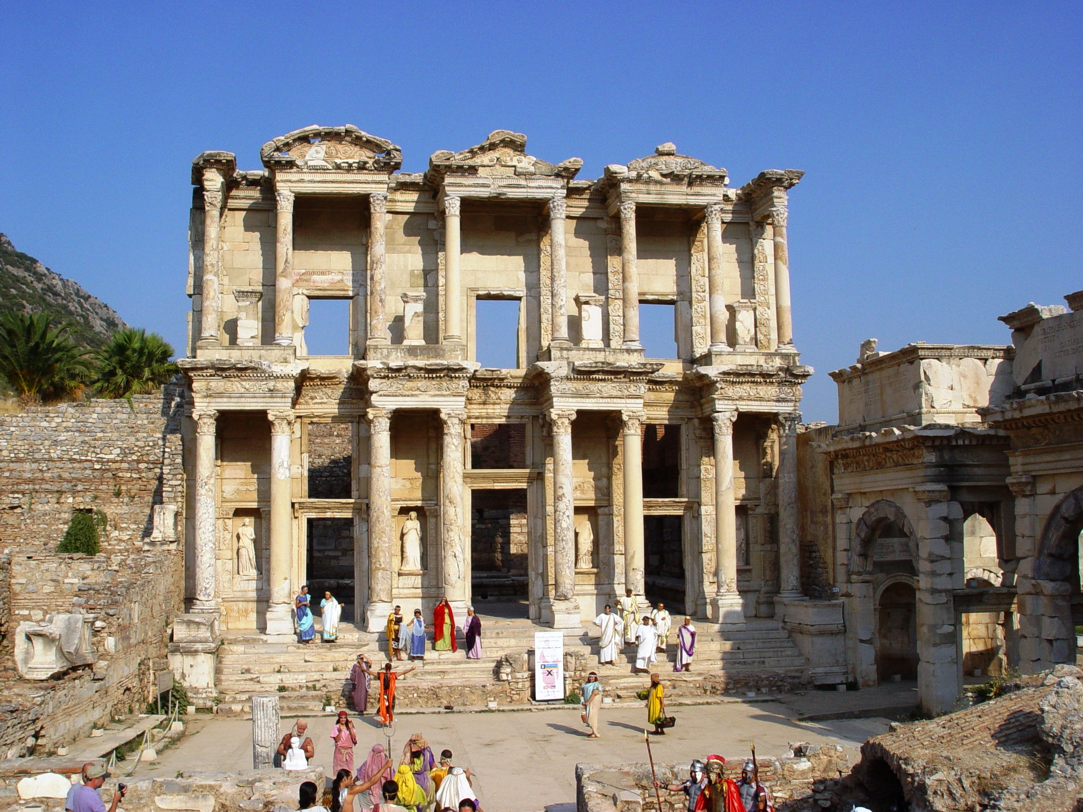

Slide 20
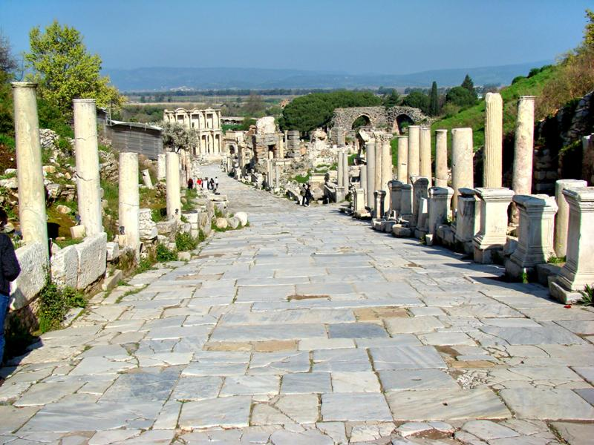
Notes:
Curetes Street received its name for the inscriptions naming the curetes, that is, the priests, of Artemis. Fountains, monuments, statues and shops would have lined the street. The street itself measured 11 meters wide. In the distance in our photo you can see the Celsus Library.

Slide 21
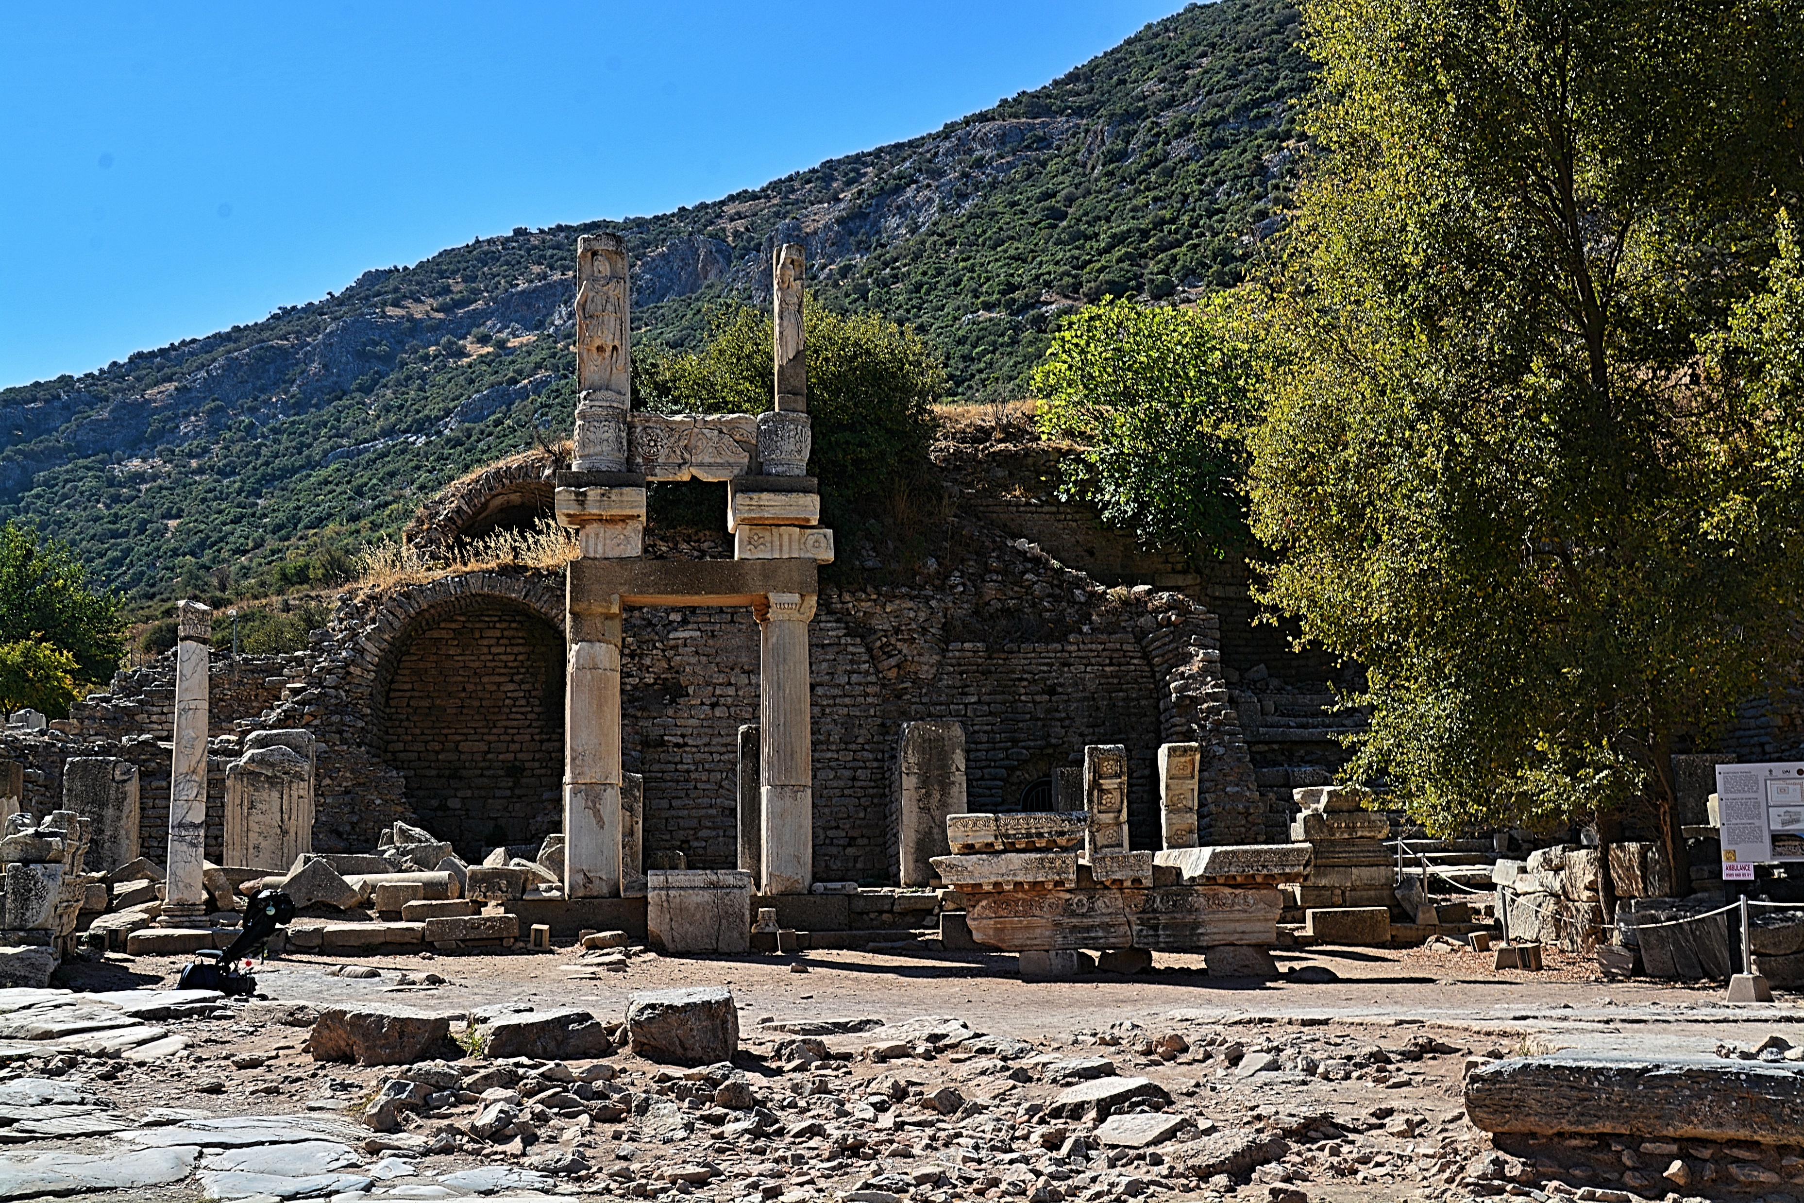

Slide 22
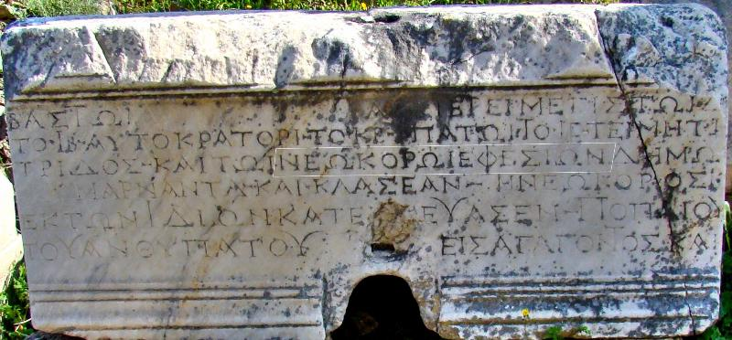
Notes:
Ephesus was named as the Neokoros, the temple keeper. Ephesus was a center of the Imperial Cult, Caesar worship.

Slide 23
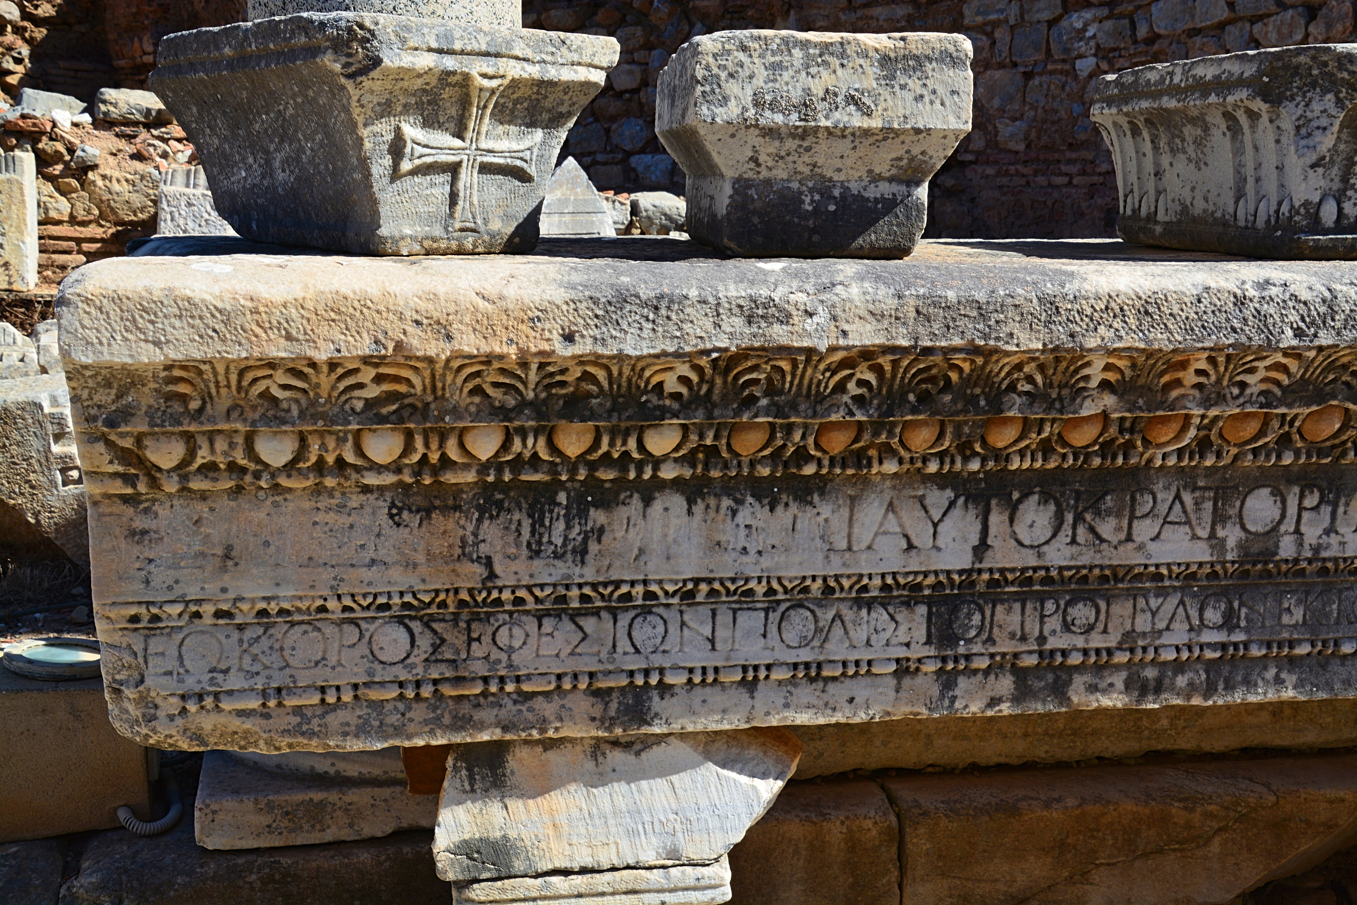

Slide 24
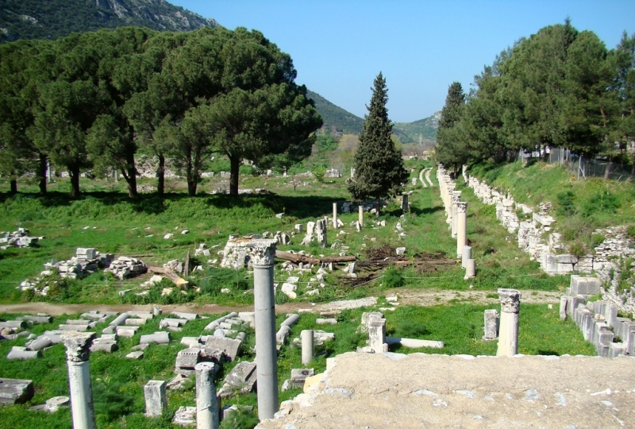
Notes:
Commercial Agora. Bolen: The commercial agora at Ephesus was first constructed in Hellenistic times. The Romans, especially under Augustus, Nero, and Caracalla, remodeled and changed it. Different types of columns were used when it was restored a second time (4th century A.D.), after an earthquake greatly damaged it. The agora measured 110 meters square (340 feet) and had a sundial/water clock in the center, the foundations of which are still visible. Inscriptions found here reveal that it was once decorated with numerous statues. There were also many shops selling food and other goods.

Slide 25
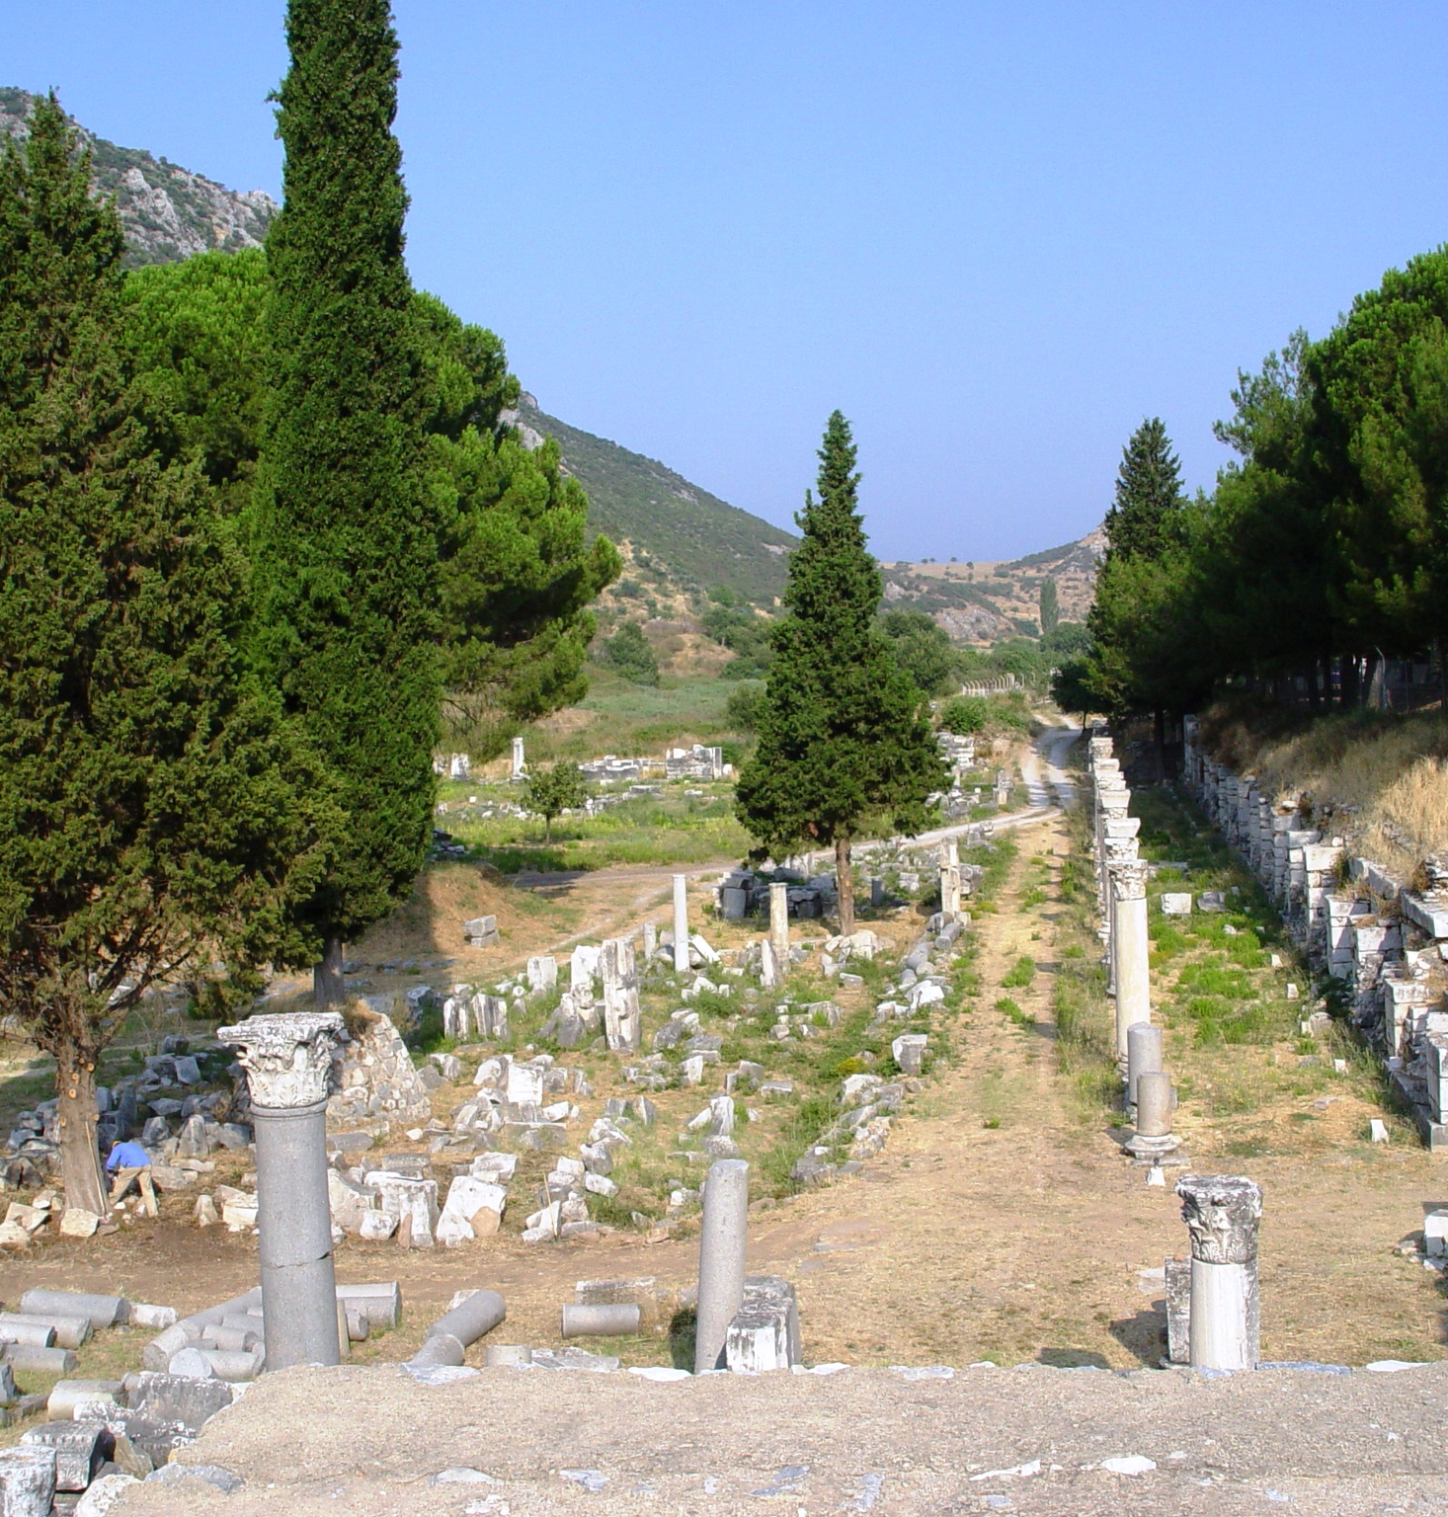
Acts 19:24 For a certain man named Demetrius, a silversmith, who made silver shrines of Diana, brought no small profit to the craftsmen.
Commercial Agora
Notes:
Commercial Agora. Bolen: The commercial agora at Ephesus was first constructed in Hellenistic times. The Romans, especially under Augustus, Nero, and Caracalla, remodeled and changed it. Different types of columns were used when it was restored a second time (4th century A.D.), after an earthquake greatly damaged it. The agora measured 110 meters square (340 feet) and had a sundial/water clock in the center, the foundations of which are still visible. Inscriptions found here reveal that it was once decorated with numerous statues. There were also many shops selling food and other goods.

Slide 26
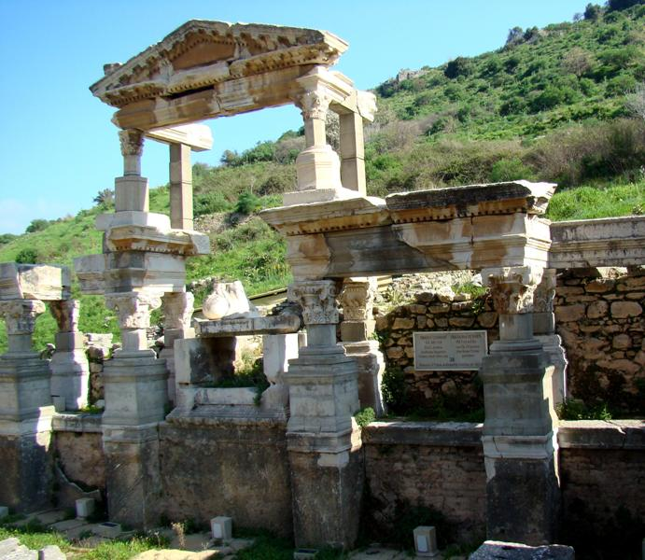
Notes:
Another structure of interest is the Trajan Fountain, dedicated to the emperor Trajan (reigned A.D. 98-117). The fountain was built A.D. 102-104. For what it’s worth, Michael Grant writes, “Trajan was a tall and well-built man, with an air of serious dignity enhanced by early greyness” (The Roman Emperors, p.75).

Slide 27
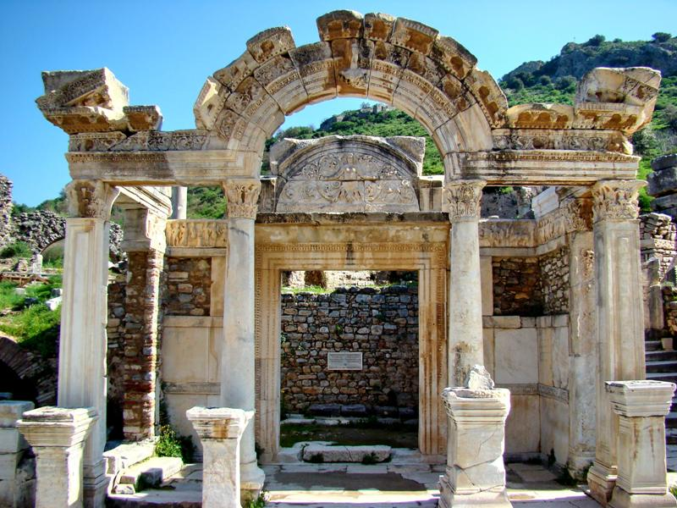
Notes:
Hadrian Temple. Emperor Hadrian reigned A.D. 117-138. The “Second Revolt” (A.D. 132) of the Jews took place during Hadrian’s reign. Michael Grant observes,
For Hadrian, whose cosmopolitan outlook was unsympathetic to Jewish separatism, had established a Roman colony and temple in Jerusalem, now renamed Aelia Capitolina after his own Aelian family; and this foundation caused great anger among the Jews, who in 132 broke into open insurrection under an inspiring leader, Simeon Bar Kosiba (nicknamed Bar Kochba, ‘son of a star’). The rebels took Jerusalem and issued their own coinage, and it took three years to overcome their uprising. During this period the emperor visited Judaea, once if not twice, and he is likely to have been present when Jerusalem finally fell in 134. The surviving militants were rounded up at Bethar the following year, and severe measures of reprisal included a total prohibition of circumcision. (ibid.79).

Slide 28
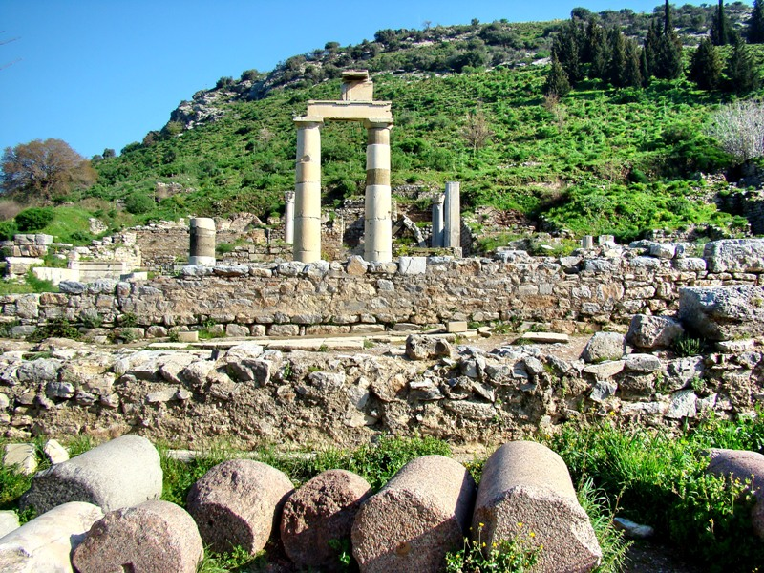
Notes:
The prytaneion was the government agora, the town hall. There was a courtyard in front of the building. There is evidence of a former temple of the Egyptian god Isis on the western side. Lance Jenott, University of Washington, says further of this site, “This Agora (usually translated as “market place” but in this case more of a “town square”) was built in the first century CE under the Flavian Emperors as the site of the Roman state cult. In the middle of the State Agora sat the temple of Divius Julius (Divine Julius Caesar) and Dea Roma (the divine personification of the Roman Empire).”

Slide 29
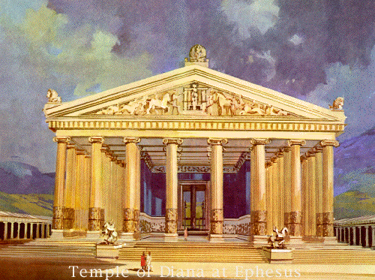
Artistic Impression of
the Temple of Diana

Slide 30
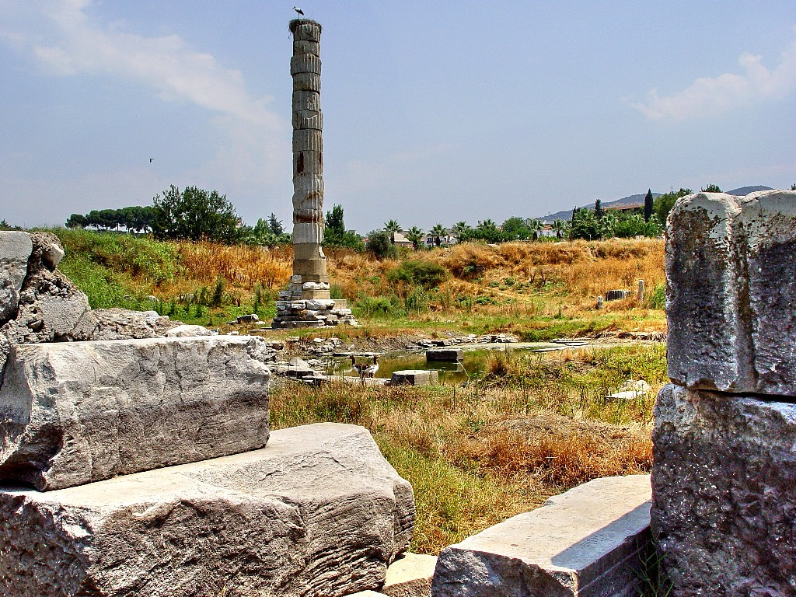

Slide 31
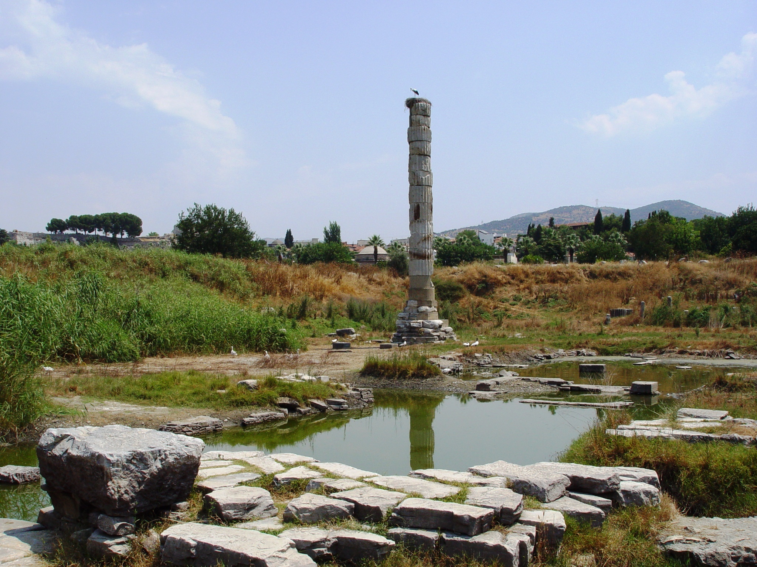
Notes:
The Temple of Artemis
Known as one of the Seven Wonders of the ancient world, the temple of Artemis, or Artemision, was in antiquity located by the sea. It was first built in the mid-6th century B.C. by Croesus, a Lydian king, atop previous temples dating to the 8th century B.C. The temple was about 60 meters wide and had approximately 106 columns. It was set on fire in 356 B.C. by an individual seeking fame, robbed in 263 A.D. by the Goths, and finally destroyed ca. 400 A.D., when the cult was discontinued. The temple was not covered; the walls surrounded an open court area inside of which was a small temple-like building containing the cult statue.
This temple dominated Ephesus’ religion, joined by temples of the Roman Emperor cult in the late 1st century A.D. Artemis was the virgin goddess of the moon, the hunt, and in some ways of fertility and “nature.” Called Diana by the Romans, she was the twin sister of Apollo and daughter of Zeus. She begged Zeus to allow her to remain unmarried, and so she roamed the forests girt with her bow and arrow and accompanied by her beloved deer and wild beasts. She protected hunters and was like “Mother Nature”—fertile and supportive—but was also cruel, revengeful and destructive. One of the most popular of Greek deities, she was the patron goddess of the city of Ephesus.

Slide 32
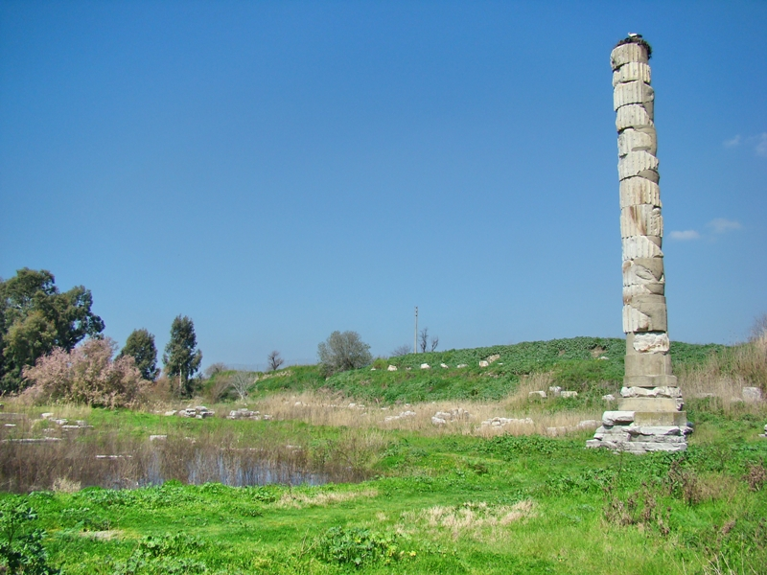

Slide 33
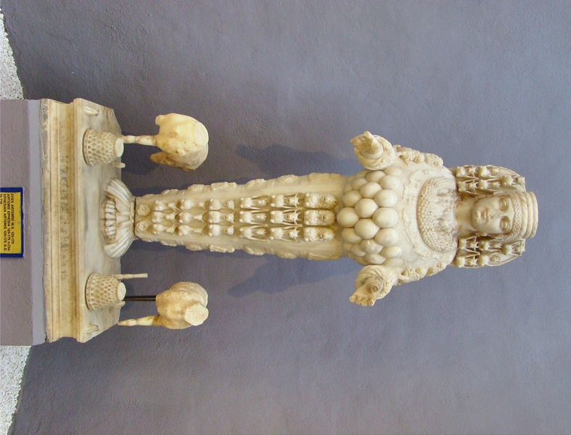
STATUE OF ARTIMIS

Slide 34
Summary of Letter to Ephesus:
The Church That Left Its First Love
A Rich History:
---Paul’s labor there: 3 yrs (Acts 20:31)
---Aquila and Priscilla (Acts 18:24ff.)
---Timothy (1 Tim.1:3)
---John.

Slide 35
Summary of Letter to Ephesus:
The Church That Left Its First Love
(Commendation) Jesus knows:
Rev. 2:2: ---their labor-- ---patience
---doctrinal soundness: “I know your works, your labor, your patience, and that you cannot bear those who are evil. And you have tested those who say they are apostles and are not, and have found them liars”

Slide 36
Summary of Letter to Ephesus:
The Church That Left Its First Love
(Commendation) Jesus knows:
---perseverance; had not become weary.
v.3 and you have persevered and have patience, and have labored for My name’s sake and have not become weary.

Slide 37
Summary of Letter to Ephesus:
Condemnation: v.4 “Nevertheless I have this against you, that you have left your first love.”
“You have left your first love.”
---devotion to God
*Baptism of the 12 (Acts 19:1-7)
*Clean break with paganism (19:18-20)
*Concern of elders (20:17-38)

Slide 38
Summary of Letter to Ephesus:
Condemnation: “You have left your first love.”
---devotion to God
---love for brethren
---love for lost souls

Slide 39
Summary of Letter to Ephesus:
Admonition
Remember, repent, do the first works
Else they would lose their identity
v.5 Remember therefore from where you have fallen; repent and do the first works, or else I will come to you quickly and remove your lampstand from its place—unless you repent.

Slide 40
Summary of Letter to Ephesus:
Further:
v.6 But this you have, that you hate the deeds of the Nicolaitans, which I also hate.
v.7 He who has an ear, let him hear what the Spirit says to the churches. To him who overcomes I will give to eat from the tree of life, which is in the midst of the Paradise of God.
Notes:
Based on the preceding evidence, what conclusions should we draw concerning the situation in Asia at the time Revelation was written? All the opponents John has mentioned so far seem to be people within the churches, people who call themselves “Christians,” people who think they are serving God. These believers are probably encouraging other Christians to go ahead and eat meat offered to idols, or say “Caesar is Lord,” or offer incense to Caesar at the public festivals and trade guild banquets and other social events. In support of this position, they could appeal to Jesus himself, who commands his followers to “Give to Caesar what is Caesar’s” (Matt 22:21). They could also appeal to the Apostle Paul’s admonition to “submit to the governing authorities” as ministers of God (Rom 13:1). (For further discussion of Emperor Worship in Daily Life, Christian Responses to the Emperor Cult, and the Christian’s Choice, see Part IV.B.3 of the Introduction.)
In the letters to the seven churches, John attacks this point of view. He offers the churches a revelation of the present in which he helps believers to see their behavior as Christ sees it. What his readers may be brushing off as harmless accommodation to Greco-Roman culture, Christ identifies as the work of Satan, the idolatry of Balaam and Jezebel, adultery committed against God.
We know nothing about the “Nicolaitans,” but they were probably promoting a similar accommodation. The Greek term “Nico laitans” literally means “conquerors of the people” or “ones who overcome the people.” (“Overcoming” is a major theme in Revela tion, as discussed below.) It is roughly equivalent to the Hebrew name “Balaam” (Baal-am), which means “lord over the people.” Like “Balaam” and “Jezebel,” the “Nicolaitans” may be John’s symbolic name for his opponents.
Davis, Christopher A.: Revelation. Joplin, Mo. : College Press Pub., 2000 (The College Press NIV Commentary), S. 139

