Slide 1
WHAT JESUS THINKS OF THE CHURCH
A STUDY OF THE SEVEN CHURCHES OF ASIA
REVELATION 2-3
Letter to the church at Pergamum

Slide 2
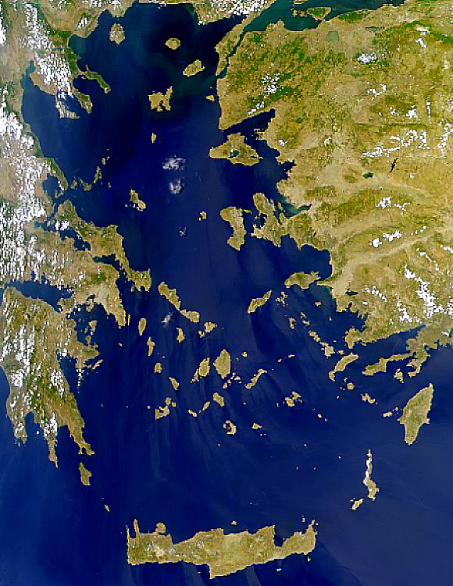
Satellite View
x
Patmos
Size: About 22 sq. miles of land area.
10 miles N-S 6 miles E-W at north end
Crete
NASA Photo

Slide 4
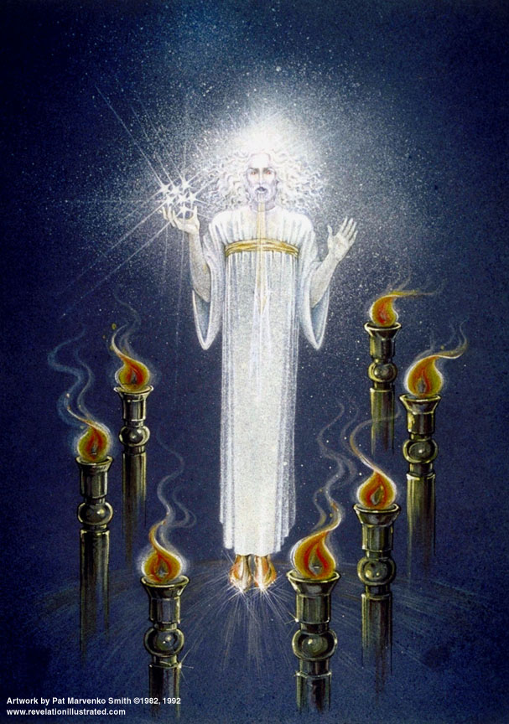
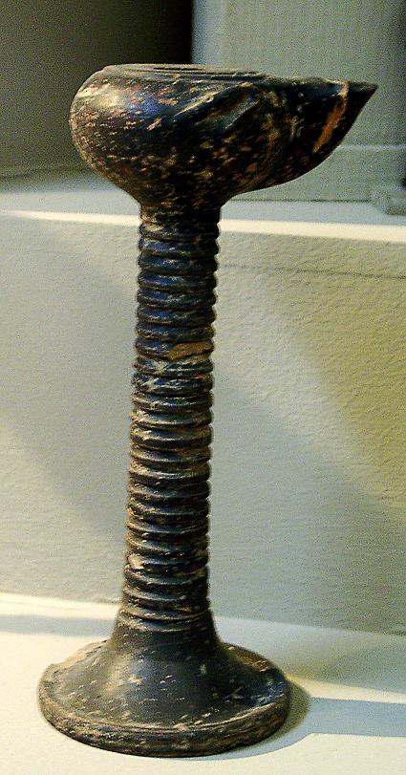
In the Middle of the Lampstands
Lamp on Stand – Ephesus Museum

Slide 5
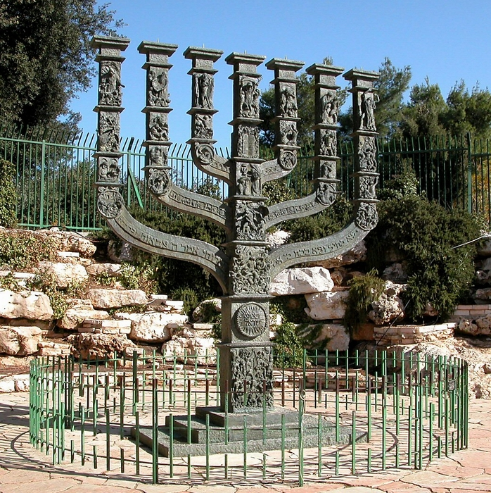
In the Middle of the Lampstands
Not this:
This:
Lamp on Stand – Ephesus Museum

Slide 6
In the Middle of the Lampstands
Lamp on Stand – Ephesus Museum

Slide 7
Notes:
Mysian capital city. 40+ miles north of Smyrna; 15 miles inland from the Aegean Sea. Capital of the province of Asia. Eumenes II, king of Pergamum (197-160 B.C.).

Slide 8
12 "And to the angel of the church in Pergamum write: These are the words of him who has the sharp two-edged sword: 13 "I know where you are living, where Satan's throne is. Yet you are holding fast to my name, and you did not deny your faith in me even in the days of Antipas my witness, my faithful one, who was killed among you, where Satan lives.

Slide 9
14 But I have a few things against you: you have some there who hold to the teaching of Balaam, who taught Balak to put a stumbling block before the people of Israel, so that they would eat food sacrificed to idols and practice fornication. 15 So you also have some who hold to the teaching of the Nicolaitans. 16 Repent then. If not, I will come to you soon and make war against them with the sword of my mouth.

Slide 10
17 Let anyone who has an ear listen to what the Spirit is saying to the churches. To everyone who conquers I will give some of the hidden manna, and I will give a white stone, and on the white stone is written a new name that no one knows except the one who receives it.

Slide 11
Pergamum: Where Satan’s Throne Is
Association with worship of snakes and handling of reptiles
--Worship of Asklepios, the god of healing
--Serpent was symbol of Asklepios
Worship of Serapis, the Egyptian god.
Worship of Zeus, Athena, Dionysus.
--During Hellenistic period
The Imperial Cult
--During Roman period

Slide 12
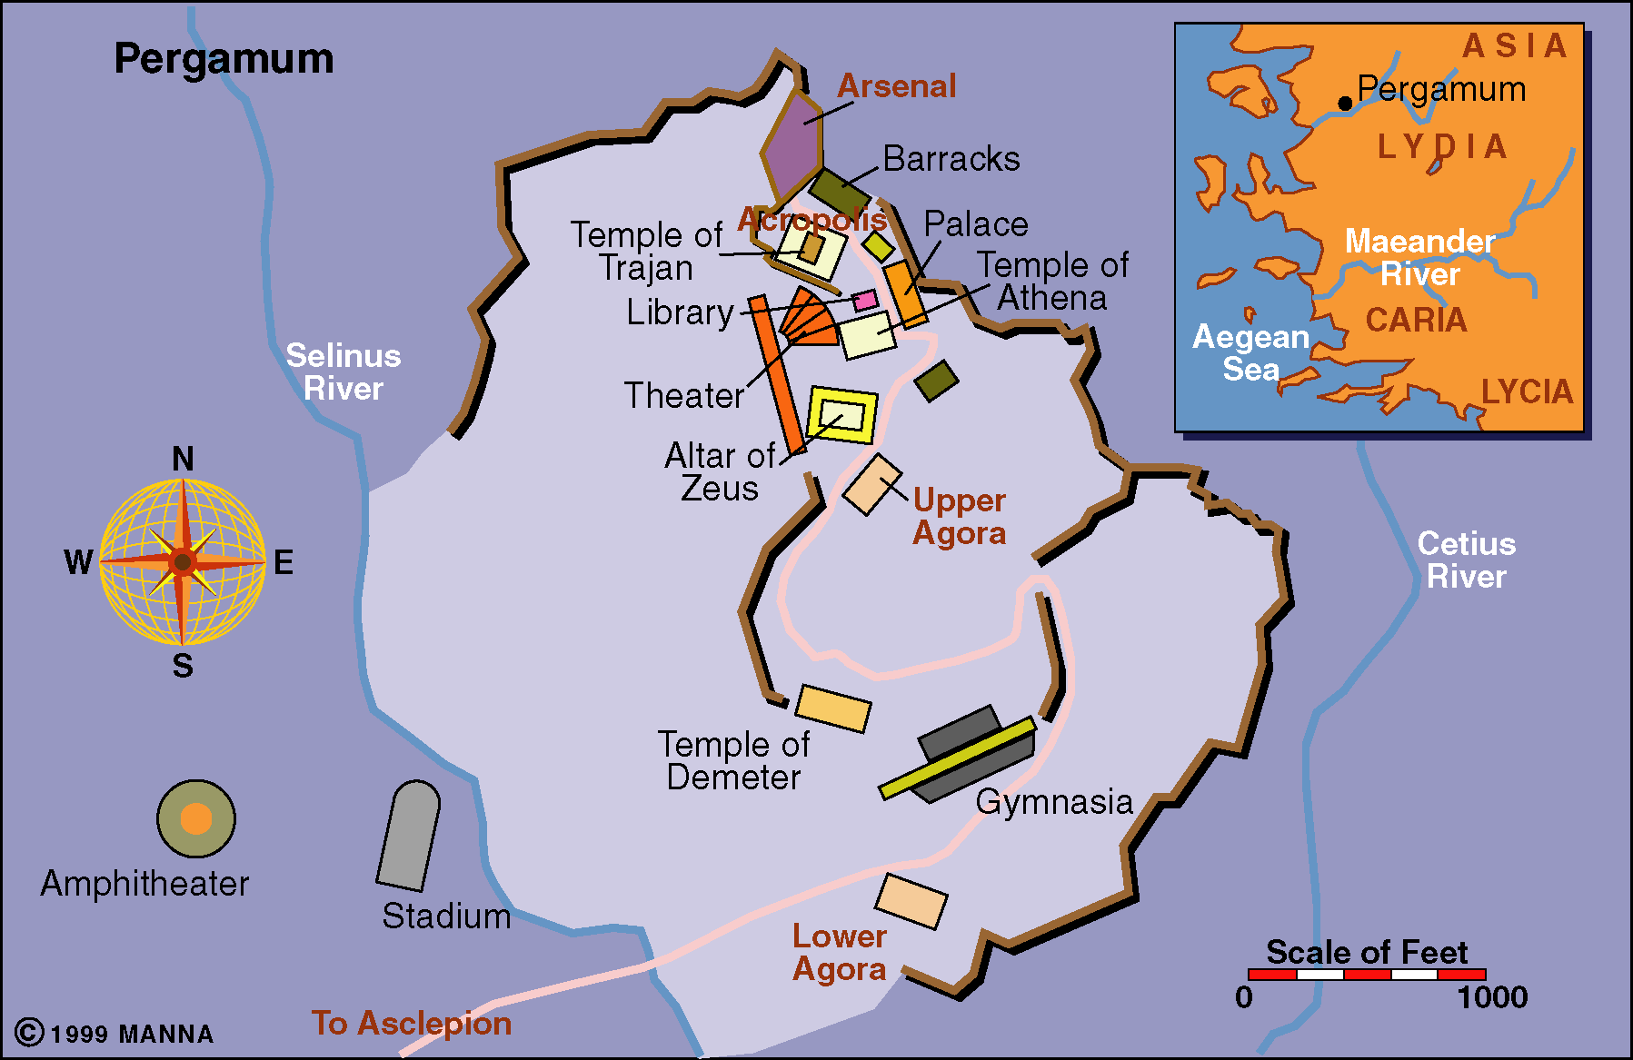
Pergamum – The Acropolis

Slide 13
Notes:
Historical Background
The site of Pergamum was first settled in the third millennium B.C. From 547-334 B.C. it was under Persian rule, until Alexander the Great conquered Asia minor (ca. 334 B.C.) and Pergamum gained importance. Upon his death his general Lysimachus turned the small town of Pergamum into a military base. He also built Ephesus during this period, a city which would be Pergamum’s main rival for power for centuries to come. When Lysimachus was killed in battle, his successor, Philetarus, inherited the city. Philetarus left the city to his adopted son, Eumenes I, founder of the Pergamene dynasty:
Under the reign of Eumenes I (263-241 B.C.), Pergamum became a leading cultural center, especially in art and science. The acropolis underwent massive restoration and the Aesculapium, a cultic healing center, was founded. When Eumenes I died, he bequeathed the city to his nephew, Attlos I.
Ruling from 241-197 B.C., Attlos’ first task was to defeat the Galatian Gauls who were demanding taxes from the city. His victory brought the establishment of the kingdom of Pergamum, which stretched from the Sea of Marmara to the Troas mountains. To celebrate his victory, he built the temple of Athena, the famous library, and the Altar of Zeus. Attlos I is also noted for his alliance with Greece and Rome.
Eumenes II succeeded Attlos I (197-159 B.C.) and extended the borders of the kingdom to Bythinia and Cappodoccia. These years were considered the first golden age of Pergamum; the city became the center for the arts and sciences, the library was enlarged, and construction on the Altar of Zeus was completed.
During the reign of Attlos II, from 159-138 B.C., Prusias, king of Bithynia, attacked the city and sacked the lower city. Because Pergamum had the support of Rome, the two rulers formed a treaty.
Attlos II was succeeded by Attlos III (138-133 B.C.), a hypochondriac more interested in chemistry than politics. He tested poisons on prisoners and the elderly in order to find antidotes. When his mother and wife died, he believed them to have been poisoned and went mad in his search for the antidote. He died in 133 B.C. and willed Pergamum to Rome.
Pergamum came under Rome’s jurisdiction between 133-40 B.C. The first state in Asia Minor was established (Provincia Asia), and Pergamum was ruled by many proconsuls. While Julius Caesar was in power of Rome, Pergamum enjoyed a second golden age. Upon his death the city was given to Marc Antony (40 B.C.-14 A.D.), who gave all 200,000 books from the library to Cleopatra. Augustus Caesar defeated Antony and gained power of the city, during which time the first temple of the Imperial cult was constructed.
During the reign of Tiberius (14-37 A.D.), the city suffered a great earthquake. Because the emperor rebuilt and repaired the city, a temple was erected here in his honor. Pergamum was to become the center for imperial veneration in Asia. Temples were built to emperors Trajan (98-117 A.D.) and Hadrian (117-138 A.D.) and to Faustina, Marcus Aurelius’ wife (157-180 A.D.). Marcus Aurelius gave a medal to Claudius Galenus, a famous doctor from the Aesculapium and personal physician of Aurelius and his son Commodus’ (of Gladiator fame). Emperor Caracalla recovered the Aesculapium and called the city “Proto Metropolis,” meaning “number one.” Under the rule of Decius (249–251 A.D.), intense persecution of Christians broke out in Pergamum. The city suffered much destruction in the years of 253-260 A.D.
The Edict of Milan (313 A.D.) declared Christianity legal and by 379 A.D. it had become the state religion; pagan temples were converted into churches. Power in the city transferred to East Roman rule in 395 A.D., to the Byzantine empire (395-1306 A.D.), to the Ottoman Turks (1306-1917), to Greece (1919), and finally to the Turks (July 14, 1922).

Slide 15
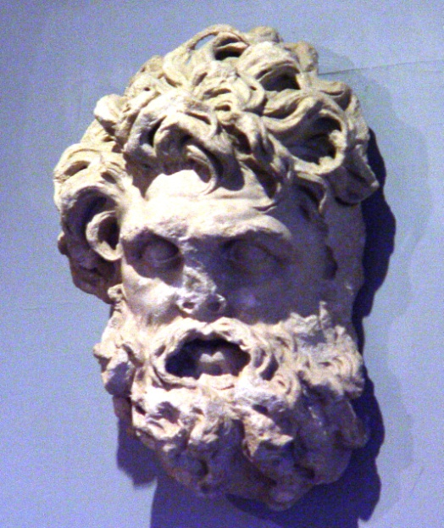
Notes:
Called “Zeus our Savior”

Slide 16
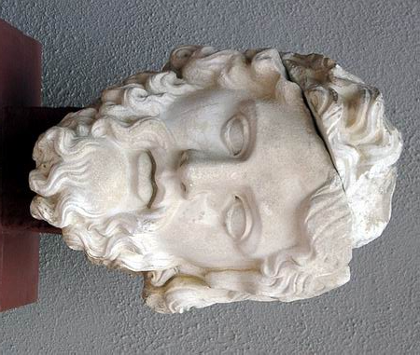
Notes:
Barclay: one of the most famous altars in the world…stood on a ledge which jutted out from the hillside 800 feet up. 90 ft. sq. and 20ft. high…All day long this altar smoked with the smoke of countless sacrifices to Olympian Zeus. It dominated the city. No one could fail to see it; the eye of anyone in Pergamos was drawn to it (44).
Bolen: The altar of Zeus was one of the most famous parts of the site of Pergamum. Built by Eumenes II to celebrate Attalus I’s victory over the Celts, it had a frieze portraying a battle between the giants and the gods. When the Germans came in, they dismantled the altar and took it to Berlin, where it is on display today. Stairs and foundations are all that remain of the altar on the site, although there is a model of the altar in the Bergama museum.

Slide 17
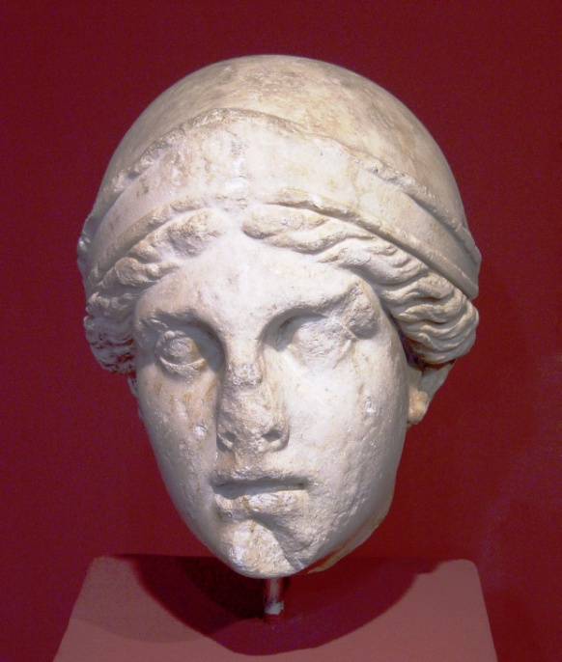
Notes:
The temple of Athena dates to the 4th century B.C., making it the oldest surviving temple at Pergamum. The central area was enclosed by Doric colonnades. An inscription found here dedicates the temple by “King Eumenes to Athena the bearer of victories.” A reconstruction of pieces found on the site can be seen in the Berlin Museum today.

Slide 19
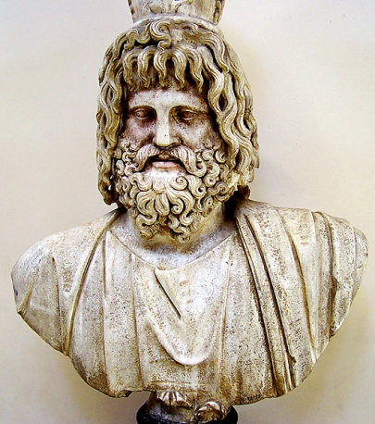
Serapis (Egyptian) Temple

Slide 20
Barclay: Invitations to such feasts often read: “I invite you to dine with me at the temple of our Lord Serapis” (p.51).

Slide 21
Heroon
Notes:
The Pergamene kings, including Attalus I and Eumenes II, were honored at the Pergamum heroon. This was built in Hellenistic times and renovated under the Romans.

Slide 23
Neokoros
Inscription at Pergamum
Twice Neokoros
Bergama, Turkey, Museum

Slide 24
Notes:
The Trajan temple was the jewel of Pergamum. Built in Roman times, it sat on a terrace in the mountainside. The temple was dedicated to Emperor Trajan (98-117 A.D.) and his heir Hadrian, whose statues once stood here. It was made of white marble and was supported by colonnades in Corinthian style. A team of German archaeologists are presently working to restore the Trajan temple.

Slide 25
Priest of the imperial cult

Slide 26
Temple of Dionysus
Notes:
Bolen: The temple of Dionysus sits just beside the foot of the theater. It was built of andesite in the 2nd century B.C. but rebuilt with marble in the 3rd century A.D., dedicated to Carcalla.

Slide 28
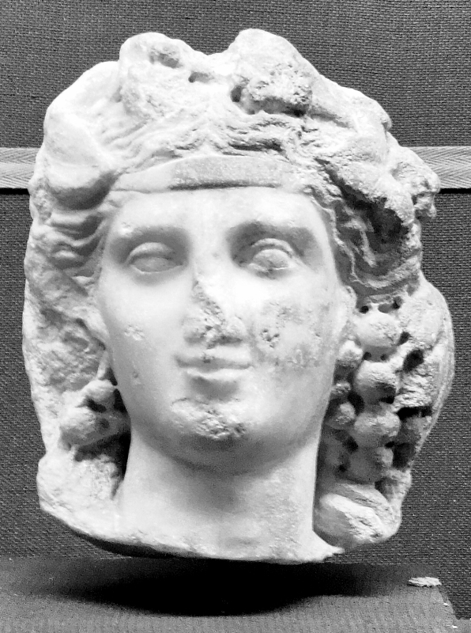

Slide 29
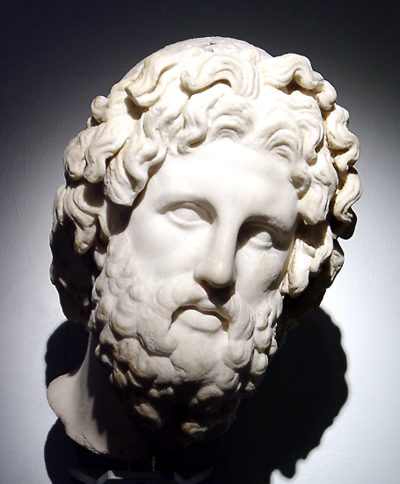
Askleipos
Notes:
Photo British Museum.

Slide 30
Notes:
Aesclepius is almost always portrayed with a snake, Propylon, who gave him healing powers.

Slide 33
Aesclepius is almost always portrayed with a snake, Propylon, who gave him healing powers.

Slide 36
Notes:
Bolen: The Sacred Passageway was one means of treatment. As patients walked from one end to the other, it is said that “doctors” shouted down positive words from holes above, in order to help them feel better. The vaulted roof and holes provided light for the tunnel.

Slide 37
Pergamum: The Church That Lived Next Door To Satan
Commendation:
“I know…where you dwell, where Satan’s throne is.”
Hold fast the Lord’s name.
Did not deny faith.
Antipas suffered martydom

Slide 38
Pergamum: The Church That Lived Next Door To Satan
Condemnation:
Some held to the doctrine of Balaam.
“But I have a few things against you, because you have there those who hold the doctrine of Balaam, who taught Balak to put a stumbling block before the children of Israel, to eat things sacrificed to idols, and to commit sexual immorality.”

Slide 39
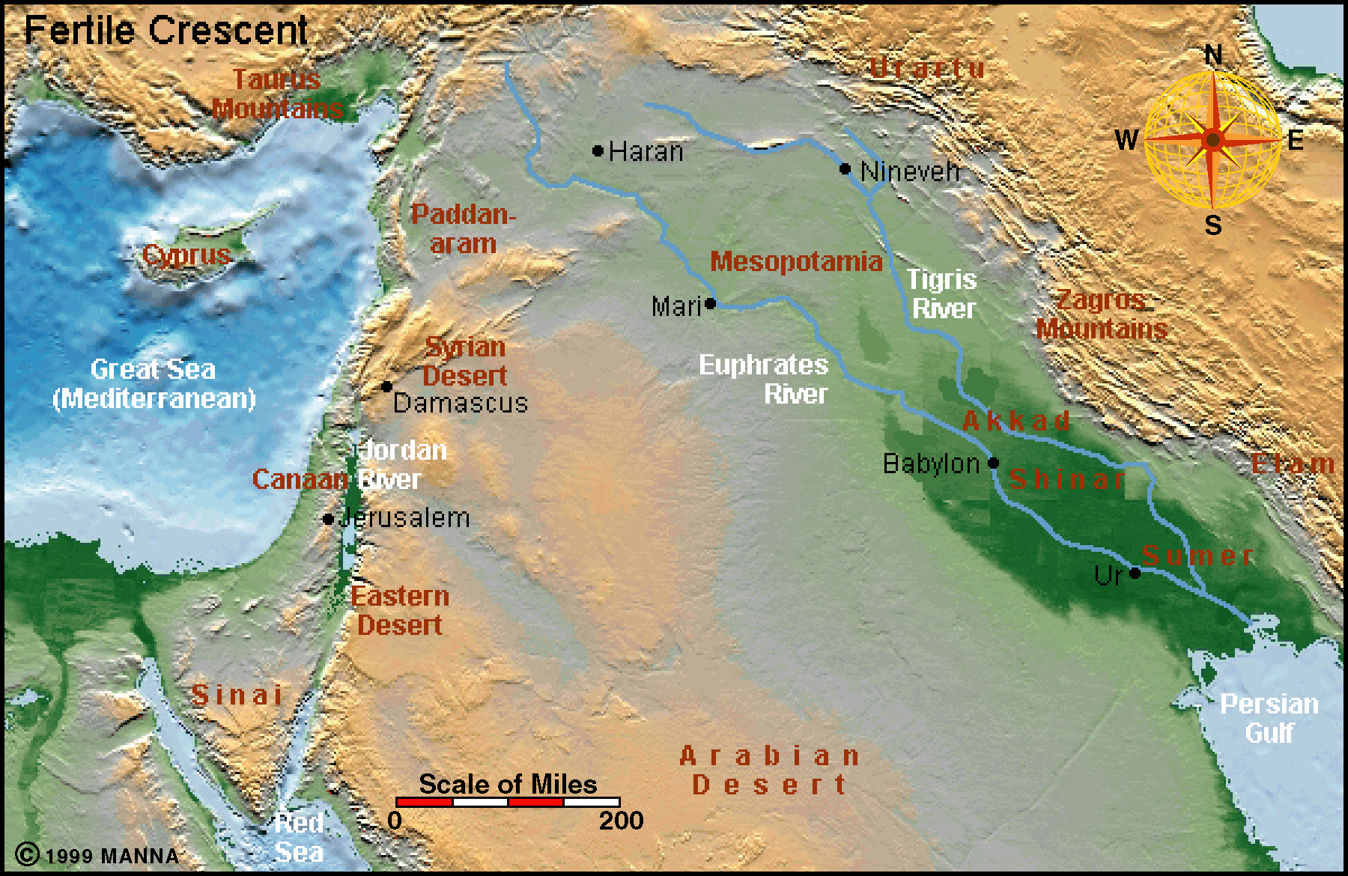
Notes:
Pethor is probably to be equated with Pitru on the west bank of the Euphrates, some twelve miles south of Carchemish. It is mentioned in Assyrian sources (cf. also Deut 23:5). The “River” is a reference to the Euphrates. Budd, Phillip J.: Word Biblical Commentary : Numbers. Dallas : Word, Incorporated, 2002 (Word Biblical Commentary 5), S. 265

Slide 40
Numbers 22:5 Then he [Balak] sent messengers to Balaam the son of Beor at Pethor, which is near the River [Euphrates] in the land of the sons of his people, to call him, saying: “Look, a people has come from Egypt. See, they cover the face of the earth, and are settling next to me”

Slide 41
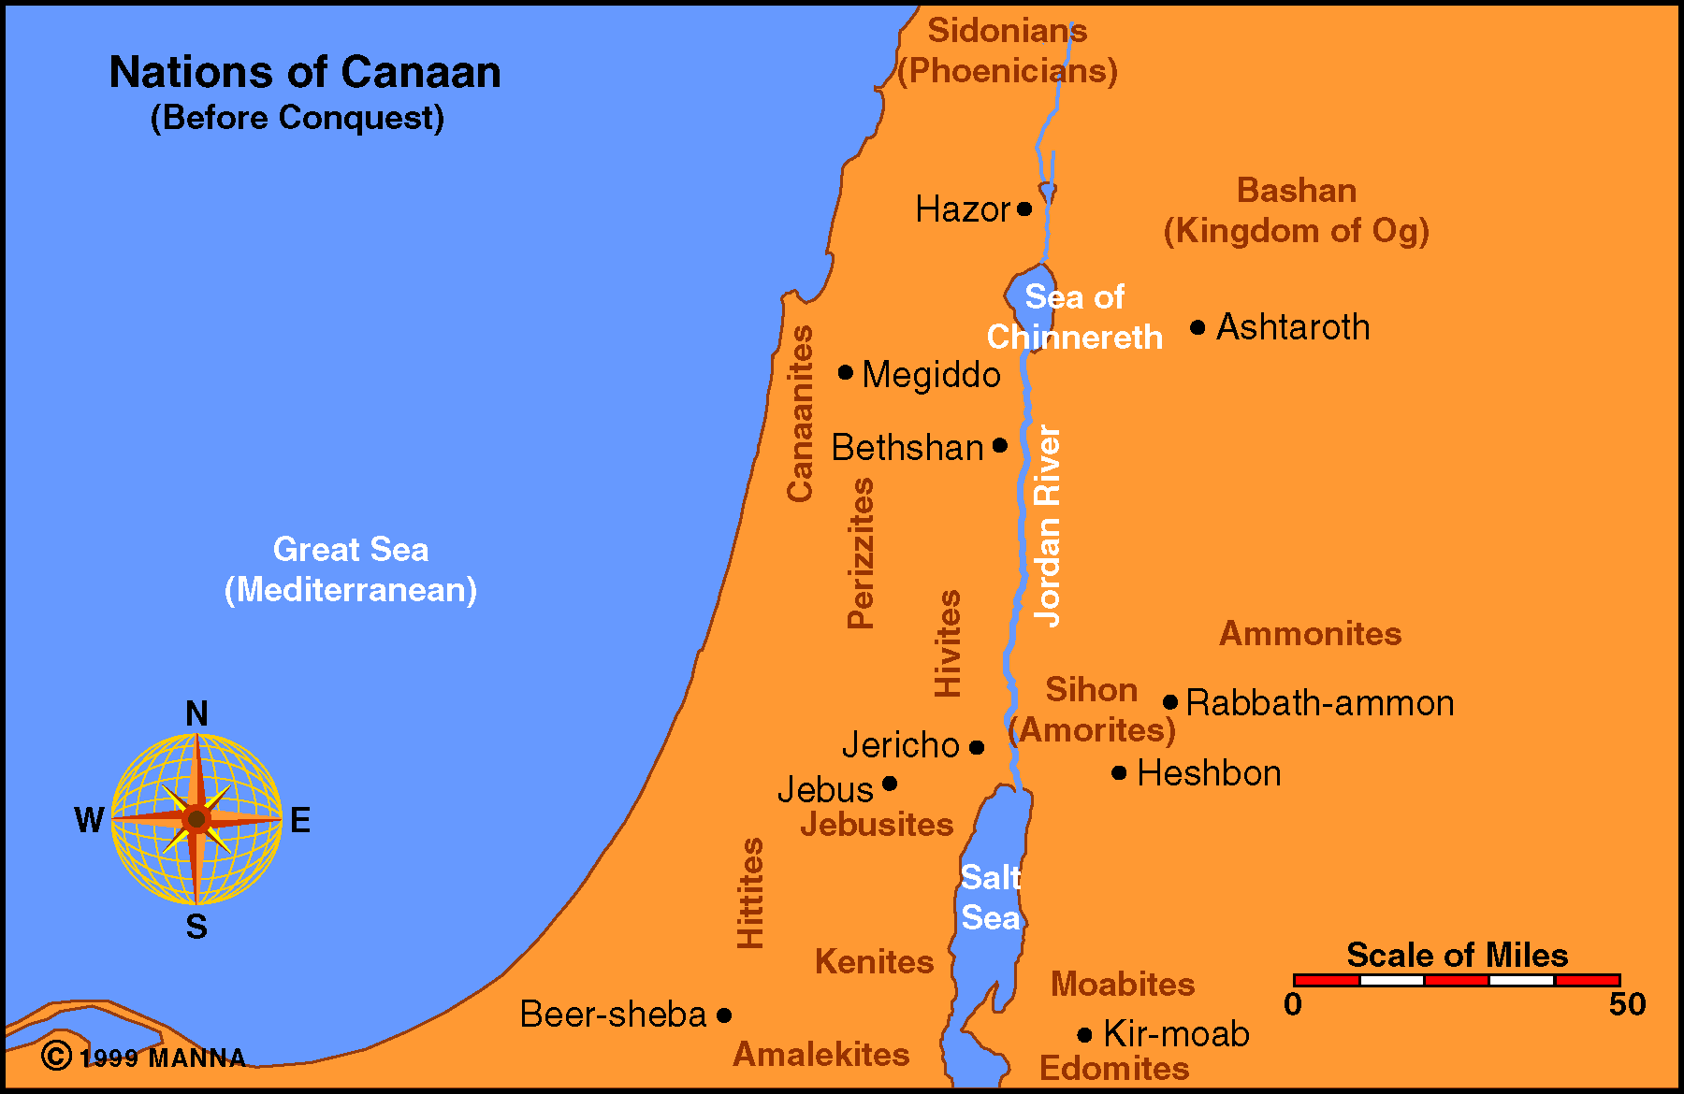

Slide 42
“The Doctrine of Balaam”
Num.31:16 Look, these women caused the children of Israel, through the counsel of Balaam, to trespass against the LORD in the incident of Peor…
Num. 25:1-2 Now Israel remained in Acacia Grove, and the people began to commit harlotry with the women of Moab. They invited the people to the sacrifices of their gods, and the people ate and bowed down to their gods.

Slide 43
“The Doctrine of Balaam”
Psalm 106:28 They joined themselves also to Baal of Peor, And ate sacrifices made to the dead.
Summary: Seduce the men; get them involved in the worship of Moabite idols and it accompanying sexual immorality.

Slide 44
“The Doctrine of Balaam”
2 Pet. 2:15: They have forsaken the right way and gone astray, following the way of Balaam the son of Beor, who loved the wages of unrighteousness;
Jude 11: Woe to them! For they have gone in the way of Cain, have run greedily in the error of Balaam for profit, and perished in the rebellion of Korah.

Slide 45
Pergamum: The Church That Lived Next Door To Satan
Condemnation:
Some held to the doctrine of Balaam.
Others endorsed the teaching of the Nicolaitans.
---Erroneous belief leads to wrong behavior.
This is why we have admonitions like Prov. 4:23!

Slide 46
Pergamum: The Church That Lived Next Door To Satan
Exhotation/Warning:
Repentance was demanded or else the Lord would come and make war “with the sword of My mouth.” cf. Heb. 10:31.
---Balaam, killed w/the sword Num.31:8.
Again, answer was not to pack their bags and move off to some place where it was easier to be a Christian.
Notes:
Commanded to repent of their tolerance.

Slide 47
Pergamum: The Church That Lived Next Door To Satan
Promises:
Hidden manna
cf. Ex.16:33: And Moses said to Aaron, "Take a pot and put an omer of manna in it, and lay it up before the LORD, to be kept for your generations“
Heb.9:4: which had the golden censer and the ark of the covenant overlaid on all sides with gold, in which were the golden pot that had the manna, Aaron’s rod that budded, and the tablets of the covenant.
A far richer feast than those who participated in the idolatrous feasts!

Slide 48
Pergamum: The Church That Lived Next Door To Satan
Promises:
Hidden Manna
White Stone; New Name
Jesus gives us His name 3:12
Our new state? 1 John 3:2-3: Beloved, now we are children of God; and it has not yet been revealed what we shall be, but we know that when He is revealed, we shall be like Him, for we shall see Him as He is. And everyone who has this hope in Him purifies himself, just as He is pure.
Notes:
Barclay: The point is that those who on this earth refused to eat the meat that had been offered to idols would in the world to come eat the bread of God. They might have to give up earthly pleasures, but heavenly joys would be theirs (53).

