Slide 1
WHAT JESUS THINKS OF THE CHURCH
A STUDY OF THE SEVEN CHURCHES OF ASIA
REVELATION 2-3
Letter to the church at Thyatira

Slide 2
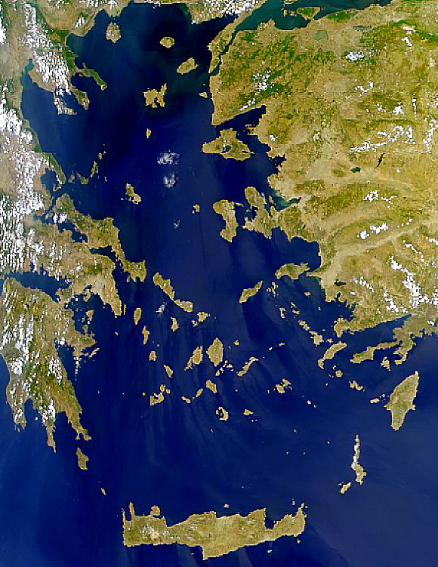
Satellite View
x
Patmos
Size: About 22 sq. miles of land area.
10 miles N-S 6 miles E-W at north end
Crete
NASA Photo

Slide 3
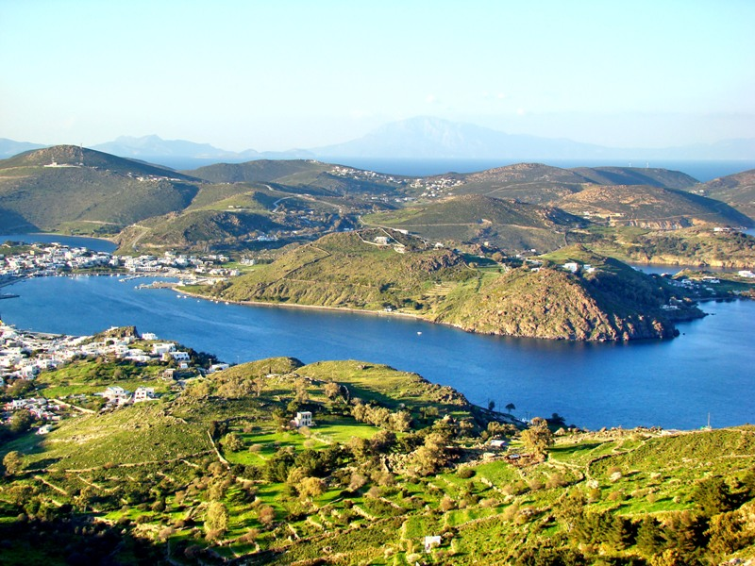

Slide 4
Notes:
From Pergamum turn south-east and travel 49 miles to Thyatira. Thyatira had a commercial rather than a political distinction. Numerous trade guilds. Noted for bakers, bronze-workers, clothiers, weavers, tanners, dyers and potters.

Slide 5
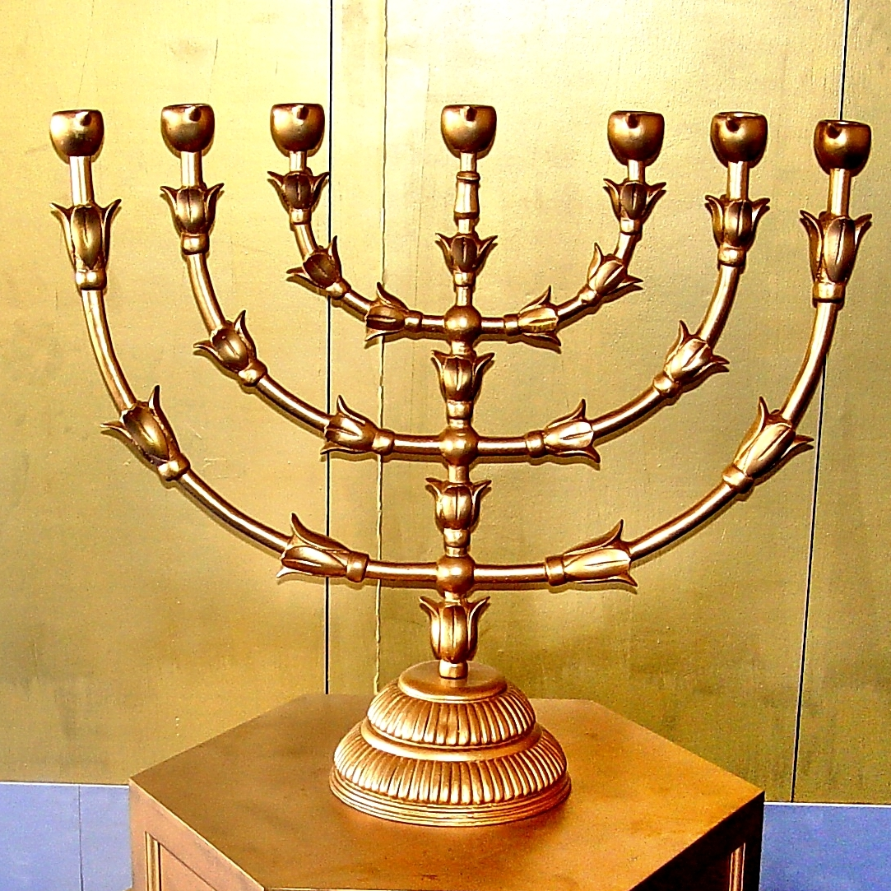
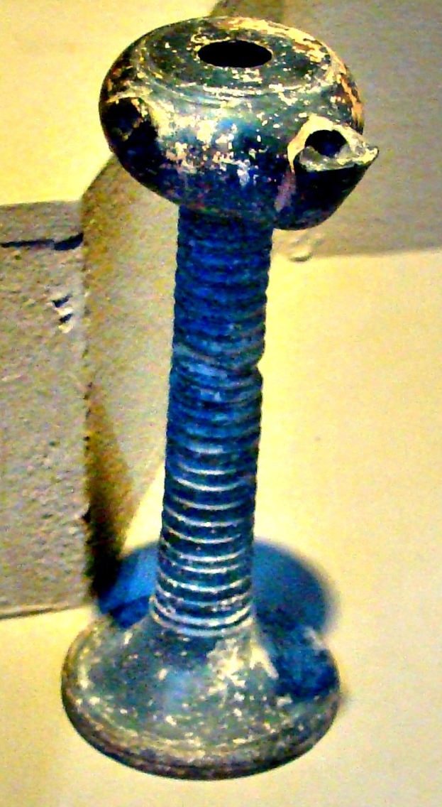
In the Middle of the Lampstands
Not this:
This:

Slide 6
⁸ " And to the angel of the church in Thyatira write, ' These things says the Son of God, who has eyes like a flame of fire, and His feet like fine brass: ¹⁹ "I know your works, love, service, faith, and your patience; and as for your works, the last are more than the first. ²⁰ "Nevertheless I have a few things against you, because you allow that woman Jezebel, who calls herself a prophetess, to teach and seduce My servants to commit sexual immorality and eat things sacrificed to idols. ²¹ "And I gave her time to repent of her sexual immorality, and she did not repent.

Slide 7
²² "Indeed I will cast her into a sickbed, and those who commit adultery with her into great tribulation, unless they repent of their deeds. ²³ "I will kill her children with death, and all the churches shall know that I am He who searches the minds and hearts. And I will give to each one of you according to your works. ²⁴ "Now to you I say, and to the rest in Thyatira, as many as do not have this doctrine, who have not known the depths of Satan, as they say, I will put on you no other burden.

Slide 8
²⁵ "But hold fast what you have till I come. ²⁶ "And he who overcomes, and keeps My works until the end, to him I will give power over the nations -- ²⁷ 'He shall rule them with a rod of iron; They shall be dashed to pieces like the potter's vessels' -- as I also have received from My Father; ²⁸ "and I will give him the morning star. ²⁹ "He who has an ear, let him hear what the Spirit says to the churches." '

Slide 9
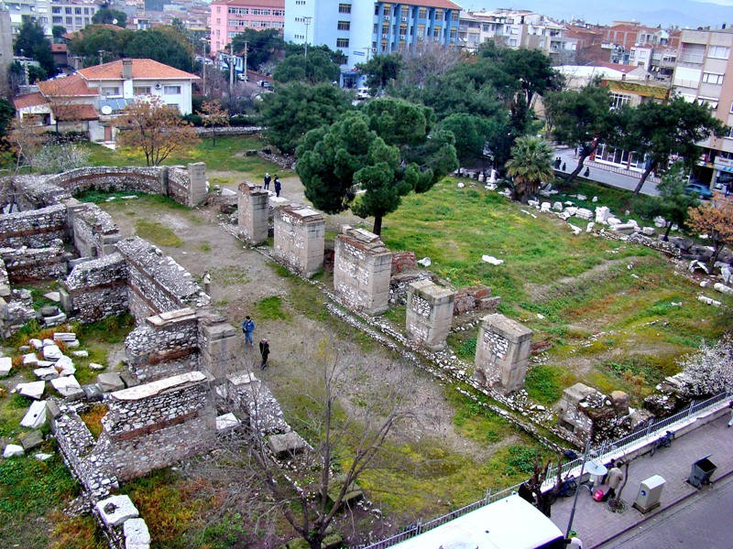
Notes:
This picture shows remains of the Byzantine Church of St. John in Thyatira, showing the continuation of Christianity in the city many years after mention of the church in Revelation

Slide 10
Ancient Thyatira is Modern Akhisar

Slide 13
Notes:
Roman Street with marble fragments. Note street level on right.

Slide 16
Home of Lydia. Converted Acts 16:11-15
She was a seller of Purple fabric.

Slide 17
The Home of Lydia
Converted in Philippi
Acts 16:11-15
A seller of purple fabrics
The Purple of Asia Minor is made from the Madder Root. It is often called Turkey Red.
F.Jenkins

Slide 18
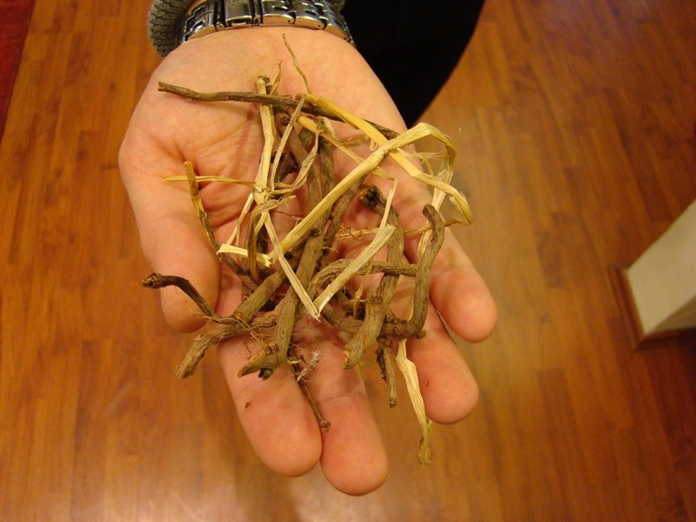

Slide 19
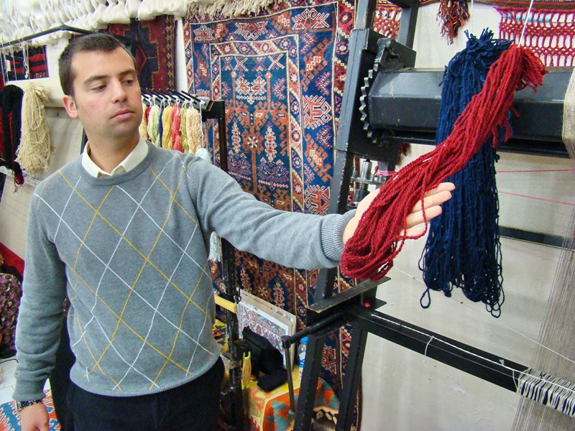

Slide 20
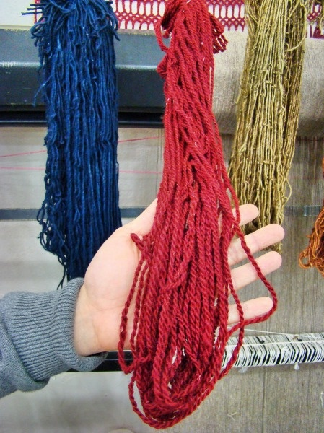

Slide 21
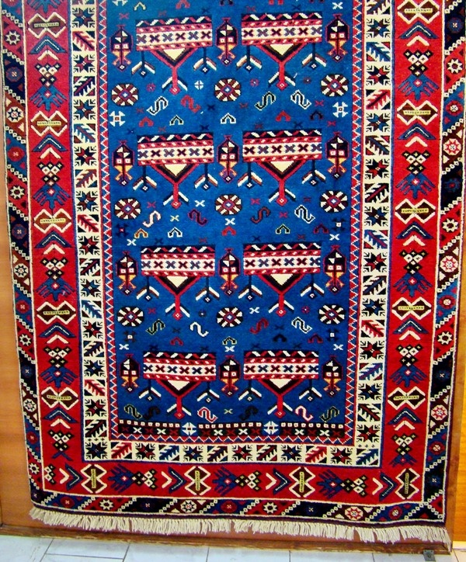

Slide 22
Thyatira: The Church That Fellowshipped Jezebel
Commendation:
Love
Service
Faith
Patience (perseverance-NASB)
Compare 1 Thes. 1:3: “We continually remember before our God and Father your work produced by faith, your labor prompted by love, and your endurance inspired by hope in our Lord Jesus Christ” (NIV).
Notes:
Not only had the busy service of Ephesus, but exhibited the love which Ephesus lacked. cf. 1 Thes. 1:3.

Slide 23
Thyatira: The Church That Fellowshipped Jezebel
Commendation:
Growth: last works more than the first.
The church at Thyatira was exceeding the works it did at first.

Slide 24
Thyatira: The Church That Fellowshipped Jezebel
Condemnation:
Overlooking evil teaching of Jezebel.
Claimed to be a prophetess.
Through her teaching led Christians into idolatry and sexual misconduct.
“She does not want to repent.” (CSB)
Notes:
The church of Thyatira displayed love, and faith, service and endurance, but HOLINESS is not included among its qualities. Made no attempt to restrain Jezebel. Stott: The church of Thyatira was the opposite of the church of Ephesus. Ephesus could not bear evil, self-styled apostles, but had no love (2:2,4). Thyatira had love, but tolerated an evil, self-styled prophetess (60).
Jezebel was known for her idolatry and witchcraft (1 Kgs.16:30-32; 18:4,19; 21:25; 2 Kgs. 9:22). She sought to contaminate Israel, and her husband Ahab lacked the moral conviction or stamina to withstand her.
Stott, quoting Charles Hodge: she was encouraging the Christians of Thyatira to attend the ceremonies and feasts of the local trade-guilds which were “dedicated no doubt to some pagan deith” and “too often ended in unbridled licentiousness.” (63).
Similar to, if not identical with the Nicolaitans and doctrine of Balaam: practices of fornication and eating of food sacrificed to idols.

Slide 25
^{ESV} I gave her time to repent, but she refuses to repent of her sexual immorality.
^{NAU} 'I gave her time to repent, and she does not want to repent of her immorality.
^{NET} I have given her time to repent, but she is not willing to repent of her sexual immorality.

Slide 26
Thyatira: The Church That Fellowshipped Jezebel
Condemnation:
Boasted that they had plumbed the deep things of Satan, v.24 (perhaps reasoning that since matter was evil the sins of the flesh could be indulged w/o damage to the spirit).
Notes:
The church of Thyatira displayed love, and faith, service and endurance, but HOLINESS is not included among its qualities. Made no attempt to restrain Jezebel. Stott: The church of Thyatira was the opposite of the church of Ephesus. Ephesus could not bear evil, self-styled apostles, but had no love (2:2,4). Thyatira had love, but tolerated an evil, self-styled prophetess (60).
Jezebel was known for her idolatry and witchcraft (1 Kgs.16:30-32; 18:4,19; 21:25; 2 Kgs. 9:22). She sought to contaminate Israel, and her husband Ahab lacked the moral conviction or stamina to withstand her.
Stott, quoting Charles Hodge: she was encouraging the Christians of Thyatira to attend the ceremonies and feasts of the local trade-guilds which were “dedicated no doubt to some pagan deith” and “too often ended in unbridled licentiousness.” (63).
Similar to, if not identical with the Nicolaitans and doctrine of Balaam: practices of fornication and eating of food sacrificed to idols.

Slide 27
Thyatira: The Church That Fellowshipped Jezebel
Condemnation:
They made no attempt to restrain Jezebel v.20.
Eph. 5:11: no fellowship with.. darkness..
2 Thes. 3:6: withdraw from.. disorderly..
Rom. 16:17-18: Now I urge you, brethren, note those who cause divisions and offenses, contrary to the doctrine which you learned, and avoid them.
18 For those who are such do not serve our Lord Jesus Christ, but their own belly, and by smooth words and flattering speech deceive the hearts of the simple.
Notes:
The church of Thyatira displayed love, and faith, service and endurance, but HOLINESS is not included among its qualities. Made no attempt to restrain Jezebel. Stott: The church of Thyatira was the opposite of the church of Ephesus. Ephesus could not bear evil, self-styled apostles, but had no love (2:2,4). Thyatira had love, but tolerated an evil, self-styled prophetess (60).
Jezebel was known for her idolatry and witchcraft (1 Kgs.16:30-32; 18:4,19; 21:25; 2 Kgs. 9:22). She sought to contaminate Israel, and her husband Ahab lacked the moral conviction or stamina to withstand her.
Stott, quoting Charles Hodge: she was encouraging the Christians of Thyatira to attend the ceremonies and feasts of the local trade-guilds which were “dedicated no doubt to some pagan deith” and “too often ended in unbridled licentiousness.” (63).
Similar to, if not identical with the Nicolaitans and doctrine of Balaam: practices of fornication and eating of food sacrificed to idols.

Slide 28
Thyatira: The Church That Fellowshipped Jezebel
Warning:
I will cast her into a sickbed.
Will kill her children with death.
***cf. 2 Kgs. 9: Jezebel’s death.
***Acts 5:1-11
***Heb. 13:4
***1 Cor. 6:9-10
“I am He who searches the minds and hearts”
Notes:
Cf. Acts 5:1-11; Heb. 13:4; 1 Cor. 6:9
Re: children: cf. Jehu in 2 Kgs. 9&10.

Slide 29
Thyatira: The Church That Fellowshipped Jezebel
Note:
Holiness of life and character is an indispensable mark of the Christian life and of the true church.
1 Thes.4:3: For this is the will of God, your sanctification: that you should abstain from sexual immorality…7 For God did not call us to uncleanness, but in holiness.
8 Therefore he who rejects this does not reject man, but God, who has also given us His Holy Spirit.
Notes:
Stott: If the devil cannot destroy the church by persecution or heresy, he will try to corrupt it with evil. Such at least was the dragon’s strategy in Thyatira.

Slide 30
Thyatira: The Church That Fellowshipped Jezebel
Holiness of life and character:
Ex. 28:36: “You shall also make a plate of pure gold and engrave on it, like the engraving of a signet: HOLINESS TO THE LORD.”
1 Pet 2:9: “But you are a chosen generation, a royal priesthood, a holy nation, His own special people, that you may proclaim the praises of Him who called you out of darkness into His marvelous light.”

Slide 31
Thyatira: The Church That Fellowshipped Jezebel
Holiness of life and character:
2 Cor. 7:1: “Therefore, having these promises, beloved, let us cleanse ourselves from all defilement of flesh and spirit, perfecting holiness in the fear of God” (NASB).
“Since we have these promises, dear friends, let us purify ourselves from everything that contaminates body and spirit, perfecting holiness out of reverence for God” (NIV).

Slide 32
Thyatira: The Church That Fellowshipped Jezebel
Admonition:
Hold fast what you have.
Notes:
Rule the nations: background is Psa.2. We share in His reign; we have been raised to sit with Him in heavenly places.
Jesus identifies Himself as the morning star: 22:16. The gift promised is Jesus Himself. Give me Jesus! Let me be found in Him! Greatest gift of all—2 Cor. 9:15.

Slide 33
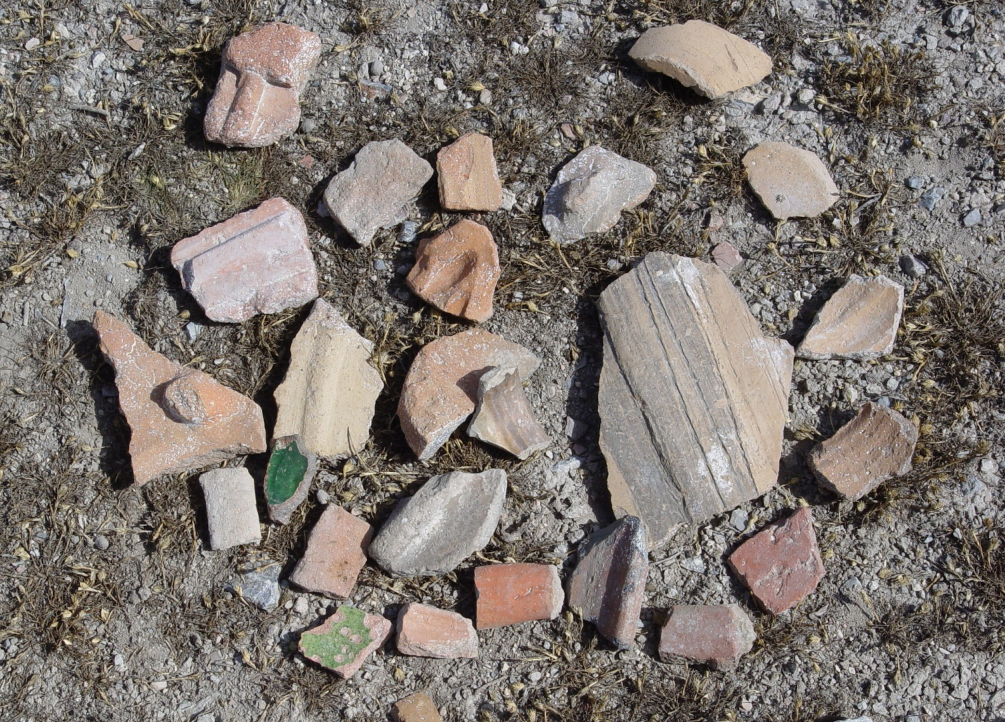
Thyatira: The Church That Fellowshipped Jezebel
Promise:
“He who overcomes Power over nations.. Rule w/rod of iron; As the potter’s vessels shall be broken to pieces…”
Notes:
Rule the nations: background is Psa.2. We share in His reign; we have been raised to sit with Him in heavenly places.
Jesus identifies Himself as the morning star: 22:16. The gift promised is Jesus Himself. Give me Jesus! Let me be found in Him! Greatest gift of all—2 Cor. 9:15.

Slide 34
Thyatira: The Church That Fellowshipped Jezebel
Promise:
“And I will give him the morning star.”
Jesus identifies Himself as the morning star: 22:16.
The gift promised is Jesus Himself.
Give me Jesus! Let me be found in Him! Greatest gift of all—2 Cor. 9:15.
Notes:
Rule the nations: background is Psa.2. We share in His reign; we have been raised to sit with Him in heavenly places.
Jesus identifies Himself as the morning star: 22:16. The gift promised is Jesus Himself. Give me Jesus! Let me be found in Him! Greatest gift of all—2 Cor. 9:15.

Slide 35
Thyatira: The Church That Fellowshipped Jezebel
May our ears be open to listen to “what the Spirit is saying to the churches!”

