Slide 1
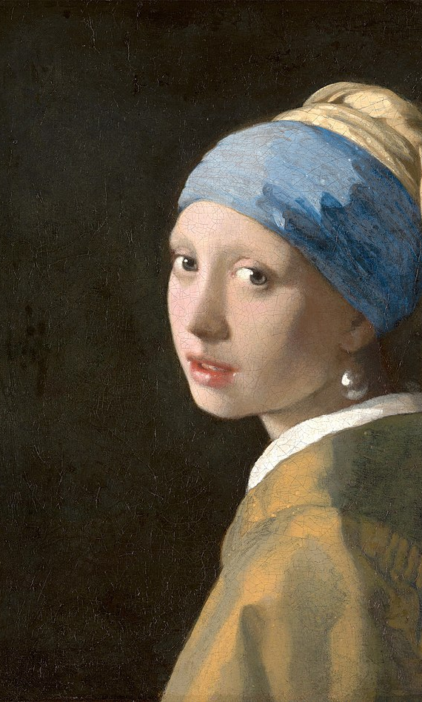
Between Young and Old
Considering how younger generations should interact with older generations in the church.

Slide 2
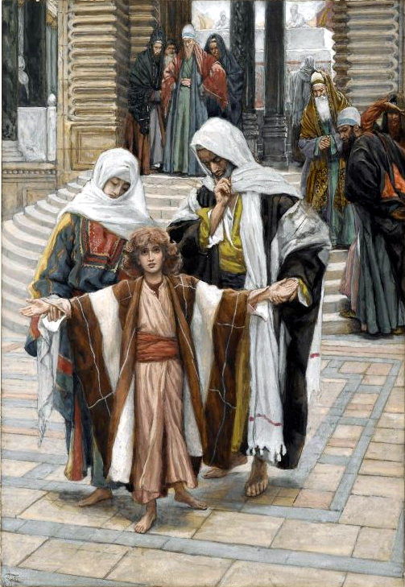
Learning from a young Jesus (Luke 2.41-52)
Jesus is learning from people who are older than Him. Learning from His parents’ faithfulness (vs. 41) and listening to rabbis and asking questions (vs. 46).
He acts submissively towards His parents, following them and doing what was asked of Him. (vs. 51) Jesus grew in His wisdom and understanding, His discipline, and in favor with God and man. (vs. 52)
We learn that we need to listen, submit, ask questions and grow. We need to keep up with a healthy relationship with Our God and then that will reflect in growth in our relationships with others.

Slide 3
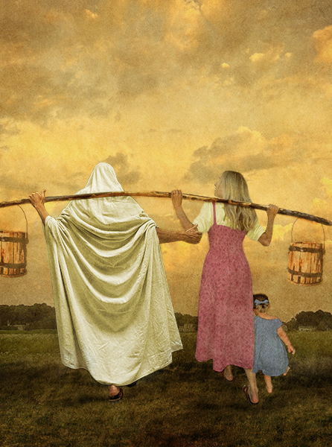
“Let no one despise you for your youth” (1st Timothy 4.6-5.2)
Young people have a responsibility for their doctrine – we need to make sure we are growing closer to God at all opportunities. We need to desire the Spiritual and Eternal over the worthless.
We need to, again, listen to those who are older than us to learn from them about the Christian walk.
We also need to consider are we examples? Are we growing? Do people notice our growth? Are we devoted to reading our scripture, encouragement, service?
When we are approaching older men and women about doctrine, we need to be very considerate of our words, and the encouragement we use. It is not our place to be rude and unkind.

Slide 4
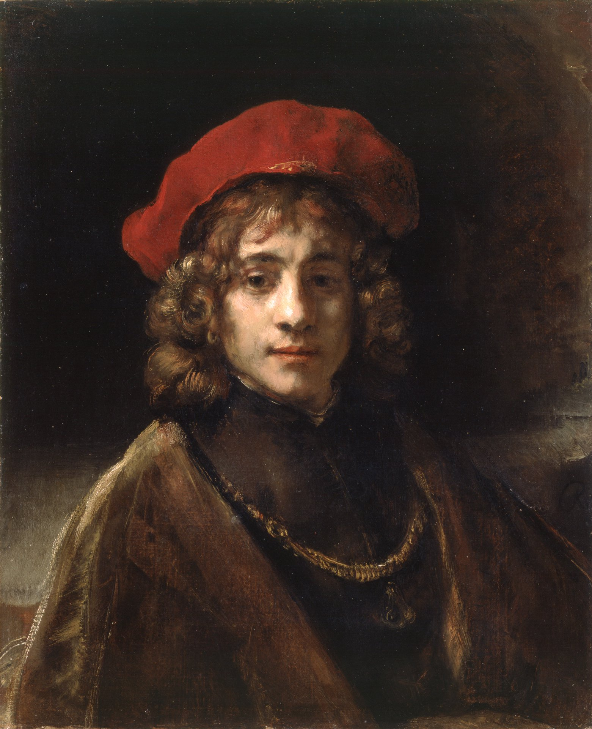
“Show perfect courtesy toward all people…” (Titus 2.1-3.11)
There are a lot of traits that are important to consider in the passage. Take note of the ones that you aren’t growing in or the ones you struggle more with.
Do we treat our older members with the respect, dignity and kindness? Do we listen with care for their needs? Do we listen to their wisdom and teaching?
Are we showing our elders proper respect? Do we gossip about them? Do we gossip about older people and maintain bitterness?
We have been called out of the realm and body of hate. We have been changed by the Lord. That means we break down the generational boundaries, motivated by the love, purity, and kindness shown to us by the Lord.

Slide 5
Final Thoughts
Who do you have a problem with? Why do you still have a problem with them? Have you made the efforts to mend the relationship, especially if it’s one sided?
Who here could you ask to be a mentor? Who here are you inspired by their faith? You should let them know and get to know them and learn from them.
How can you serve someone who is older? We have a lot of older members who are suffering right now – what efforts are we making to serve them and show kindness to them? How can we strive to be united with older members?

