Slide 1
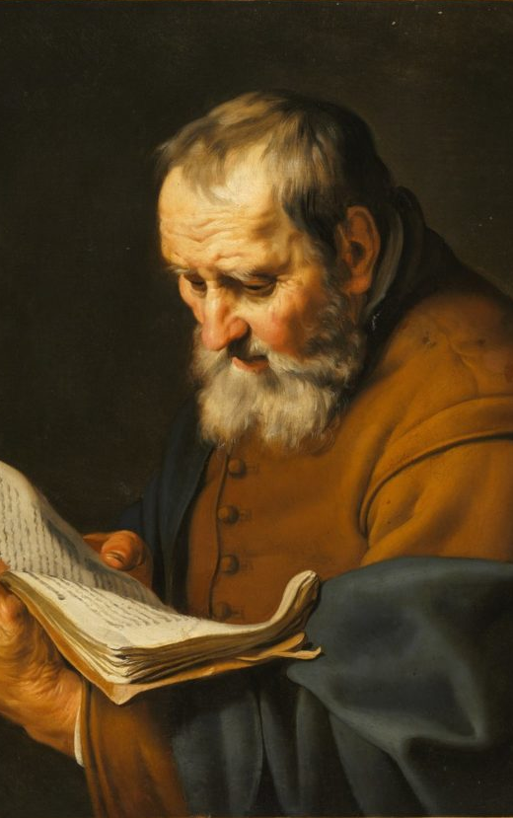
Between Old and Young
Considering how older generations should interact with younger generations in the church.

Slide 2
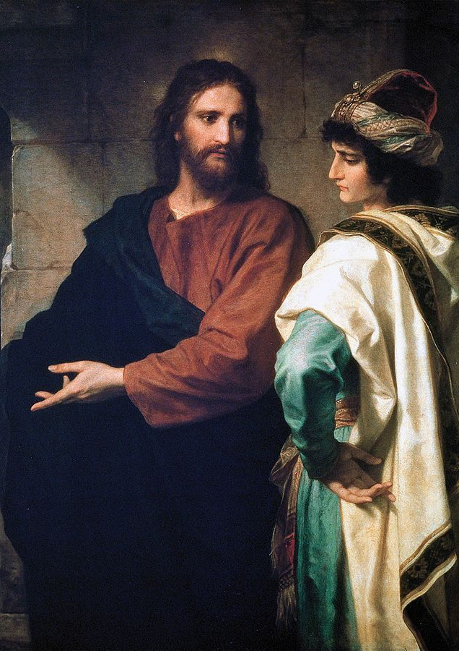
Learning from an older Jesus (Mark 10.17-31)
Jesus’ interaction with the rich young ruler displays the heart, wisdom, example, and knowledge for older members when interacting with younger members.
Jesus has a clear understanding of the scripture, not just in His knowledge of the last six commandments, but also His understanding of the first that challenged the man who thought He had it all together.
Jesus was a living example of walking by faith. With little resources, He trusted in the mercy of the Father and desired the Father’s will above all things.
Jesus didn’t just rebuke the man – He was motivated by his deep love for Him. That meant telling Him an impossible thing to do. Older members need to be similarly motivated by truth and love.

Slide 3
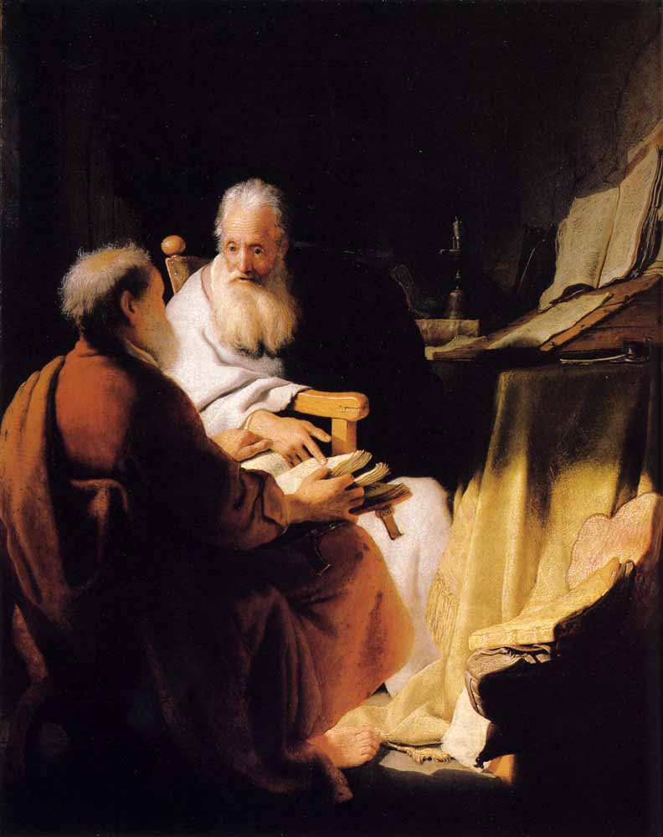
“Do your best to present yourself to God as one approved…” (2 Timothy 2:14-26)
Paul and Timothy’s relationship give us a healthy look into the relationship between an older member of the church and how He cares for a younger man.
14-19: Avoiding the “gangrene” talk. Are we focused on what builds up the hearers? Are we focused on Bible study and encouraging talk? Do we stand on the firm foundation of God’s foundation?
20-26: Are you willing to be used by the Lord for every good work? Are you focused on being “the Lord’s servant”? Do you embody a kind, truthful, peaceful person dedicated to winning over your enemies?

Slide 4
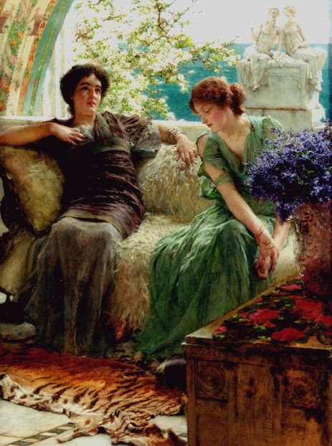
“Show yourself in all respects to be a model of good works…” (Titus 2.1-14)
Why is doctrine important? It reminds of our relationship with our Lord and our responsibilities attitudes towards others because of that relationship.
Older men: are you leading in love? Are you self-controlled? Are you steadfast in care for the Lord and His people? If you aren’t, how can you be more dedicated?
Older women: Are you reverent? Do you take your responsibility as a teacher seriously? Do you live as an example to those who look up to you?
God has redeemed all of us. That means we need to be dedicated to the service of one another and showing the hope within us through the works we do.

Slide 5
Final Thoughts
Are you reading your Bible every day? Are you challenging your understanding of the text? Are you looking to challenge yourself to follow the righteous commands of the Lord?
Are you making efforts to reach younger generations in kindness? Are you being considerate and seeking to mentor them? What could you be doing better?

